Slide 1
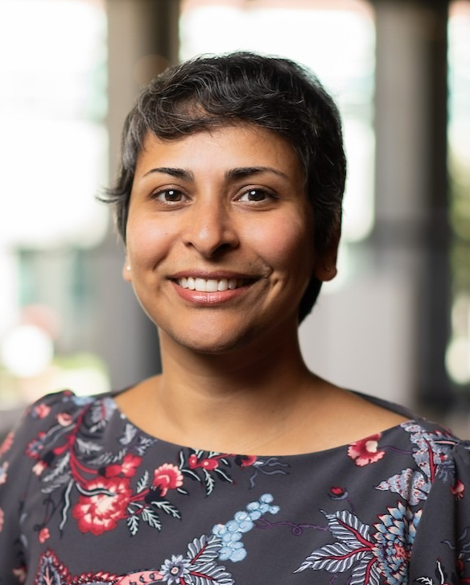
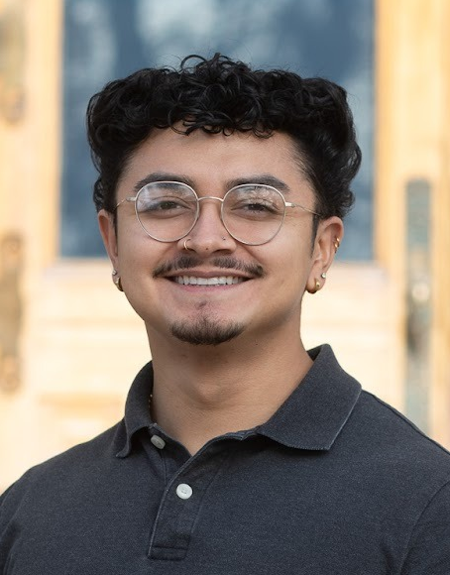
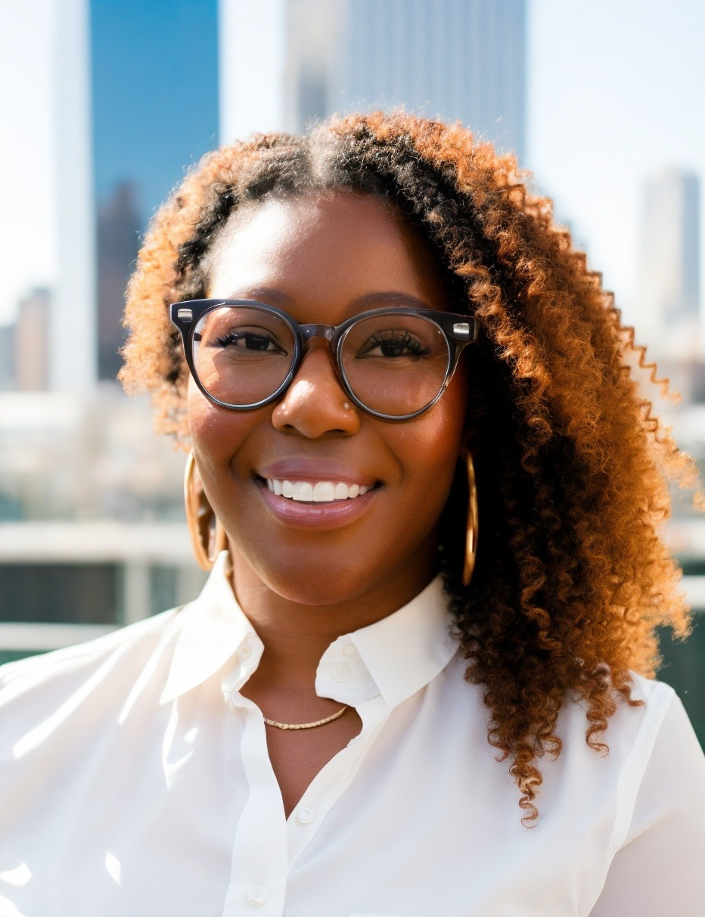
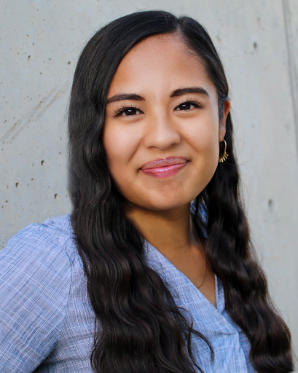
Well Heard Communities
Tools to Enhance Civic Engagement in Planning
Moderator
Divya Chandrasekhar, PhD
Chair & Associate Professor, Department of City & Metropolitan Planning University of Utah
Chimalli Hernandez, MCMP Neighborhood Specialist,
Salt Lake City Mayor’s Office
Ashley Cleveland, MCMP
Civic Engagement Practice, Bloomberg Center for Public Innovation at Johns Hopkins University
Claudia Loayza, MCMP Associate Developer Developed. By Women.

Slide 2
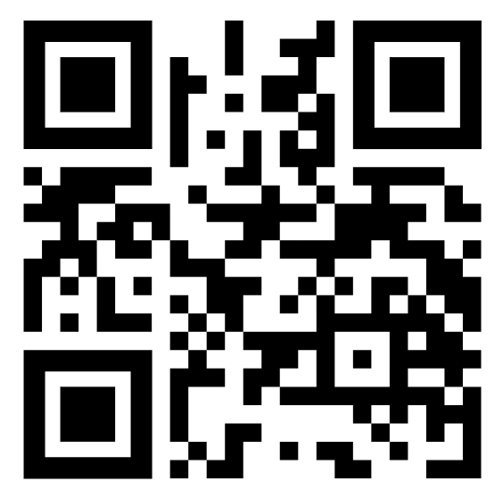
Well Heard Communities
Tools to Enhance Civic Engagement in Planning
Scan this for engagement learning and other resources!
This list will be made available through the APA UT 2026 Spring Conference website.

