Slide 1
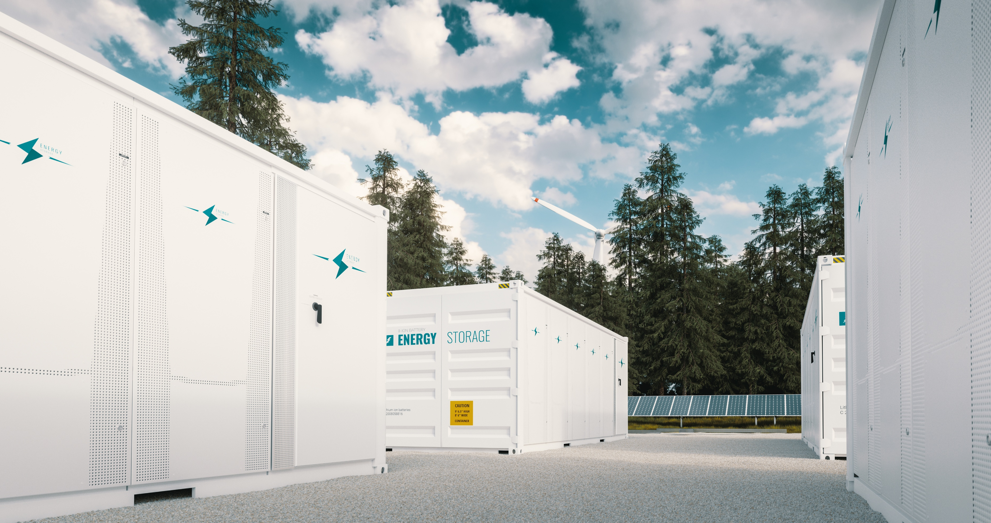
Regulating BESS Systems
Michael Hutchings | Holland & Hart

Slide 2
Zoning Regulations
Three primary approaches for BESS zoning regulations.
BESS is specifically defined in the zoning ordinance and identified in the use table.
BESS is regulated under a specific use ordinance.
BESS is not specifically regulated but falls under a broader use category.

Slide 3
Definition and Use Table Approach
BESS is specifically defined in the zoning ordinance and identified in the use table.
Definition:
Battery Energy Storage System. Means one or more devices, assembled together, capable of storing energy in order to supply electrical energy at a future time, not to include a stand-alone 12-volt car battery or an electric motor vehicle. A Battery Energy Storage System is classified as a Tier 1 or Tier 2 Battery Energy Storage System as follows:
Tier 1 BESS have an aggregate energy capacity less than or equal to 600 kWh and, if in a room or enclosed area, consist of only a single energy storage system technology; and
Tier 2 BESS have an aggregate energy capacity greater than 600 kWh or are composed of more than one storage battery technology, which may be located outdoors in a cabinet, container, or enclosed area

Slide 4
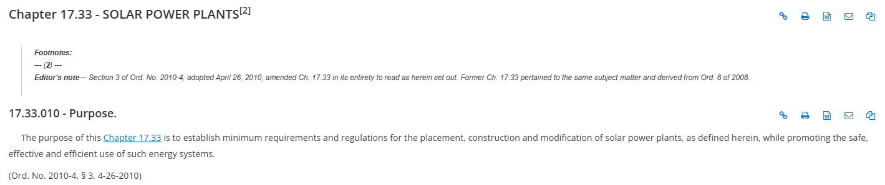
Specific Use Ordinance
BESS is regulated under a specific use ordinance.
Could include specific regulations and design standards specific to a BESS use.

Slide 5
Specific Use Ordinance
Items to include in a specific use ordinance:
Whether BESS is a permitted or conditional use, and tiers of review.
Specific development standards such as setbacks, height standards, lot size standards, etc.
Performance or design standards such as noise limitations, visual impact, fencing, or lighting.
Safety and first responder standards.
Decommissioning standards including a decommissioning bond requirement.

Slide 6
Broader Use Category Approach
Case Study
City does not have a BESS definition or specific BESS use on the use table. City also does not have a specific BESS ordinance. An applicant wants to construct a BESS use in the City’s manufacturing district, and submits a request for an official determination as to whether a BESS is permitted in the manufacturing zone. The City identifies two potential categories for the BESS use:

Slide 7
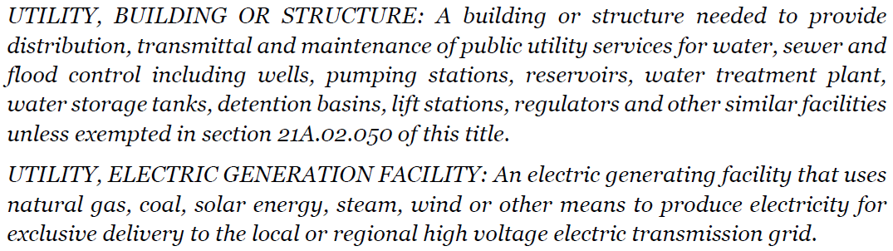
Broader Use Category Approach

Slide 8
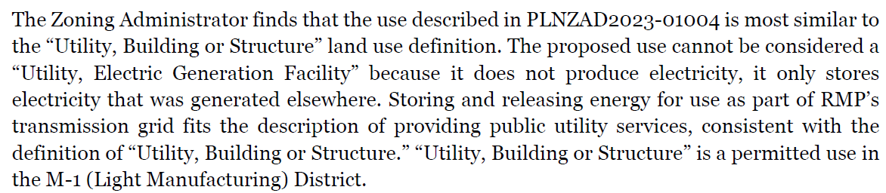
Broader Use Category Approach.

Slide 9
What is the best approach?
Approach | Pros | Cons
Definition and Use Table | Simple and flexible approach where details can be ironed out in the conditional use permit process. | Missed opportunity to impose thoughtful regulations and requirements. Developers and county risk conditional use permit disputes.
Specific BESS Ordinance | Regulations are thoughtful and comprehensive. Developers know the City’s/County’s development expectations. | Expensive and time consuming. Difficult to amend regulations.
Broader Use Category Approach | No action is required until an interpretation request is submitted. | May allow for BESS as a permitted or conditional use in unintended areas.

Slide 10
Conditional Use Permit Standard of Review
(1) (a) A county may adopt a land use ordinance that includes conditional uses and provisions for conditional uses that require compliance with objective standards set forth in an applicable ordinance.
(b) A county may not impose a requirement or standard on a conditional use that conflicts with a provision of this chapter or other state or federal law.
(2) (a) (i) A land use authority shall approve a conditional use if reasonable conditions are proposed, or can be imposed, to mitigate the reasonably anticipated detrimental effects of the proposed use in accordance with applicable standards.
(a) (ii) The requirement described in Subsection (2)(a)(i) to reasonably mitigate anticipated detrimental effects of the proposed conditional use does not require elimination of the detrimental effects.
(b) If a land use authority proposes reasonable conditions on a proposed conditional use, the land use authority shall ensure that the conditions are stated on the record and reasonably relate to mitigating the anticipated detrimental effects of the proposed use.
(c) If the reasonably anticipated detrimental effects of a proposed conditional use cannot be substantially mitigated by the proposal or the imposition of reasonable conditions to achieve compliance with applicable standards, the land use authority may deny the conditional use.
(3) A land use authority's decision to approve or deny a conditional use is an administrative land use decision.
(4) A legislative body shall classify any use that a land use regulation allows in a zoning district as either a permitted or conditional use under this chapter.

Slide 11
Conditional Use Permits
Reasonably Anticipated Detrimental Effects
Noise Concerns
Fire Safety
Screening
Traffic
Safety & Security
Decommissioning
Environmental Contamination

Slide 12
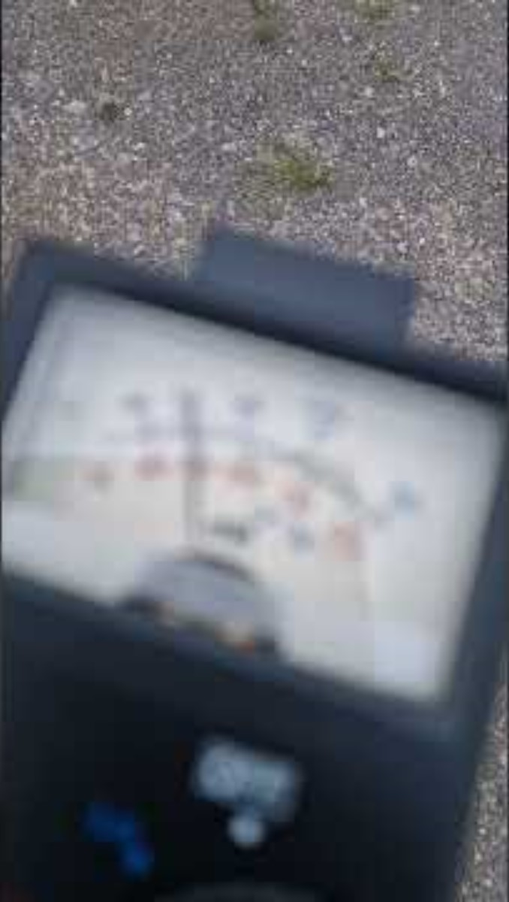
Reasonable Conditions to Address RADEs

Slide 13
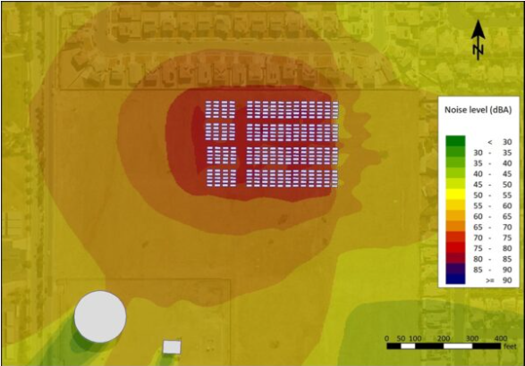
BESS Noise (No Mitigation)

Slide 14
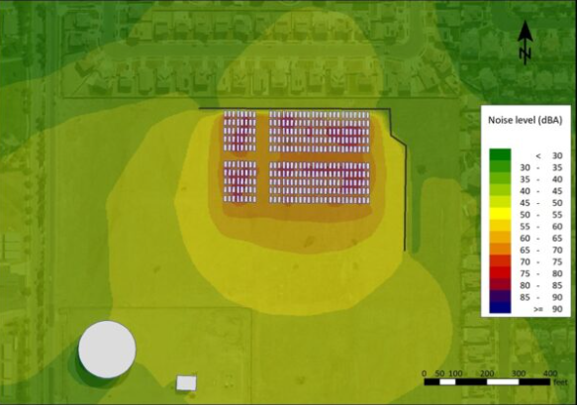
BESS Noise (With Mitigation

Slide 15
Sample Conditions
If the BESS Is located within a certain distance of a residence, then require sound mitigation and sound control measures to reduce the decibels.
Consider amending the City/County Code to include specific decibel metrics that a BESS use must meet at certain distances. For example, a BESS facility cannot exceed 60 decibels at the property line of the nearest residence.
Sound mitigation efforts are expensive so a blanket requirement for a BESS located in a rural area does not make sense and may be an unreasonable condition if taken too far.

Slide 16
Fire Safety
Fire Safety: Certain BESS technologies are subject to thermal runaway issues that are fire safety risks.
Fire safety is often identified as the number one concern for a new BESS project, but the concern is largely overstated. A BESS facility’s fire risk depends on the technology being used.
 | Lithium Iron Phosphate (LFP) | Nickel Manganese Cobalt (NMC)
Chemical Composition | Lithium iron phosphate (LiFePO4) is known for its stable olivine* structure¹ | Lithium nickel manganese cobalt oxide (LiNiMnCoO2), with varying ratios of nickel, manganese, and cobalt.¹
Operating Temperature Range | Typically − 20 °C to 60 °C, with high thermal stability¹ | Typically − 20 °C to 55 °C, with sensitivity to high temperatures¹²
Thermal Runaway Threshold | Higher, around 270 °C, due to stable phosphate structure¹ | Lower, around 150–200 °C, due to the layered oxide structure¹²
Oxygen release during failure | None ² | Yes ²
Fire self-propagation | Very low² | High²
Contains cobalt/nickel | No | Yes
Cycle Life | 8,000 – 9,000 ** | 4,000 – 4,500
Dominant in Utility-Scale BESS | 80% +⁴ | Declining⁴
LFP is not subject to thermal runaway like NMC.
Sample Conditions: Require a fire safety plan and coordinate additional training for fire department. Consider a more comprehensive fire safety plan if NMC technology is utilized.

Slide 17
Screening
BESS facilities may be unsightly in certain areas
Sample Conditions: Require the BESS to be painted colors that match the natural surroundings or be designed to blend in with the project site’s natural topography, if possible.
Caution: Do not require vegetative screening of BESS facilities as it may increase the fire hazard risk and be counterproductive to fire safety efforts.

Slide 18
Traffic
Traffic to and from the BESS facility will create additional trips on county roads.
In reality: Most BESS facilities are monitored remotely and after construction is completed, require little onsite maintenance. Once construction traffic ends, BESS facilities generate little to no traffic.
Sample Conditions: Require a construction traffic management plan, identifying haul routes, hours of operation, and road restoration obligations upon project completion.

Slide 19
Safety and Security
BESS facilities may attract trespassers who could be harmed by the facility.
Sample Conditions: Require security fencing around the facility, and if allowed by the code, consider adding barbwire to the top of the fence.

Slide 20
Restoration of Property After Project Life
BESS facilities have a 15-30 useful life. What happens then?
Sample Condition: Require the applicant to submit a decommissioning plan to the authority as a condition to receiving a building permit.

Slide 21
Environmental Contamination
Environmental Contamination: BESS failures pose a risk of chemical leakage into soil and groundwater.
Sample Condition: The applicant shall submit a spill containment plan to the county with the applicant’s building permit application. Consider requiring soil and groundwater testing upon decommissioning.

Slide 22
Final Thought
Micromanaging the product design can create more problems than solutions. Instead, require compliance current building and safety regulations in effect at the time of a building permit application.
Example: some authorities want to create a requirement that batteries are spaced 10 feet apart while the safety code may require 12 feet of distance or determine 8 feet is perfectly safe.

Slide 23


Questions?
Michael Hutchings
Associate | Salt Lake City
801.799.5861
MBHutchings@hollandhart.com

