Slide 1
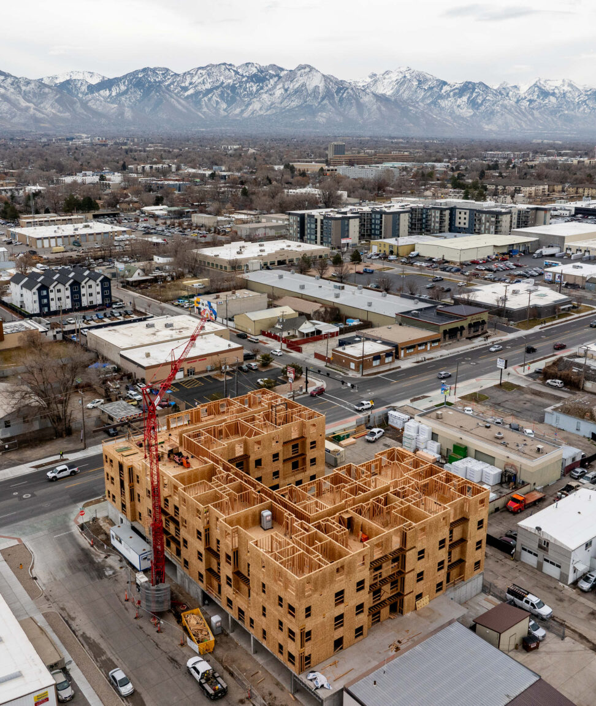
Moderate Income Housing (MIH)
2025 Report Walkthrough
Notes:
SCRIPT
Hello and welcome to the Moderate Income Housing (or MIH) 2025 Report Walkthrough, brought to you by the Housing & Community Development Division in the Utah Department of Workforce Services.
We’ll now walk you through how to access and fill out the MIH report. For the rest of the presentation, I will refer to Moderate Incoming Housing as MIH.

Slide 2
Before we start:
some webinar logistics
We will take breaks for basic Q&A throughout the webinar. If your community has specific questions about your MIH report, it would be best to schedule a one-on-one appointment with MIH staff by:
emailing mih@utah.gov, or
calling Todd Andersen at (385) 290-9717.
If we can’t answer a question during the webinar, we will be happy to look into it and provide an answer to you afterwards.
We will email slides to webinar attendees afterwards.
This webinar will be recorded and available on apautah.org, or you can contact admin@apautah.org.

Slide 3
SUBMISSION DEADLINE
MIH STRATEGIES
May 1
MIH annual report opened and Qualtrics links sent to each municipality/county required to report. If you did not receive the link on May 1st, please reach out to us at mih@utah.gov.
August 1st @ 11:59 pm
MIH annual report due. Late reports will not be accepted.
Municipalities: Utah Code 10-9a-403, Section (2)(b)(iii) lists the MIH strategies available to municipalities.
Counties: Utah Code 17-27a-403, Section (2)(b)(ii) lists the MIH strategies available to counties.
jobs.utah.gov/mihreporting
Notes:
SCRIPT
The MIH annual report opened on May 1 and report links were sent to each municipality and county required to report. If you did not receive the link on May 1st, please reach out to us at mih@utah.gov. The report is due on August 1st @ 11:59 pm. Late reports will not be accepted!
Each year, certain cities and counties are required to report on the MIH element of their general plan, including the list of strategies they plan to implement, or are currently implementing. For municipalities, Utah Code 10-9a-403, Section (2)(b)(iii) lists the MIH strategies available to municipalities. For counties, Utah Code 17-27a-403, Section (2)(b)(ii) lists the MIH strategies available to counties. Both lists of strategies are very similar, with only some slight variation.

Slide 4
NEW MIH ‘SUPER’ STRATEGIES
Recent Legislative Changes
House Bill (HB) 37 - Utah Housing Amendments adds new MIH “submenu” or “super” strategies promoting affordable homeownership that offer the following advantages:
If a municipality without fixed guideway stations uses one of the new strategies, it counts as three normal MIH strategies, and the municipality shall be considered compliant for the base year AND two subsequent reporting years.
If a municipality with fixed guideway stations uses one of the new strategies, they can implement at least three strategies to achieve compliance instead of five.
If a county uses one of the new strategies, they can implement at least one strategy to achieve compliance instead of three. Also, the county shall be considered compliant for the base year AND two subsequent reporting years.
New MIH strategies: for municipalities, refer to Utah Code 10-9a-403, Section (2)(b)(iii); for counties, refer to Utah Code 17-27a-403, Section (2)(b)(ii):
Create a housing and transit reinvestment zone (HTRZ).
Create a home ownership promotion zone (HOPZ).
Create a first home investment zone (FHIZ).
Approve a project that receives funding from, or qualifies to receive funding from the Utah Homes Investment Program.
Adopt or approve a qualifying affordable home ownership density bonus for single-family residential units.
Adopt or approve a qualifying affordable home ownership density bonus for multi-family residential units.
jobs.utah.gov/mihreporting
Notes:
SCRIPT
This year, the Utah Legislature passed House Bill 37 regarding Utah Housing Amendments. This bill focuses on new MIH strategies that promote affordable homeownership and offer specific advantages if municipalities or counties use them.
If a municipality without fixed guideway stations uses one of the new strategies, it counts as three normal MIH strategies, and the municipality shall be considered compliant for the base year AND two subsequent reporting years.
If a municipality with fixed guideway stations uses one of the new strategies, they can implement at least three strategies to achieve compliance instead of five.
If a county uses one of the new strategies, they can implement at least one strategy to achieve compliance instead of three. Also, the county shall be considered compliant for the base year AND two subsequent reporting years.

Slide 5
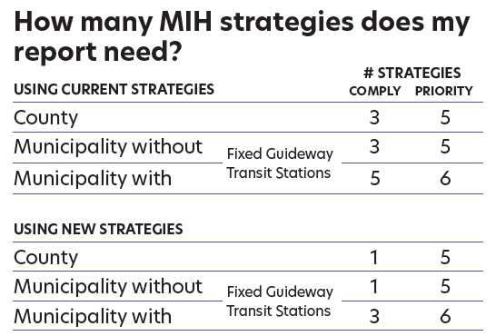
MIH STRATEGIES
Fixed Guideway Transit Station: public transit facilities that use rail for public transit or a separate right-of-way for public transit, such as bus rapid transit systems (TRAX, Frontrunner, etc.)
Priority Consideration: if a community surpasses the minimum number of strategies in their general plan element and annual progress report, they will receive priority consideration for certain state transit funds. For details, go to jobs.utah.gov/mihreporting.
jobs.utah.gov/mihreporting
Notes:
SCRIPT
The following table shows how many MIH strategies your community is required to report on.
A fixed guideway transit station is a public transit facility that uses rail for public transit or a separate right-of-way for public transit, such as a bus rapid transit system. An example would be TRAX or Frontrunner.
If a community surpasses the minimum number of strategies in their general plan element and annual progress report, they will receive Priority Consideration for certain state transit funds. For details, go to jobs.utah.gov/mihreporting.

Slide 6
MIH STRATEGIES
Questions online or in the chat?
jobs.utah.gov/mihreporting

Slide 7
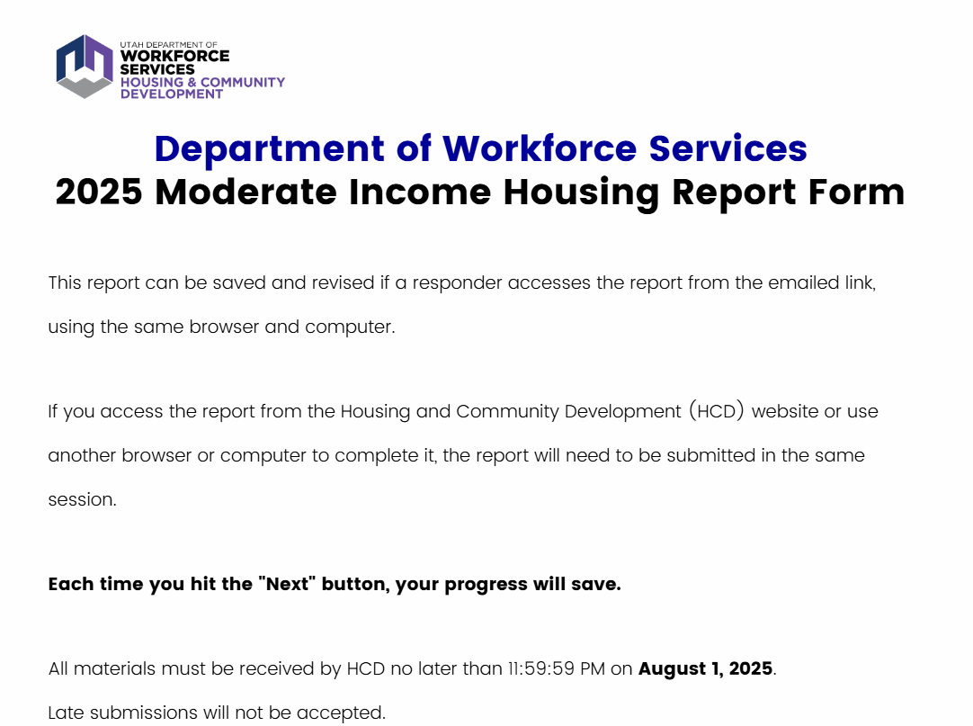
Qualtrics automatically saves your progress in the report using cookies stored in your browser. If you close the browser or navigates away from the survey, you can return to it later by clicking the same survey link initially used.
But be aware that if you clear your browser cookies, uses a different browser or computer, or have ad or script blockers enabled, you may not be able to resume from where you left off.
On the MIH website, we have a PDF that “previews” all the questions on the 2025 report. I would recommend using this to prepare your answers in a separate document before filling out the report online. This will protect you if you experience unintended technical difficulties.
jobs.utah.gov/mihreporting
Notes:
SCRIPT
We’ll now walk you through how to fill out the MIH report, which is in Qualtrics. Qualtrics is an online survey tool.
Qualtrics automatically saves your progress in the report using cookies stored in your browser. If you close the browser or navigates away from the survey, you can return to it later by clicking the same survey link initially used.
But be aware that if you clear your browser cookies, uses a different browser or computer, or have ad or script blockers enabled, you may not be able to resume from where you left off.
On the MIH website, we have a PDF that “previews” all the questions on the 2025 report. I would recommend using this to prepare your answers in a separate document before filling out the report online. This will protect you if you experience unintended technical difficulties.

Slide 8
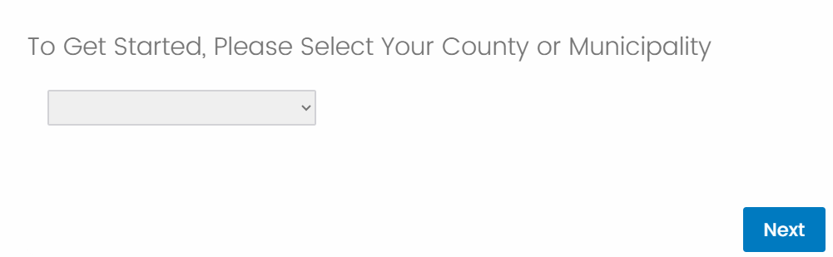
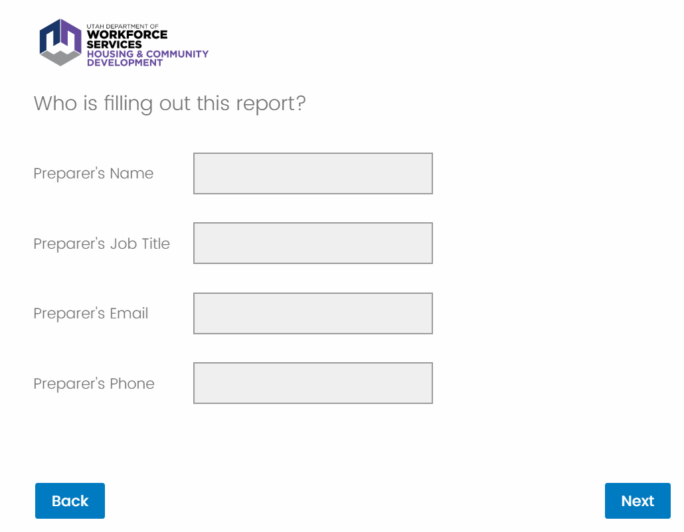
Email will need it to be in a valid @ format
Phone number must be in XXX-XXX-XXXX format
jobs.utah.gov/mihreporting
Notes:
SCRIPT
First, you will enter your municipality or county. Then, you will fill out your contact information. The report requires that the email must be in a valid format like @gmail.com, @utah.gov, etc. The phone number must be in 10-digit format.

Slide 9
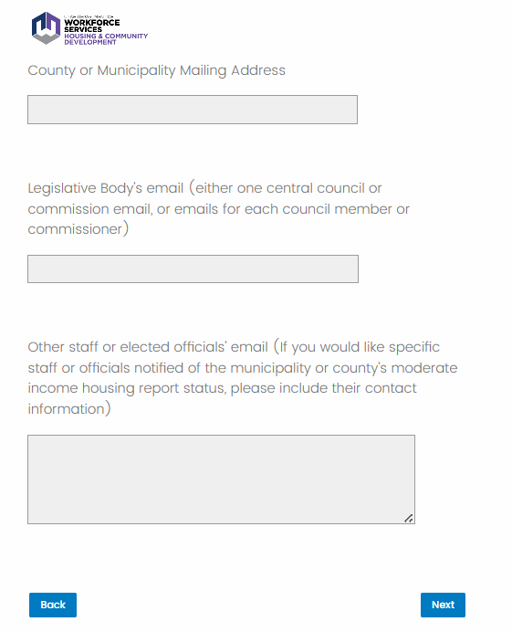
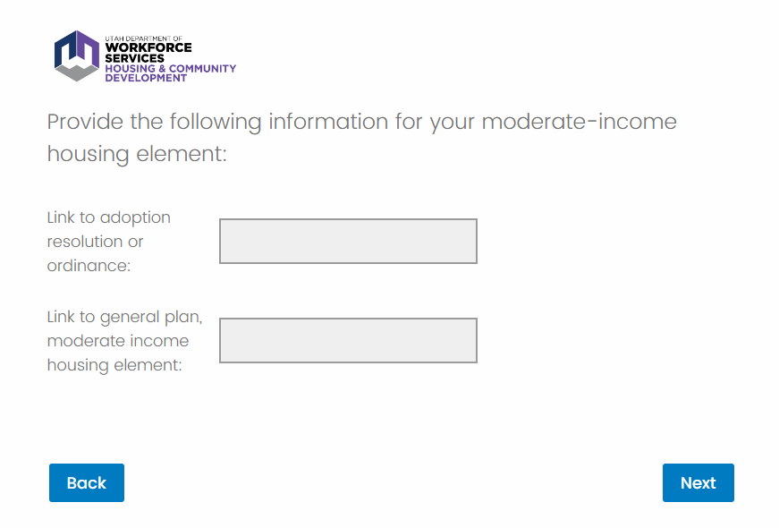
jobs.utah.gov/mihreporting
Notes:
SCRIPT
Next, you will fill out your county or municipality’s mailing address. And if you would like specific staff or elected officials to be notified of your MIH report’s status going forward, please include their contact information. Then, you will provide links to any adopted resolutions or ordinances related to MIH, and your General Plan’s moderate-income housing element. For example, if you updated or amended MIH strategies in your General Plan this year, you would attach the resolution or ordinance where your elected officials adopted these changes.

Slide 10
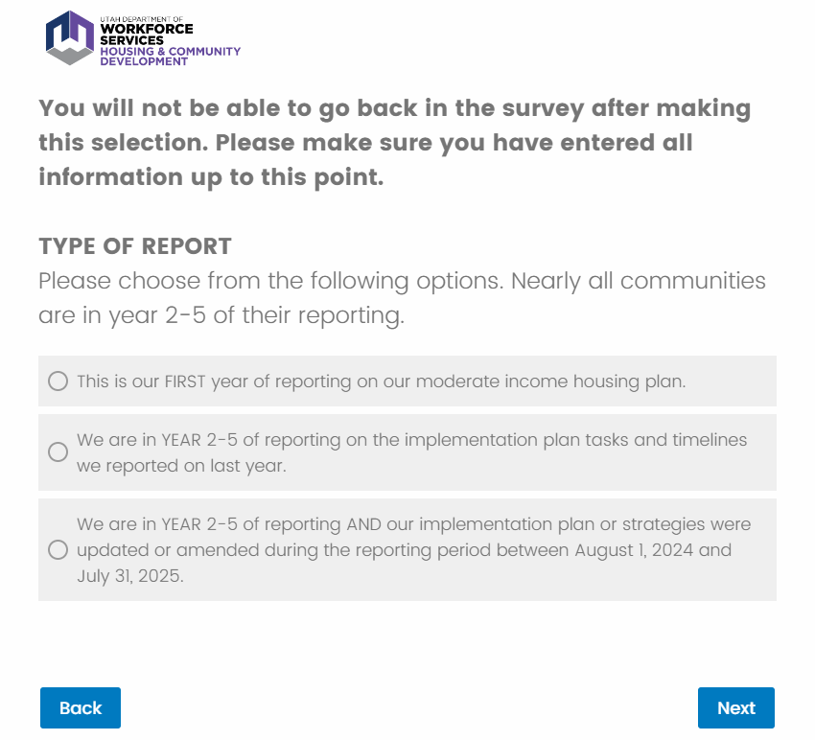
jobs.utah.gov/mihreporting
Notes:
SCRIPT
Next, you will choose the type of report you’re submitting this year. This is an important question, as you will NOT be able to go back in the survey after completing this question.
Qualtrics will take you on different question “paths” based on what type of report you select. Nearly all communities are in year 2-5 of their reporting, so you will most likely choose OPTION #2 or OPTION #3.
If you make a mistake and select the wrong option, please reach out to us at mih@utah.gov.
We will now go through each of the three question “paths.”

Slide 11
Questions online or in the chat?
jobs.utah.gov/mihreporting

Slide 12
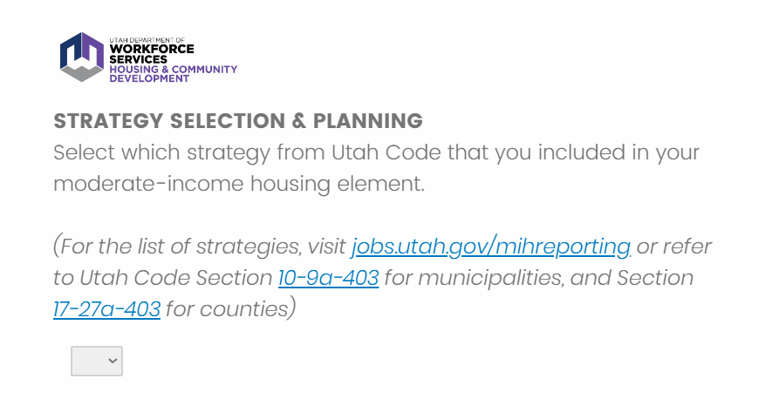
PATH #1
jobs.utah.gov/mihreporting
Notes:
SCRIPT
If you select PATH #1 and it is your FIRST YEAR of MIH reporting, you will first select the MIH strategies your municipality or county plan to implement.
For the list of strategies, the report provides links to Utah Code Section 10-9a-403 for municipalities and Section 17-27a-403 for counties.

Slide 13
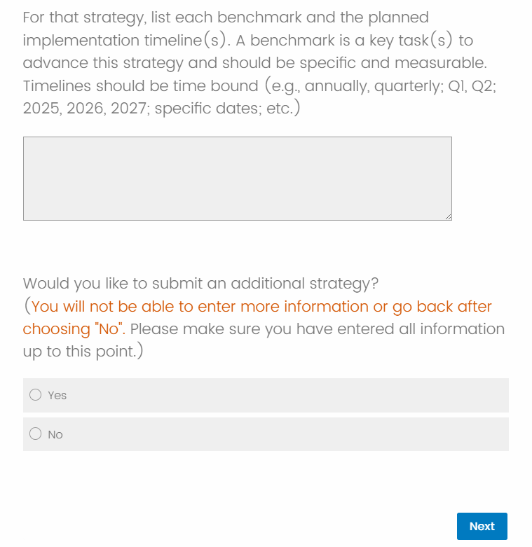
PATH #1
If you need to submit more than one strategy, clicking ‘Yes’ will take you BACK to the previous question in the report, where you will enter another strategy and its benchmarks and implementation timeline. You can go through this loop as many times as you need, depending on how many strategies you are reporting on.
jobs.utah.gov/mihreporting
Notes:
SCRIPT
Next, you will list each benchmark and the planned implementation timeline for the strategy. Details about benchmarks and timelines are provided in the same question.
If you need to submit more than one strategy, clicking ‘Yes’ will take you BACK to the previous question in the report, where you will enter another strategy and its benchmarks and implementation timeline. You can go through this loop as many times as you need, depending on how many strategies you are reporting on.
Once you have entered all your strategies, you will then click ‘No’ on the question ‘Would you like to submit an additional strategy?’ PLEASE NOTE that you can NOT go back after choosing ‘No’ on this question. If you make a mistake and incorrectly select ‘No’ before you’re done adding strategies, please reach out to us at mih@utah.gov.

Slide 14
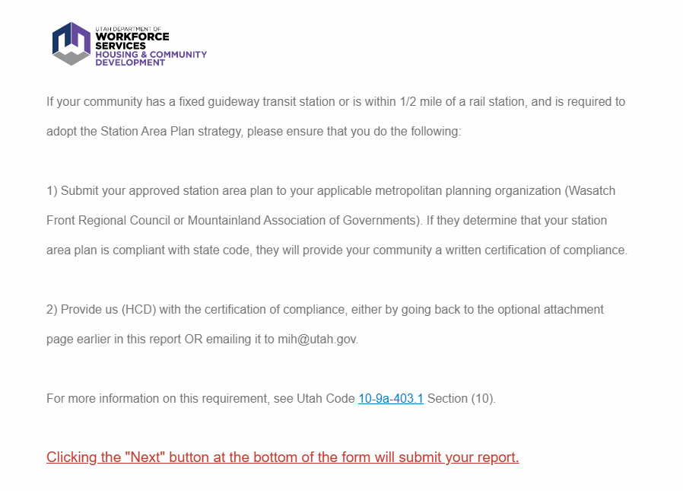
PATH #1
Only applies to municipalities; for more information, refer to Utah Code 10-9a-403.1, Section 10.
jobs.utah.gov/mihreporting
Notes:
SCRIPT
If your community has a fixed guideway transit station or is within one-half mile of a rail station, and is required to adopt the Station Area Plan Strategy, the survey will outline several steps that you need to take.
Once you click ‘Next’ your report will be officially submitted.

Slide 15
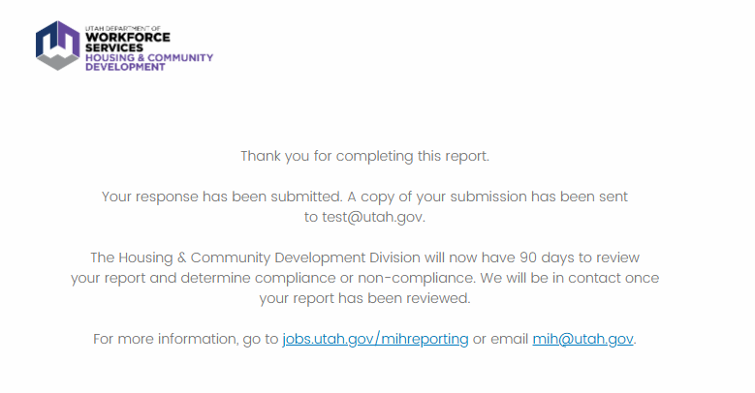
PATH #1
jobs.utah.gov/mihreporting
Notes:
SCRIPT
A copy of your submission will be sent to the email entered at the beginning of the report. Our staff will then have 90 days to review your report and determine compliance or non-compliance. Staff will be in contact with you once your report has been reviewed.
We will go through the report review & appeal process later on in the presentation.

Slide 16
PATH #2
jobs.utah.gov/mihreporting
Notes:
SCRIPT
Now, we will go through the question path if you select PATH #2 and you are in YEAR 2-5 of reporting.

Slide 17
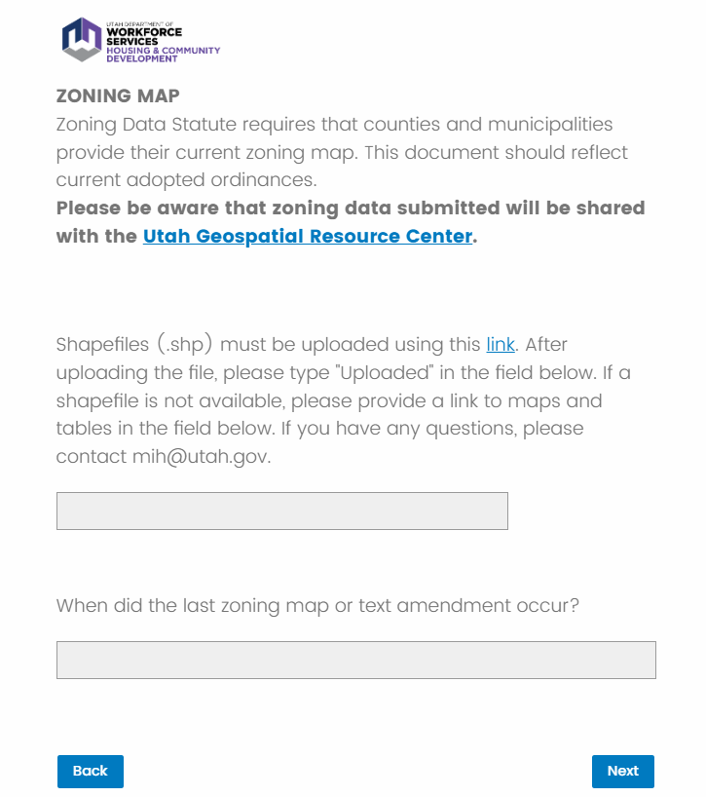
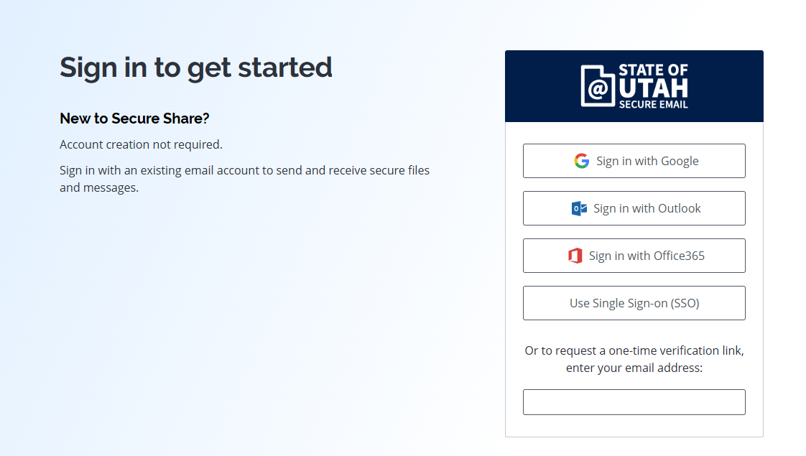
PATH #2
jobs.utah.gov/mihreporting
Notes:
SCRIPT
Utah Code requires that communities provide shapefiles or website links to current maps and tables related to zoning. A shapefile is a file format used to show the location, shape, and attributes of geographic features. Clicking on the link will open a new window and take you to a secure file-sharing program called Virtru.

Slide 18
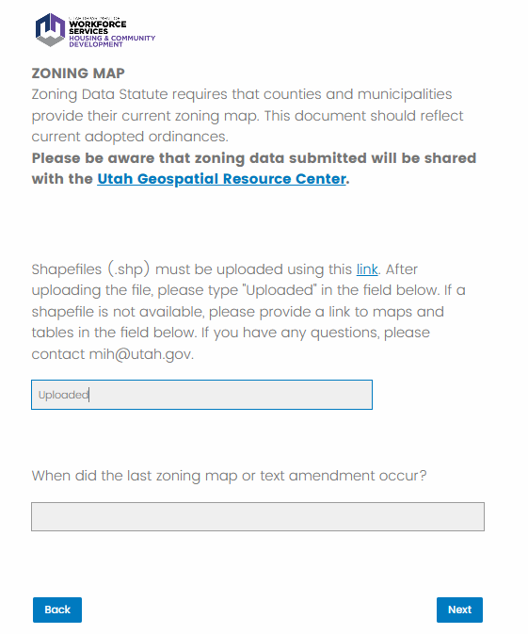
PATH #2
jobs.utah.gov/mihreporting
Notes:
SCRIPT
Once you have successfully uploaded your files through the Virtru secure file-sharing program, go back to the report and type ‘Uploaded’ into the first question. If a shapefile is not available, please provide a link to maps and tables. If you have any issues with uploading files, please email mih@utah.gov.

Slide 19
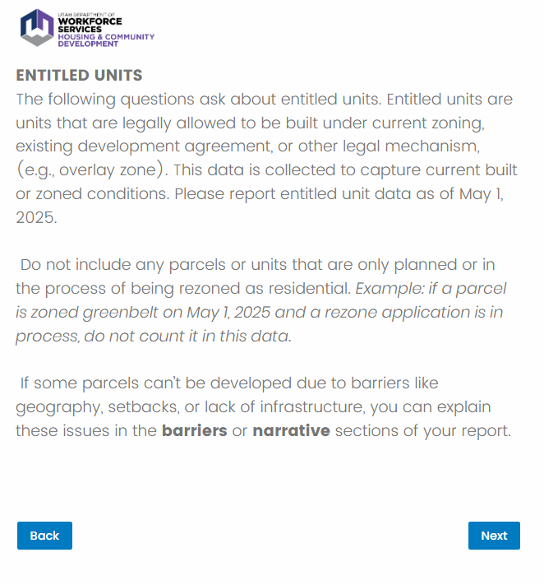
PATH #2
jobs.utah.gov/mihreporting
Notes:
SCRIPT
The next several questions in the report are about entitled units. Please report entitled unit data as of MAY 1, 2025.

Slide 20
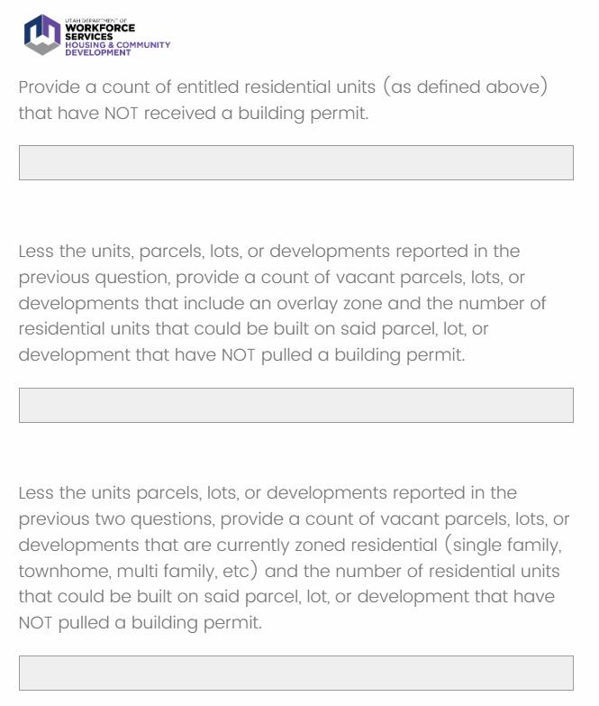
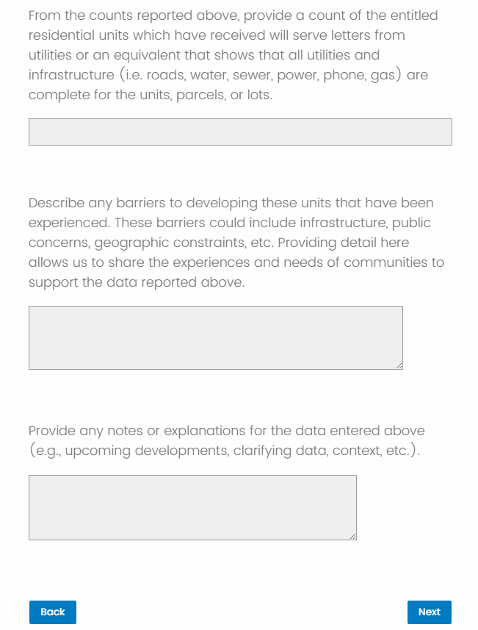
PATH #2
OPTIONAL
*REQUIRED
OPTIONAL
OPTIONAL
OPTIONAL
OPTIONAL
Notes:
SCRIPT
The first question about entitled units is the only one that is required. There are 5 other questions after that, which are not required, but are helpful to understand the entitled unit “landscape” in each community.
We know that many communities have had questions about how to report entitled units. For help, you can refer to our Frequently Asked Questions page on jobs.utah.gov/mihreporting. The FAQ page has an entire section on entitled units. You can also email us at mih@utah.gov if you have questions about reporting entitled units.

Slide 21
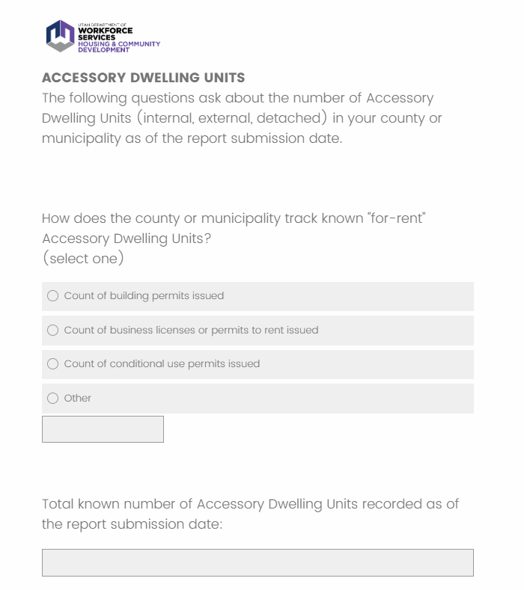
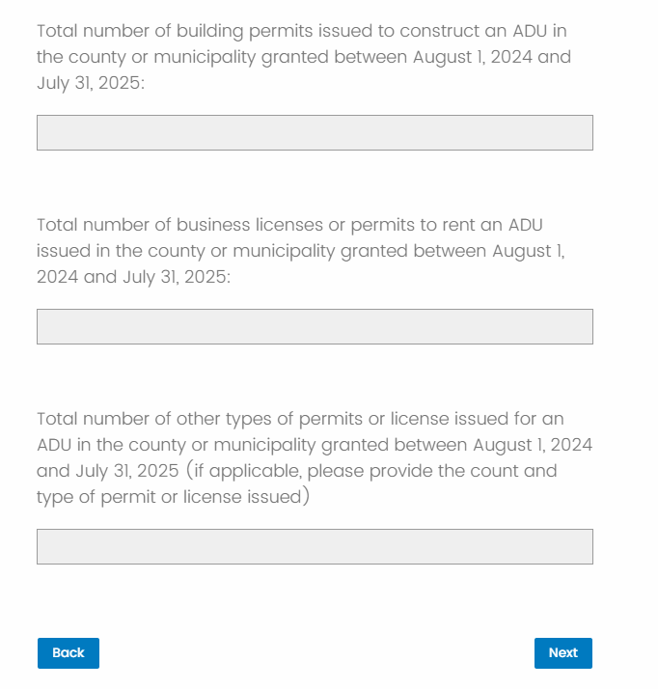
PATH #2
Notes:
SCRIPT
Next, there are several questions about Accessory Dwelling Units, more commonly known as ADUs.

Slide 22
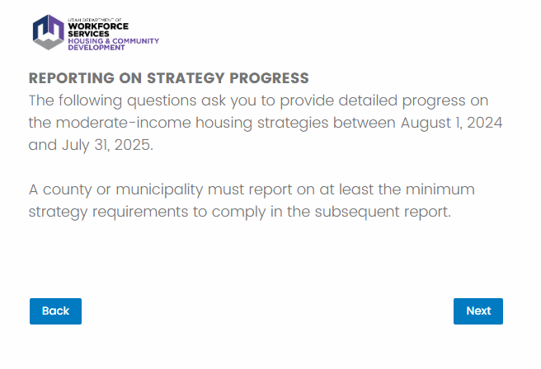
PATH #2
jobs.utah.gov/mihreporting
Notes:
SCRIPT
In the next section, you will report on your community’s MIH strategies.

Slide 23
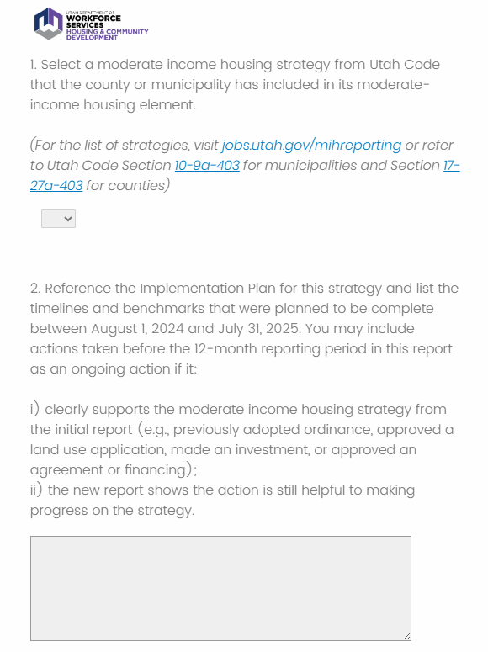
PATH #2
Notes:
SCRIPT
For the list of strategies, the report provides links to Utah Code Section 10-9a-403 for municipalities and Section 17-27a-403 for counties.
Once you pick the strategy, the report will ask you several questions about actions taken on this strategy from the reporting period, which is August 1, 2024 to July 31, 2025.

Slide 24
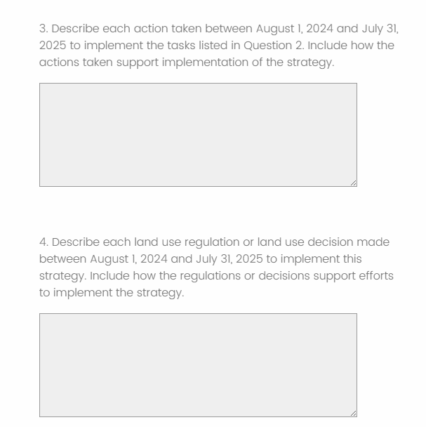
PATH #2
Question #3 Example (Strategy E- ADUs)
“Since the notice of compliance was issued, City staff have researched best practices & model ordinances for external accessory dwelling units, identified parking capacities needed to accommodate ADUs, and drafted an ordinance to present to Council. A copy of the meeting minutes are attached.”
Question #4 Example (Strategy E- ADUs)
“Planning Commission recommended an ordinance to the City Council, which was presented on April 20, 2024. The Council passed ordinance 2024-06 allowing external and detached accessory dwelling units in June 2024.
The ordinance reduces regulations by allowing additional types of ADUs in the city. Internal units were the only type of ADU allowed before the ordinance. A copy of the ordinance is attached.”
jobs.utah.gov/mihreporting
Notes:
SCRIPT
For questions 3 and 4, we have provided some example responses.

Slide 25
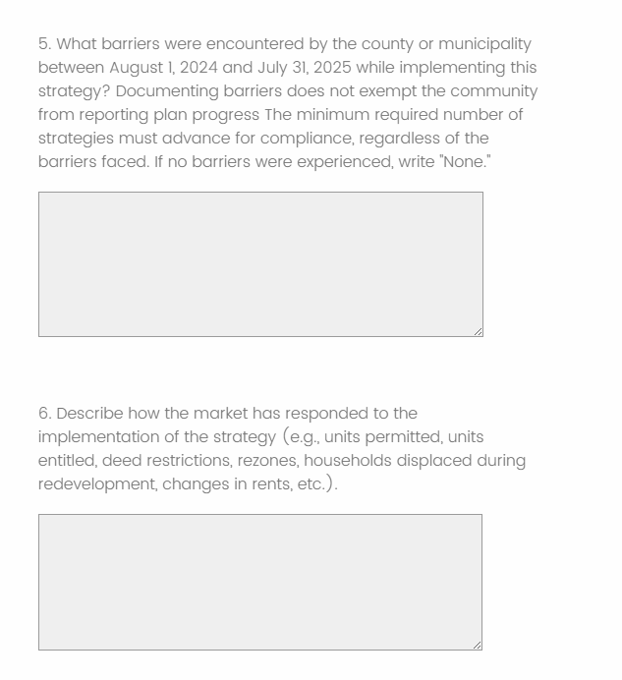
PATH #2
Question #5 Example (Strategy E- ADUs)
“Members of the public and some council members expressed concern about the parking capacity due to ADUs.”
Question #6 Example (Strategy H – Parking Requirement Reduction)
“The barriers to seeing steps being taken in the private market are based on available land and increased construction costs. The City is seeing slower development than in the past, and we believe this has resulted in a slower market response to the parking reduction.”
jobs.utah.gov/mihreporting
Notes:
SCRIPT
For questions 5 and 6, we have provided some example responses.

Slide 26
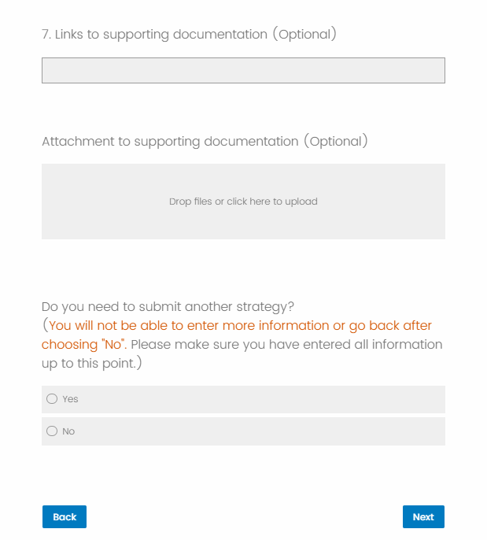
PATH #2
If you need to submit more than one strategy, clicking ‘Yes’ will take you BACK to the previous question in the report, where you will enter another strategy and its benchmarks and implementation timeline. You can go through this loop as many times as you need, depending on how many strategies you are reporting on.
jobs.utah.gov/mihreporting
Notes:
SCRIPT
The report will give you the option of providing links or attachments to any other documentation that would support your report answers.
If you need to submit another strategy, clicking ‘Yes’ will take you BACK to the previous question in the report, where you will enter another strategy and complete the associated questions. You can go through this loop as many times as you need, depending on how many strategies you are reporting on.
Once you have entered all your strategies, you will then click ‘No’ on the question ‘Would you like to submit an additional strategy?’ PLEASE NOTE that you can NOT go back after choosing ‘No’ on this question. If you make a mistake and incorrectly select ‘No’ before you’re done adding strategies, please reach out to us at mih@utah.gov.

Slide 27
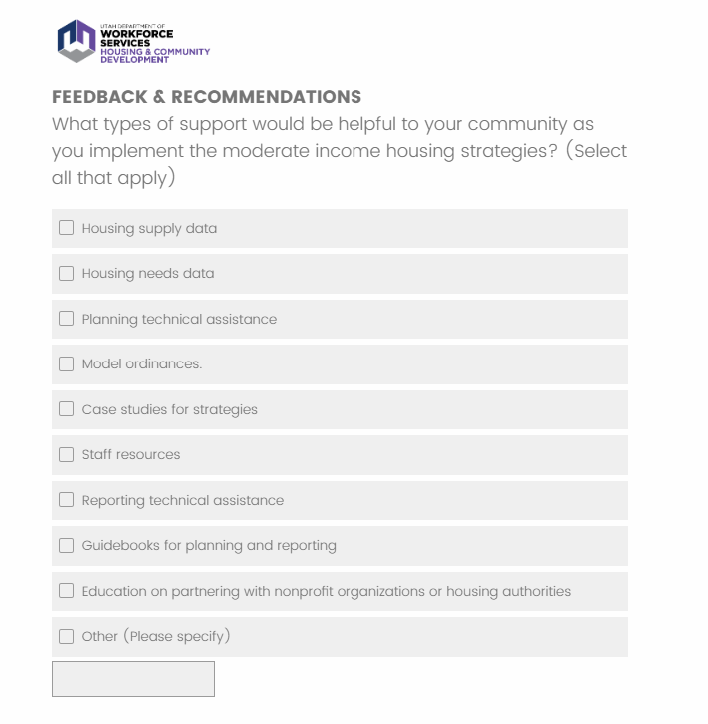
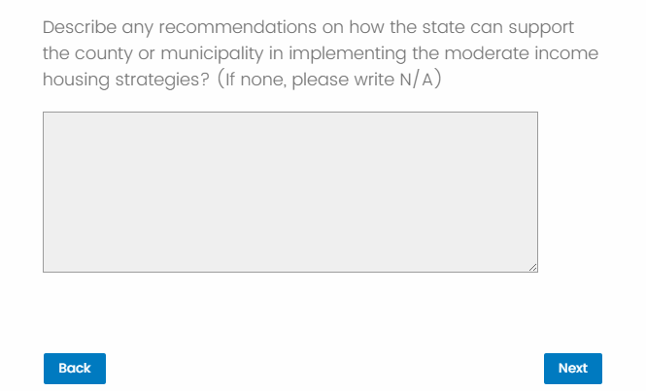
PATH #2
OPTIONAL
jobs.utah.gov/mihreporting
Notes:
SCRIPT
Next is a question on what type of support would be helpful to your community as you implement MIH strategies. We will go over some helpful resources available to your community later in the presentation.The second recommendation question is optional.

Slide 28
PATH #2
Only applies to municipalities; for more information, refer to Utah Code 10-9a-403.1, Section 10.
jobs.utah.gov/mihreporting
Notes:
SCRIPT
If your community has a fixed guideway transit station or is within one-half mile of a rail station, and is required to adopt the Station Area Plan Strategy, the survey will outline several steps that you need to take.
Once you click ‘Next’ your report will be officially submitted.

Slide 29
PATH #2
jobs.utah.gov/mihreporting
Notes:
SCRIPT
A copy of your submission will be sent to the email entered at the beginning of the report. Our staff will then have 90 days to review your report and determine compliance or non-compliance. Staff will be in contact with you once your report has been reviewed.
We will go through the report review & appeal process later on in the presentation.

Slide 30
PATH #2
Questions online or in the chat?
jobs.utah.gov/mihreporting

Slide 31
PATH #3
jobs.utah.gov/mihreporting
Notes:
SCRIPT
Now, we will go through the question path if you select PATH #3. You should select this option if you are in YEAR 2-5 of reporting AND your implementation plan or strategies were updated or amended during the reporting period.
You will first provide any NEW strategies that were adopted or amended. Afterward, you will report on the previous progress made with your OLD strategies.

Slide 32
PATH #3
NEW STRATEGIES
On this page, you will provide any NEW strategies that were adopted or amended.
For example, if you adopted one of the new MIH strategies into your General Plan this year OR switched to a new strategy after dropping an old one, you would enter them here.
jobs.utah.gov/mihreporting
Notes:
SCRIPT
On this page, you will provide any NEW strategies that were adopted or amended. For example, if you adopted one of the new MIH strategies into your General Plan this year OR switched to a new strategy after dropping an old one, you would enter them here.

Slide 33
PATH #3
If you need to submit more than one NEW strategy, clicking ‘Yes’ will take you BACK to the previous question in the report, where you will enter another strategy and its benchmarks and implementation timeline. You can go through this loop as many times as you need, depending on how many strategies you are reporting on.
jobs.utah.gov/mihreporting
Notes:
SCRIPT
Next, you will list each benchmark and the planned implementation timeline for the NEW strategy. Details about benchmarks and timelines are provided in the same question.
If you need to submit another NEW strategy, clicking ‘Yes’ will take you BACK to the previous question in the report, where you will enter another NEW strategy and its benchmarks and implementation timeline. You can go through this loop as many times as you need, depending on how many NEW strategies you are reporting on.
Once you have entered all your strategies, you will then click ‘No’ on the question ‘Would you like to submit an additional strategy?’ PLEASE NOTE that you can NOT go back after choosing ‘No’ on this question. If you make a mistake and incorrectly select ‘No’ before you’re done adding strategies, please reach out to us at mih@utah.gov.

Slide 34
PATH #3
jobs.utah.gov/mihreporting
Notes:
SCRIPT
Similar to PATH #2, you will use the Virtru secure file-sharing program to upload zoning files and tables. Follow the same steps as outlined earlier in the presentation.

Slide 35
PATH #3
jobs.utah.gov/mihreporting
Notes:
SCRIPT
The next several questions in the report are about entitled units. Please report entitled unit data as of MAY 1, 2025.

Slide 36
PATH #3
OPTIONAL
*REQUIRED
OPTIONAL
OPTIONAL
OPTIONAL
OPTIONAL
Notes:
SCRIPT
The first question about entitled units is the only one that is required. There are 5 other questions after that, which are not required, but are helpful to understand the entitled unit “landscape” in each community.
We know that many communities have had questions about how to report entitled units. For help, you can refer to our Frequently Asked Questions page on jobs.utah.gov/mihreporting. The FAQ page has an entire section on entitled units. You can also email us at mih@utah.gov if you have questions about reporting entitled units.

Slide 37
PATH #3
Notes:
SCRIPT
Next, there are several questions about Accessory Dwelling Units, more commonly known as ADUs.

Slide 38
PATH #3
OLD STRATEGIES
When you get to this screen, you will now report on progress made on OLD strategies.
jobs.utah.gov/mihreporting
Notes:
SCRIPT
When you get to this screen, you will now report on progress made on OLD strategies.

Slide 39
PATH #3
jobs.utah.gov/mihreporting
Notes:
SCRIPT
For the list of strategies, the report provides links to Utah Code Section 10-9a-403 for municipalities and Section 17-27a-403 for counties.
Once you pick the strategy, the report will ask you several questions about action taken on this strategy from the reporting period, which is August 1, 2024 to July 31, 2025.

Slide 40
PATH #3
Question #3 Example (Strategy E- ADUs)
“Since the notice of compliance was issued, City staff have researched best practices & model ordinances for external accessory dwelling units, identified parking capacities needed to accommodate ADUs, and drafted an ordinance to present to Council. A copy of the meeting minutes are attached.”
Question #4 Example (Strategy E- ADUs)
“Planning Commission recommended an ordinance to the City Council, which was presented on April 20, 2024. The Council passed ordinance 2024-06 allowing external and detached accessory dwelling units in June 2024.
The ordinance reduces regulations by allowing additional types of ADUs in the city. Internal units were the only type of ADU allowed before the ordinance. A copy of the ordinance is attached.”
jobs.utah.gov/mihreporting
Notes:
SCRIPT
For questions 3 and 4, we have provided some example responses.

Slide 41
PATH #3
Question #5 Example (Strategy E- ADUs)
“Members of the public and some council members expressed concern about the parking capacity due to ADUs.”
Question #6 Example (Strategy H – Parking Requirement Reduction)
“The barriers to seeing steps being taken in the private market are based on available land and increased construction costs. The City is seeing slower development than in the past, and we believe this has resulted in a slower market response to the parking reduction.”
jobs.utah.gov/mihreporting
Notes:
SCRIPT
For questions 5 and 6, we have provided some example responses.

Slide 42
PATH #3
If you need to submit more than one OLD strategy, clicking ‘Yes’ will take you BACK to the previous question in the report, where you will enter another strategy and its benchmarks and implementation timeline. You can go through this loop as many times as you need, depending on how many strategies you are reporting on.
jobs.utah.gov/mihreporting
Notes:
SCRIPT
The report will give you the option of providing links or attachments to any other documentation that would support your report answers.
If you need to submit another OLD strategy, clicking ‘Yes’ will take you BACK to the previous question in the report, where you will enter another strategy and complete the associated questions. You can go through this loop as many times as you need, depending on how many OLD strategies you are reporting on.
Once you have entered all your OLD strategies, you will then click ‘No’ on the question ‘Would you like to submit an additional strategy?’ PLEASE NOTE that you can NOT go back after choosing ‘No’ on this question. If you make a mistake and incorrectly select ‘No’ before you’re done adding strategies, please reach out to us at mih@utah.gov.

Slide 43
PATH #3
OPTIONAL
jobs.utah.gov/mihreporting
Notes:
SCRIPT
Next is a question on what type of support would be helpful to your community as you implement MIH strategies. We will go over some helpful resources available to your community later in the presentation. The second recommendation question is optional.

Slide 44
PATH #3
Only applies to municipalities; for more information, refer to Utah Code 10-9a-403.1, Section 10.
jobs.utah.gov/mihreporting
Notes:
SCRIPT
If your community has a fixed guideway transit station or is within one-half mile of a rail station, and is required to adopt the Station Area Plan Strategy, the survey will outline several steps that you need to take.
Once you click ‘Next’ your report will be officially submitted.

Slide 45
PATH #3
jobs.utah.gov/mihreporting
Notes:
SCRIPT
A copy of your submission will be sent to the email entered at the beginning of the report. Our staff will then have 90 days to review your report and determine compliance or non-compliance. Staff will be in contact with you once your report has been reviewed.
We have now gone through ALL THREE REPORT PATHS!

Slide 46
PATH #3
Questions online or in the chat?
jobs.utah.gov/mihreporting

Slide 47
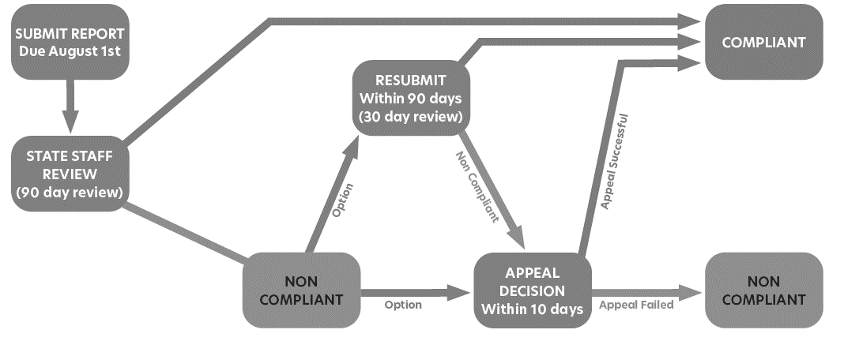
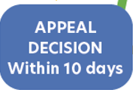
REPORTING REVIEW & APPEAL PROCESS
1) STATE STAFF REVIEW The Housing & Community Development Division will then have 90 days to review the report. The division will review and determine if the report is compliant or non-compliant. After reviewing a report, the division will provide notice as provided in Section 10-9a-408 or 17-27a-408 of Utah Code.
2) IF COMPLIANT The community can continue working towards the goals in their plan and report the next year (unless they used one of the new strategies, upon which they wouldn’t need to report for two additional years).
IF NON-COMPLIANT If the report is non-compliant, the reporting entity may either submit a corrected report or request an appeal of the determination.
Notes:
SCRIPT
The Housing & Community Development Division will then have 90 days to review the report. The division will review and determine if the report is compliant or non-compliant. After reviewing a report, the division will provide notice as provided in Section 10-9a-408 or 17-27a-408 of Utah Code.
If the report is compliant, the community can continue working towards the goals in their plan and report the next year (unless they used one of the new strategies, upon which they wouldn’t need to report for two additional years).
If the report is non-compliant, the reporting entity may either submit a corrected report or request an appeal of the determination.

Slide 48
REPORTING REVIEW & APPEAL PROCESS
RESUBMIT If they choose to submit a corrected report, it must happen within 90 days from when the notice is sent. You can receive technical assistance from HCD staff if you need help with your resubmission. The division will review the corrected report within 30 days after the report is received.
APPEAL If your community wants to appeal a notice of non-compliance, you must send a written request within 10 days of when the notice was sent. The appeal must include your community’s name, a representative’s signature, and the reason for the appeal. You can send it by email, fax, mail, courier, or hand-delivery.
Once the appeal is received, the division will work with other organizations to form an appeal board. You can submit more information or arguments within 15 calendar days of your appeal, but it must relate to either the 12-month reporting period or your compliance strategy. If you decide to cancel the appeal, you must send a written notice at least seven days before the appeal board’s first meeting. If you withdraw, your community will still need to fix the issue within the original 90-day correction period.
Notes:
SCRIPT
If you choose to submit a corrected report, it must happen within 90 days from when the notice is sent. You can receive technical assistance from HCD staff if you need help with your resubmission. The division will review the corrected report within 30 days after the report is received.
If your community wants to appeal a notice of non-compliance, you must send a written request within 10 days of when the notice was sent. The appeal must include your community’s name, a representative’s signature, and the reason for the appeal. You can send it by email, fax, mail, courier, or hand-delivery.
Once the appeal is received, the division will work with other organizations to form an appeal board. You can submit more information or arguments within 15 calendar days of your appeal, but it must relate to either the 12-month reporting period or your compliance strategy. If you decide to cancel the appeal, you must send a written notice at least seven days before the appeal board’s first meeting. If you withdraw, your community will still need to fix the issue within the original 90-day correction period.

Slide 49
PENALTIES FOR NON-COMPLIANCE
Communities that do not submit their MIH report are ineligible for:
Transportation Investment Fund of 2005 & the Transit Transportation Investment Fund.
State Tax Commission Distribution of Sales and Use Tax to fund Highways.
Non-compliant communities pay a $250/day penalty fee and $500/day for a second consecutive year of non-compliance (Utah Code 10-9a-408 and 17-27a-408)
jobs.utah.gov/mihreporting
Notes:
SCRIPT
There are penalties for communities who do not submit a report, or are still deemed non-compliant after a resubmission or appeal.
A community will become ineligible for various state transit funds and must pay a $250 per day penalty fee the first year they are non-compliant, and $500 per day the second year.

Slide 50
PLANNING & DATA RESOURCES
State
The Utah Housing Affordability Dashboard - In collaboration with the Kem C. Gardner Policy Institute, a Utah Housing Affordability Dashboard has been created which identifies moderate and affordable housing needs & supply, and a 5-year projection across Utah communities with populations greater than 5,000 people.
Land Use Strategies to Bring Housing Back Within Reach - A 2024 report by Envision Utah on best practices to reform zoning and housing regulations, with the ultimate goal of increasing housing attainability and affordability in Utah.
‘How Do We Make Housing Affordable?’ - a 9-minute video produced by Envision Utah describing land use and construction regulation barriers to affordable housing and recommendations for potential changes to facilitate more affordable housing.
Moderate Income Housing (MIH) Element Model Resolution - a model resolution that communities can use to amend and adopt a moderate-income housing element in their General Plan.
Federal
The American Community Survey (ACS) - an extensive annual household survey produced by the U.S. Census Bureau which provides several tables of demographic and housing data on its website.
Comprehensive Housing Affordability Strategy (CHAS) – datasets from the U.S. Department of Housing & Urban Development (HUD) that organize housing needs according to household income and program eligibility limits.
Notes:
SCRIPT
This slide shows some state and federal planning and data resources that might be helpful for your community as you work on your General Plans and MIH strategies.

Slide 51
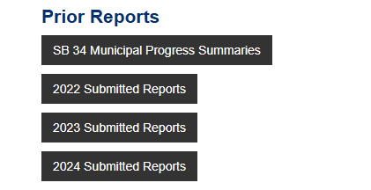
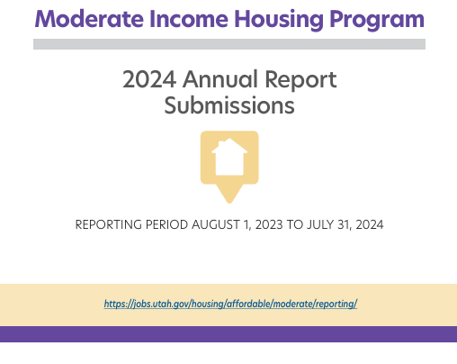
PLANNING & DATA RESOURCES
Want access to previous years’ MIH reports?
Go to jobs.utah.gov/mihreporting and go to the Prior Reports section at the bottom of the page.
Reports from 2022-2024 are available for all reporting municipalities/counties.
jobs.utah.gov/mihreporting
Notes:
SCRIPT
If you would like to see your community’s MIH reports from previous years, you can go to the ‘Prior Reports’ section of jobs.utah.gov/mihreporting.

Slide 52
PLANNING & DATA RESOURCES
Final questions online or in the chat?
jobs.utah.gov/mihreporting

Slide 53
QUESTIONS & SUPPORT
If you need any assistance submitting your MIH report or have questions about MIH reporting requirements,
Email mih@utah.gov and schedule a one-on-one technical assistance appointment.
Go to jobs.utah.gov/mihreporting under the ‘Questions & Support’ section, which includes FAQs, a walkthrough video, walkthrough slides, and a PDF of the 2025 Report questions.
Call Todd Andersen (MIH Program Specialist) at (385) 290-9717.
For other assistance, contact Meg Ryan from Utah League of Cities and Towns (ULCT) at mryan@ulct.org.
jobs.utah.gov/mihreporting

