Slide 1


Unsticking Utah: Planning Boldly for a Thriving, Mobile Future
APA Utah Spring 2025 Conference
Jason Boal, AICP, APA Utah President
5/8/2025
Notes:
🗒️ Speaker Note: Welcome audience. Introduce the theme: how planning can “unstick” communities held back by outdated housing and mobility policies.

Slide 2

Planning Is the Way Forward
Planning can either reinforce systems of exclusion… or help us break free.
We choose progress.
Progress by Nick Youngson CC BY-SA 3.0 Pix4free
Notes:
🗒️ Speaker Note: Frame the rest of the talk. Emphasize planning’s role in shaping access and equity.

Slide 3
APA Utah’s Four Commitments
Educate
Promote
Pioneer
Influence
Notes:
🗒️ Speaker Note: Introduce the structure. “These four pillars will guide how we get Utah unstuck.”

Slide 4

What Does “Stuck” Mean?
Inspired by Stuck by Yoni Appelbaum
Americans are “stuck” due to:
  Restrictive zoning
  NIMBYism
  Lack of housing mobility
Utah is not immune
Notes:
Speaker Note: Explain the premise of Appelbaum’s book. Tie national trends to what’s happening in Utah.

Slide 5
APA Must Educate
Affordable, accessible professional education
Stronger partnerships to expand learning
Public outreach to explain planning
Shared repository of best practices
Notes:
🗒️ Speaker Note: Education is our foundation—for members and the public alike.

Slide 6

Why Education Matters
What % of Utahns who understand what planners do?
“People support what they understand.”
“People support what they helped create.” - Joseph Logan
Notes:
🗒️ Speaker Note: Make the case for broader public planning literacy.

Slide 7
APA Must Promote
Advocate for smart growth
Highlight success stories (e.g., APA awards)
Engage decision-makers at all levels
Give planners advocacy tools
Notes:
🗒️ Speaker Note: Promote our work and values so that planning is respected and expected.

Slide 8


Amplify Our Voices
“We can’t be silent pieces—we must be active players.”
Residents
Planners
Developers
Politicians
Notes:
🗒️ Speaker Note: Planning must be visible in legislative and community arenas.

Slide 9
APA Must Pioneer
Platform to share tools, templates, and insights
Link education, research, and practice
Support innovation and risk-taking
Notes:
🗒️ Speaker Note: We need to lead in technology, resilience, housing solutions, and climate adaptation.

Slide 10
Innovation in Action
APA Utah 2024 Award Winner for Planning Tool or Implementation:
Salt Lake City’s Affordable Housing Incentives
“Innovation is taking two things that exist and putting them together in a new way.“
Tom Freston, Co-founder of MTV
Notes:
🗒️ Speaker Note: Encourage creativity and experimentation across all community sizes.

Slide 11
APA Must Influence
Empower emerging leaders
Foster diversity and inclusion
Partner with universities and students
Support mentorships and internships
Notes:
🗒️ Speaker Note: Influence is our legacy. Who we train and uplift today will shape the Utah of tomorrow.

Slide 12
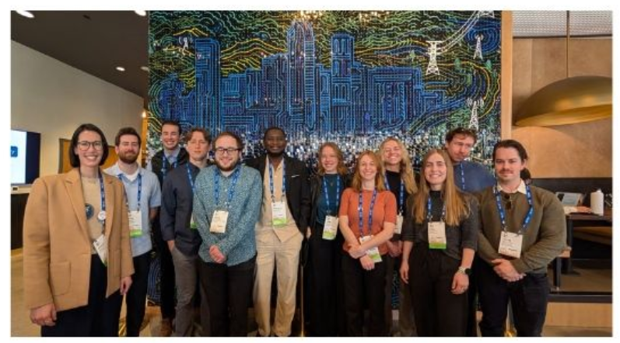
Connecting with Emerging Planners
Campus info sessions
Networking events
APA Utah Mentorship Program
Gene Carr Scholarship Founded by APA Utah
.
Notes:
🗒️ Speaker Note: Let’s make APA membership meaningful early—and keep it that way.

Slide 13

Planning—at its best—is about making change possible.
Notes:
🗒️ Speaker Note: Influence is our legacy. Who we train and uplift today will shape the Utah of tomorrow.

Slide 14
Recap - Our 4 Commitments
Educate — so we grow knowledge and trust.
Promote — so planning becomes visible and valued.
Pioneer — so we stay bold and innovative.
Influence — so we build a lasting, diverse, dynamic profession.
Notes:
🗒️ Speaker Note: Reinforce structure and summarize your leadership plan.

Slide 15

Call to Action
Let’s be the generation of planners that didn’t accept being stuck.
Let’s move Utah forward.
Notes:
Speaker Note: End with energy. Invite collaboration. Reaffirm optimism and responsibility.

Slide 16
Thank You!
Jason Boal, AICP
APA Utah President

Slide 17
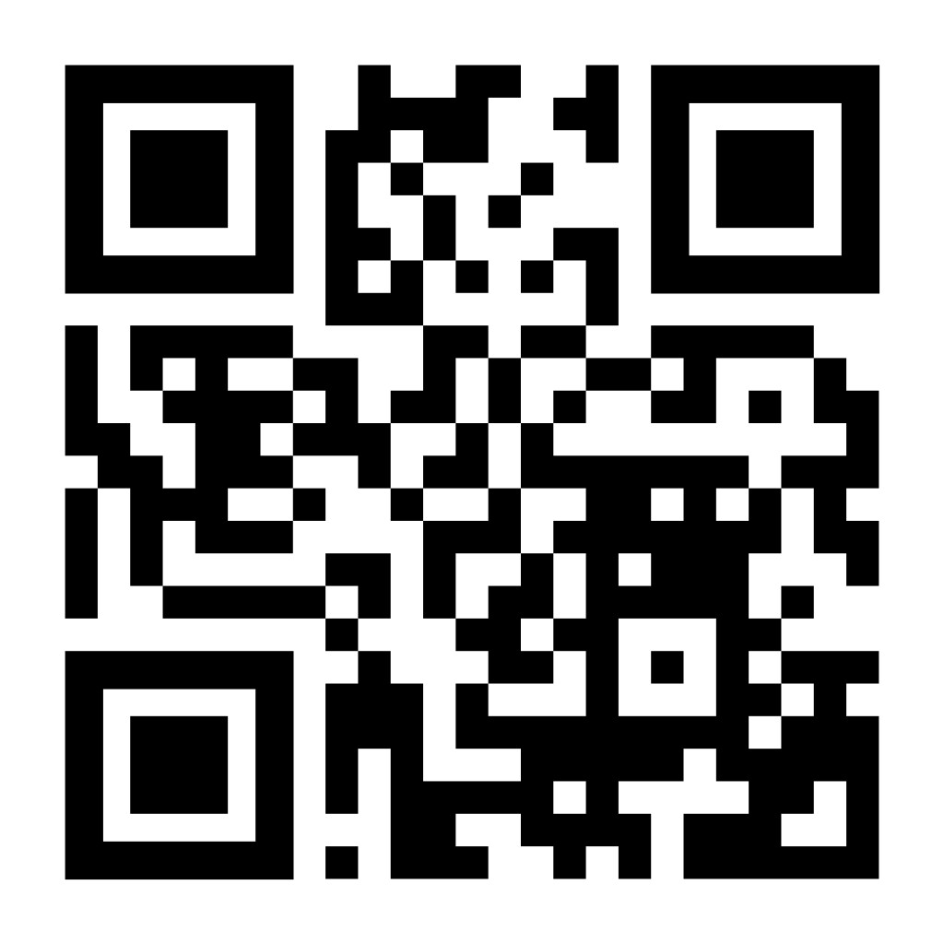
Housekeeping Items:
10:15 am session “From Policy to Plow” will be in the Ballroom
2:30 pm session “Agency Coordination: Early Engagement to Build Consensus will be in the Ballroom.
Please respond to the Conference Survey (QR Code)
Friday’s Legislative sessions will have a Zoom Link

