Slide 1
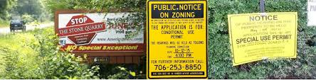
For Planning Commissioners & City Council members and staff Utah APA Logan Conference 2025
Catching Up with Conditional Use Permits
John Janson, Meg Ryan

Slide 2
Session Objectives:
Understand the implications of Legislative versus Administrative decisions
Understand how State Law has changed
Look at typical language
Consider potential new language
Site plans versus conditional uses
Consider process implications
On the fly – let’s look at your ordinance!

Slide 3

Legislative
Relates to adoption of policy and new rules to implement that policy
Decisions are more political than legal
Policy Choice of legislative/governing body members given broad deference by the courts
Typical actions include General Plan, zone changes, ordinance text changes, Development Agreements if making new law
PC role is to make a recommendation, after a public hearing on the ordinance creation
CC role to set policy make the decision and adopt ordinance

Slide 4
Administrative
Items being considered under the rules established by ordinances (you have an ordinance and you must follow it)
Decisions are more legal & technical, implementing the established laws
Standards for review (ordinance and evidence)
Courts require “substantial evidence” for the action taken- findings of fact
Typical applications (Permitted Uses/Site Plans, CUPs, Subs, PRUDs)
PC or another Land Use Authority can have final approval (if the CC delegates it by ordinance in the Powers & Duties section of your code)

Slide 5
Types of Uses in Your Code: Permitted, Prohibited & Conditional

Slide 6
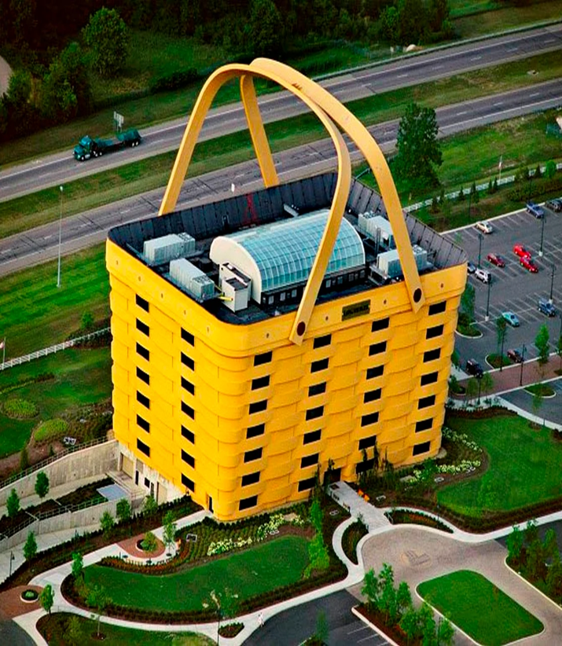
Conditional Uses
Utah State Law (10-9a-507) LUDMA
(1) A land use ordinance may include conditional uses and provisions for conditional uses that require compliance with standards set forth in an applicable ordinance.
(2) (a) A conditional use SHALL be approved if reasonable conditions are proposed, or can be imposed, to mitigate the reasonably anticipated detrimental effects of the proposed use in accordance with applicable standards.
(b) If the reasonably anticipated detrimental effects of a proposed conditional use cannot be substantially mitigated by the proposal or the imposition of reasonable conditions to achieve compliance with applicable standards, the conditional use may be denied.

Slide 7
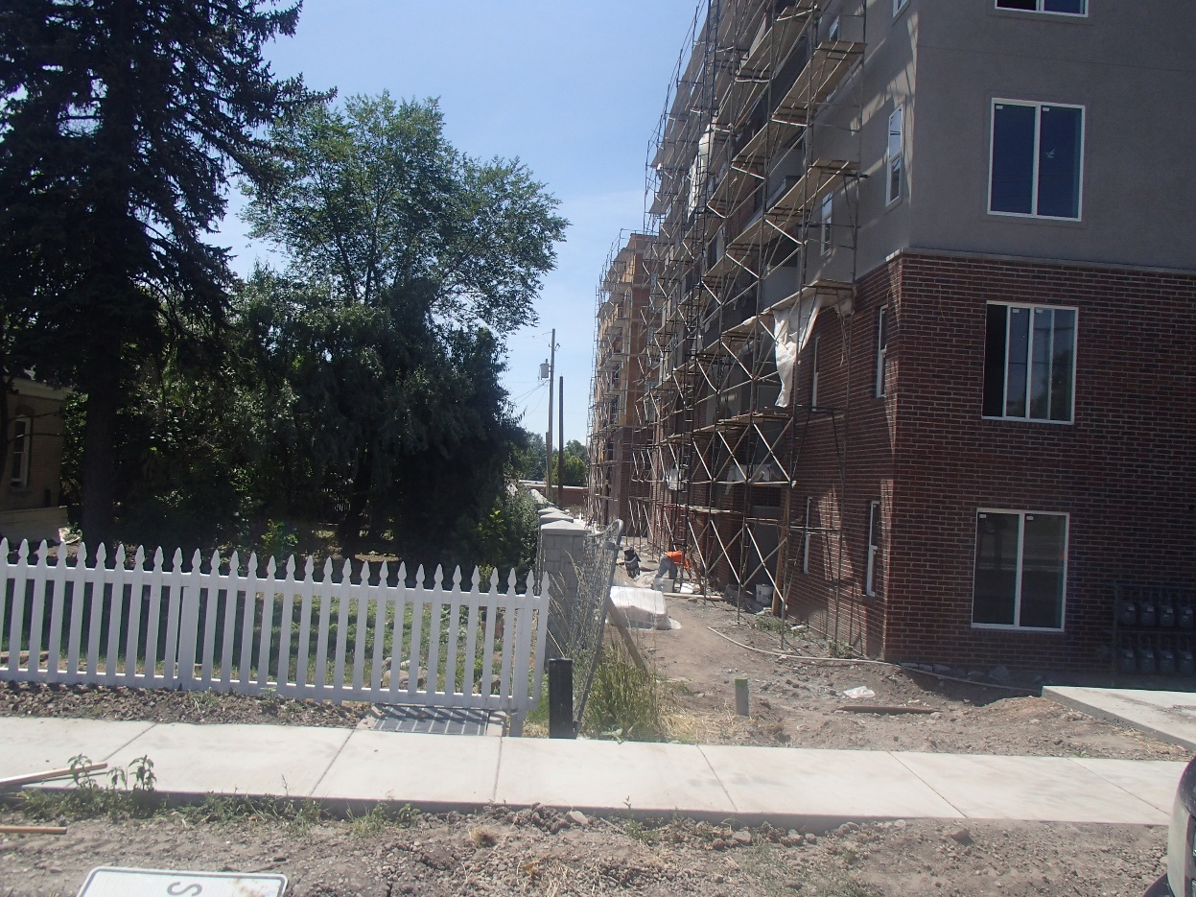
Administrative Actions
There is very little Discretion!(some say none!)
State Law clearly prevents PCs from being discretionary for Administrative Actions
Must have those standards

Slide 8
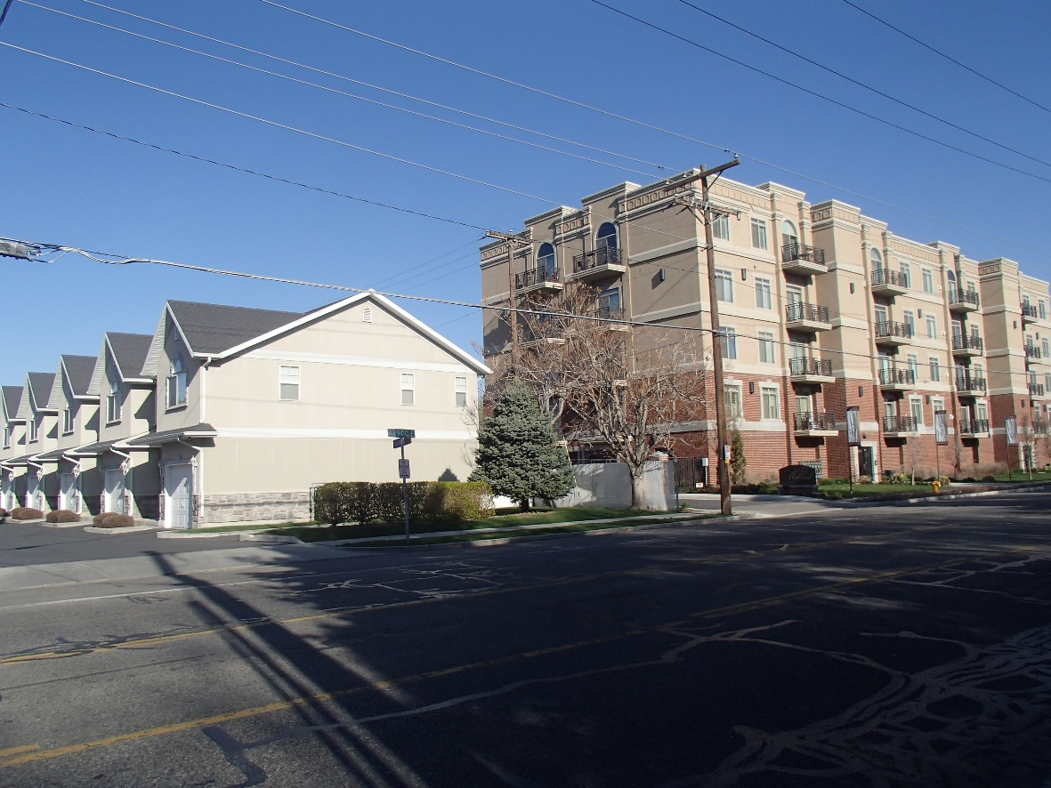
Check your Uses Chart for each zone
There is an assumption that the uses within a zone already work.
The word “compatible” is not in the Legislation – it says “comply with standards”
The uses should comply with the intent of your general plan
Conditional uses may need conditions based on standards to be “more” of a fit but they are not uses that are contrary to the zone intent! They belong there!

Slide 9
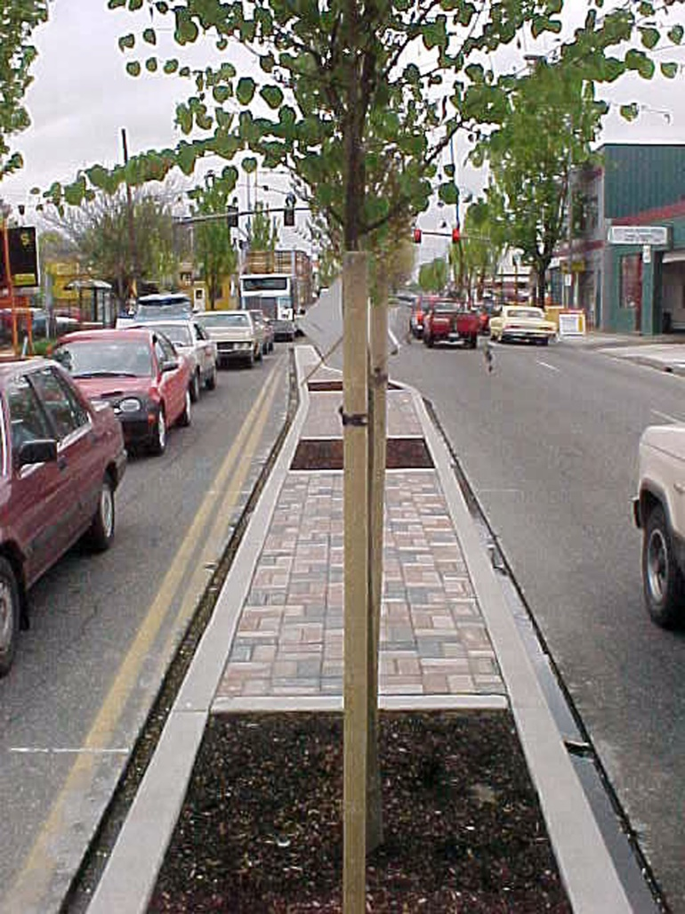
What are some potential standards to review Conditional Uses?
Complying with the Zoning Ordinance, Federal and State Law
Address reasonably anticipated detrimental effects by the use on existing systems and neighborhoods, including the prevention of:
Decreased street service levels and/or traffic patterns that may require the need for street modifications such as dedicated turn lanes, traffic control devices, street widening, curb, gutter and sidewalks, trip generation reductions, and/or vehicle mixes
Increased service demands for utility service delivery and system capacities
Mitigate impacts on connectivity and safety for pedestrians and bicyclists

Slide 10
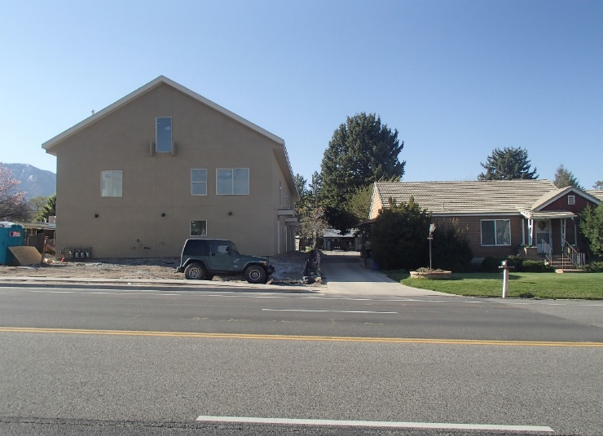
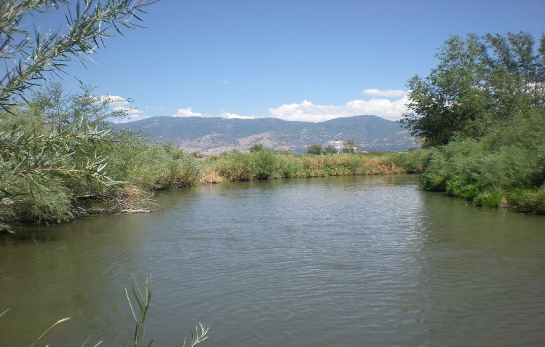
Conditional Use Standards
Noise that exceeds sound levels normally found in residential areas, odors beyond what is normally considered acceptable within a neighborhood, hours of operation not normally found in the neighborhood, mitigating solid waste disposal
Negative environmental impacts that increase the risk of contamination or other impacts to adjacent properties and people including: impacts on the aquifer, well heads, wetlands, slope retention, storm water, and flood potential
Incompatible designs in terms of use, scale, intensity, mass, character, construction, solar access, and in some cases architectural design and exterior detailing/finishes and colors within the neighborhood in which the conditional use will be located.

Slide 11
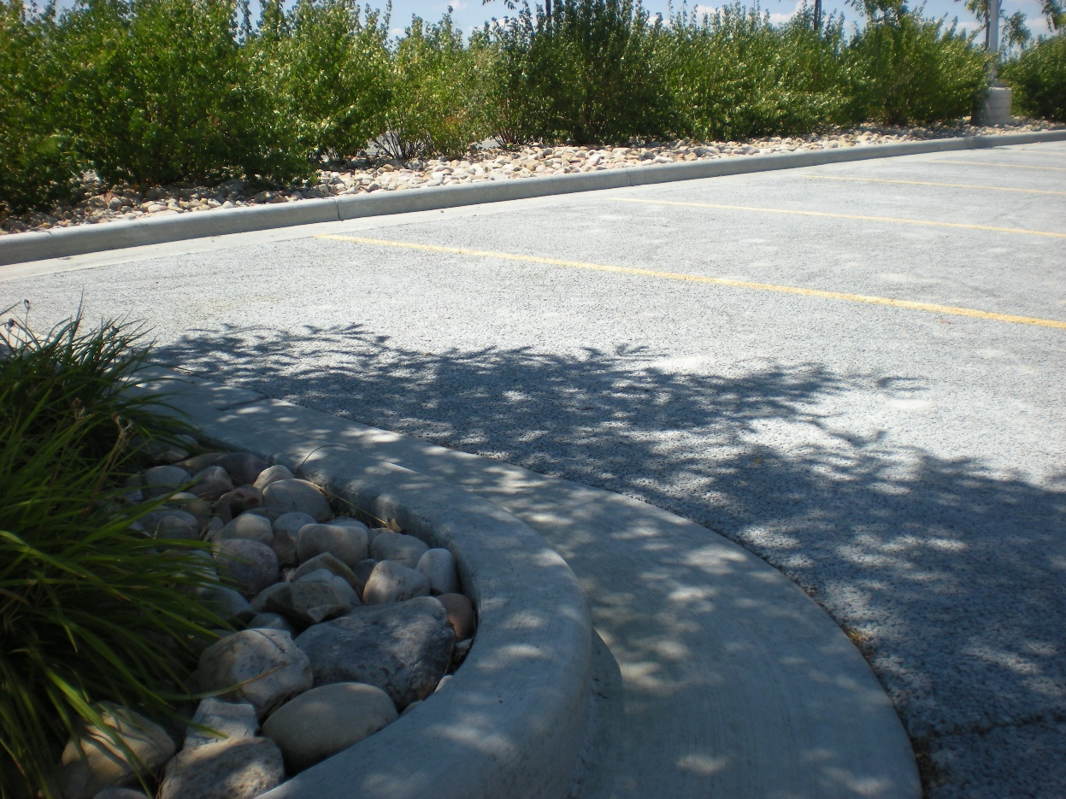
Conditional Use Standards
Site designs that negatively impact emergency vehicle access
Manmade environmental impacts such as dust, fumes, smoke, odor, noise, and vibrations from impacting the neighborhood.
Site plan designs that are detrimental to the neighborhood such as the location of ingress/egress, lot surfacing and design of off-street parking and circulation, compliance with off-street parking standards
Conflicts between uses, including signs, lighting, landscaping/open space, and fencing

Slide 12
Typical CUP Ordinance Language
The Planning Commission may impose additional requirements to mitigate the reasonably anticipated detrimental effects of the proposed use as defined.
In approving any conditional use, the Planning Commission shall impose such requirements and conditions as it deems necessary for the protection of adjacent properties and the public welfare.
(1) A conditional use permit shall not be granted unless the evidence presented by the applicant is such as to show all of the following: (2) That such use will not under the circumstances of the particular case, be detrimental to the health, safety, or general welfare of persons residing or working in the vicinity, or injurious to property or improvements in the vicinity.
3) That the proposed use will comply with regulations and conditions specified in this Code for such use.
(4) Upon the approval of any conditional use permit, the Planning Commission shall itemize, describe, and justify the conditions imposed on the use.

Slide 13
Not so great CUP Ordinance examples
The proposed use is necessary or desirable to provide a service or facility which will contribute to the general well-being of the community; and (“necessary and desirable” was common language prior to the State Law change 15 years ago)
Such use will not be detrimental to the health, safety and general welfare of persons nor injurious to property or improvements in the community, (has been proven to be extremely vague language)
but will be compatible with and complementary to the existing surrounding and/or planned future uses, buildings and structures when considering traffic generation, parking, building design and location, landscaping and signs; and (the uses should already be compatible. Some implied standards here!)

Slide 14
Better?
The proposed use will comply with the regulations and conditions specified in this title including the design standards of the city and the standards of this chapter; and (good use of the term standards – might reference the appropriate chapters)
The proposed use conforms to the goals, policies, governing principles, and the land uses found in the General Plan of the city; and (in theory your ordinances implement the General Plan, so this goes without saying)
The proposed use will not lead to the deterioration of the environment or ecology of the general area, nor will produce conditions or emit pollutants of such a type or of such a quantity so as to detrimentally effect, to any appreciable degree, public and private properties (ok environmental standard)

Slide 15

Better Standards lists are needed
Types of transportation conditions that can be imposed
Utility capacity issues
Connectivity
Hours of operation
Trash/odors
Emergency vehicle access
Parking lot designs
Compatibility (define that!) between adjacent uses

Slide 16
Let’s take a look at one of yours!
Do we have a volunteer??

Slide 17
Slight diversion to Site Plans
A conditional use should include the site plan for that use
The Planning Commission may review any application for a conditional use or a permitted use site plan by the use regulations of that zone.
In reviewing any conditional use or permitted use site plan application, the Planning Commission shall include the written requirements and conditions necessary for the protection of adjacent properties and the public welfare which are already included in the written standards in the appropriate chapter(s).
Do you approve site plans at the PC level? Do you need to?
Are the site plans the same as Conditional uses?
Site plans are permitted uses!
Site plan review should be an administrative review.
Both CUPs and Site Plans are administrative uses that are subject to standards and not discretionary (except for the imposition of standards to address detrimental effects for CUPs)

Slide 18
Is there a distinction between CUPs and Permitted Uses? Not Really....
Permitted use: If you meet the given standards, you get to go ahead
Conditional Use standards: You have standards but may not be sure which ones to apply as you address the detrimental effects
Approach ideas
Get your standards, sort of topics you will address, in the CU chapter
Standards within a particular zone
Standards for certain uses
Combination

Slide 19
Strategies for updating your Ordinances
Revising ordinances is a legislative action
Some Questions to Ask:
Are we satisfied with the types of development (the uses) occurring in the zones?
Are we satisfied with the appearance that our ordinances achieve? Design ordinance creates a good set of standards!
Are we achieving compatibility between uses through the application of standards?
Are we creating enduring places?
Some Ideas:
Update CUP chapter with more standards (listing topics you might need to address), as a minimum
Incorporate CUP standards philosophy in updates of other ordinances
Some chapters could have more specific standards (Design or special use standards)
Look closely at the intent of each zone – do we have the right mix of uses? PUs versus CUPs
Drop PC review of Site Plans (if you have staff)
Drop CC review of Conditional Uses (?) Why?

Slide 20
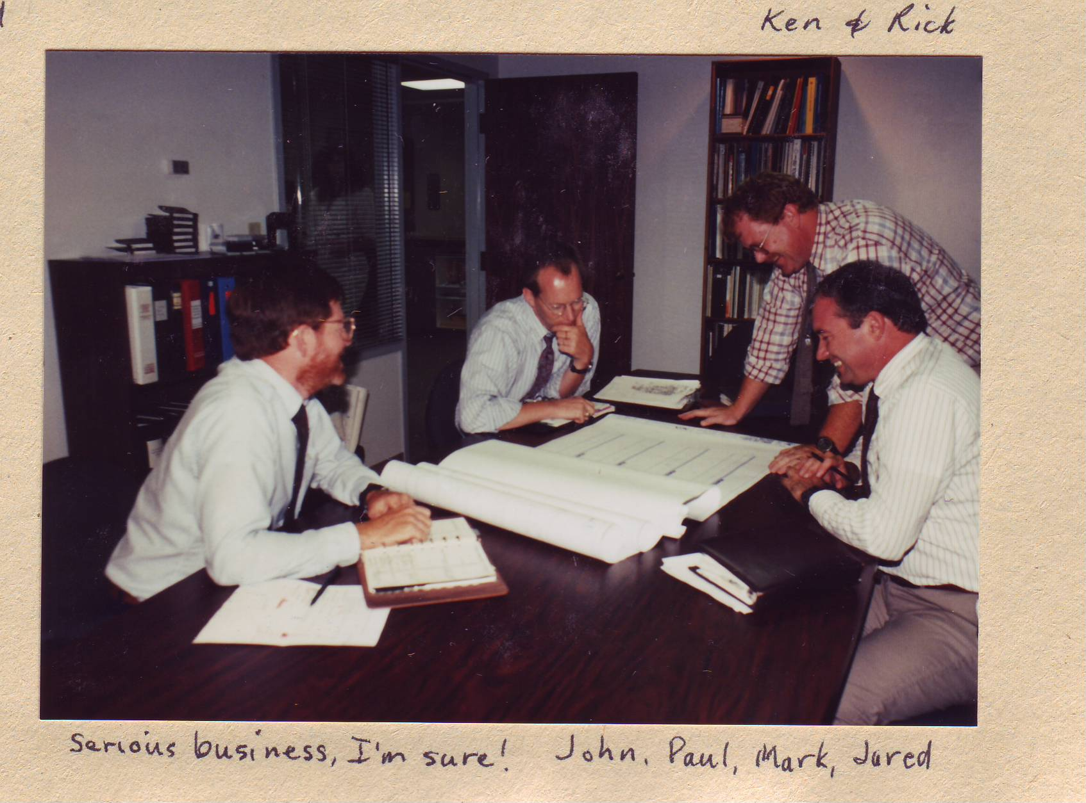
Process issues
Mail out to residents (not required by law )
Revise your notice. Use plain language. Don’t imply the CUP can be denied. Don't suggest the public can say whatever they want!
Public meeting or Public hearing?
Revise your agenda and explain the difference between Administrative and Legislative
What kind of input do you want?

Slide 21
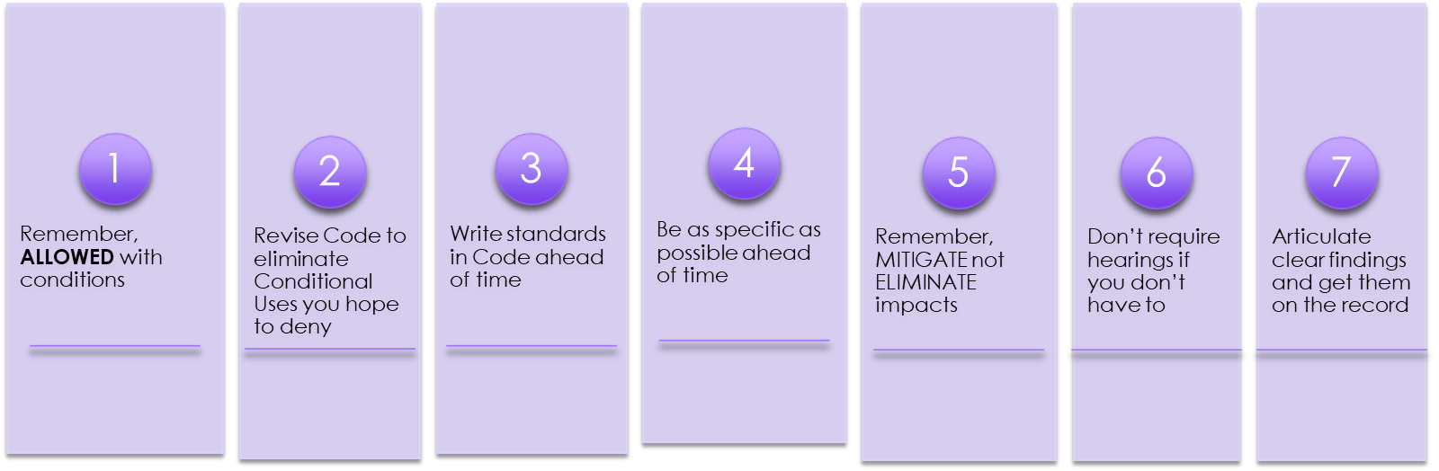
CUP SUMMARY

Slide 22

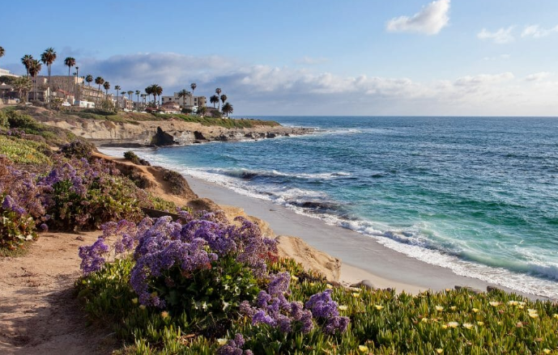
Questions? And Thanks for your time
John Janson hard at work mitigating adverse conditions
Meg Ryan starring in another movie on the beach in San Diego!!!

