Slide 1

APA UTAH: Intentional Governance
Meagan Booth and Jason Boal, AICP

Slide 2

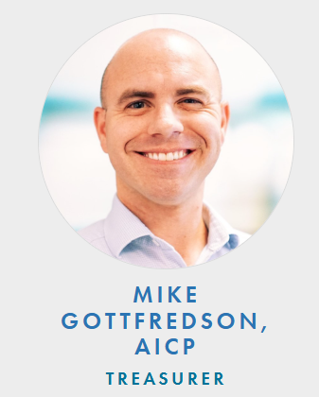
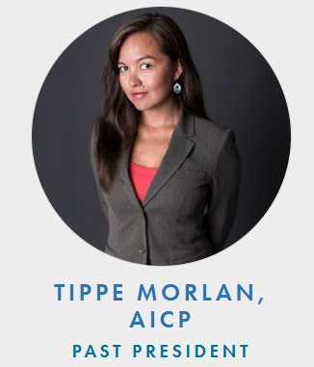
OFFICERS

Slide 3
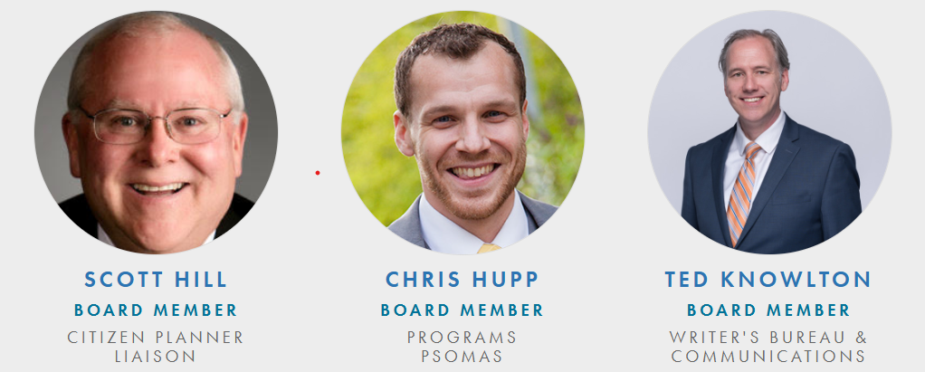
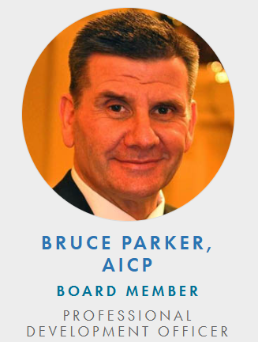
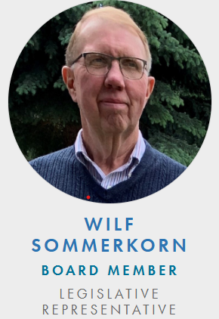
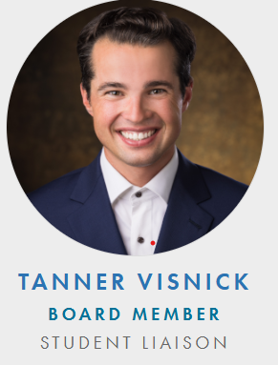
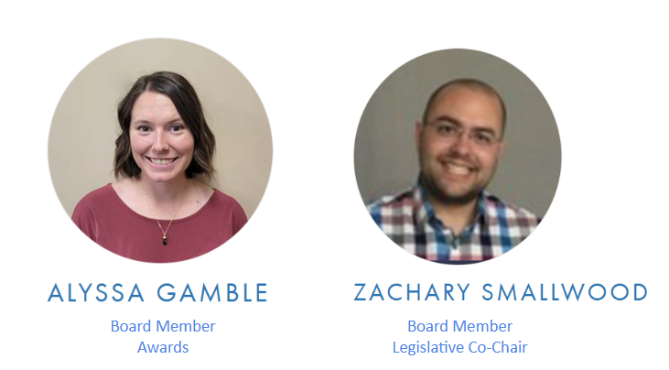
BOARD MEMBERS

Slide 4

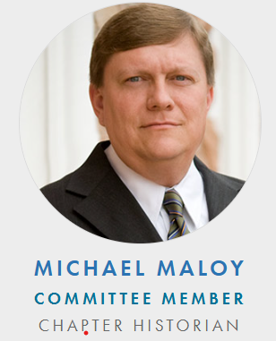
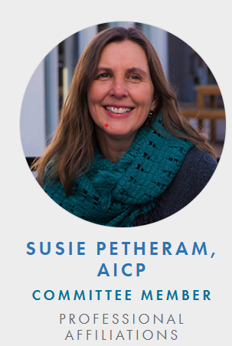
CHAPTER COORDINATORS

Slide 5
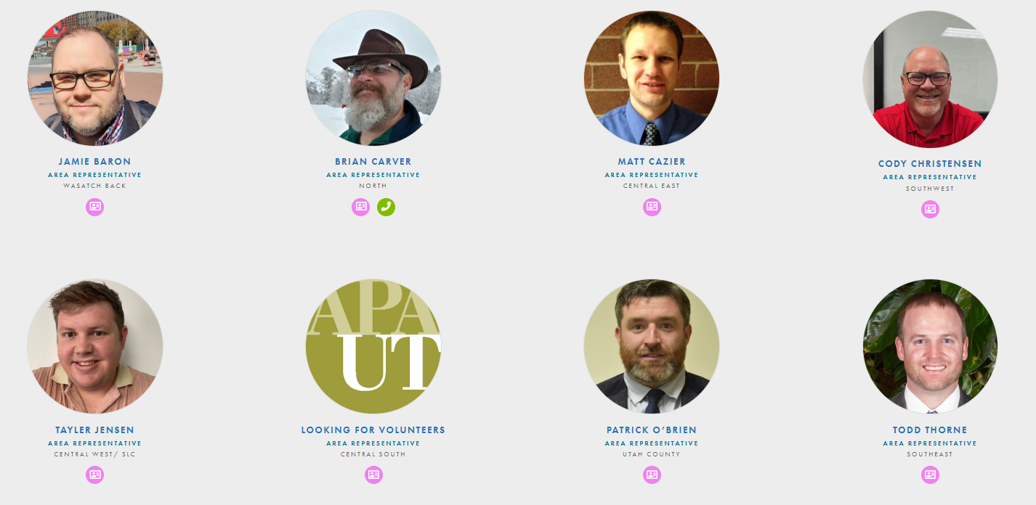
AREA REPRESENTATIVES

Slide 6

"Lead an intentional life, and you'll find clarity in your choices and actions.”
-Unknown
“Intentional living is about living on purpose, with purpose.“
John C. Maxwell

Slide 7
APA Utah’s mission is to:
01
02
03
Encourage and foster the principles of visioning and planning for a better future
Provide a wide range of educational opportunities for professional planners, citizen planners, and others involved in shaping our communities
Represent APA Utah Chapter members in matters related to the national organization of the American Planning Association.

Slide 8
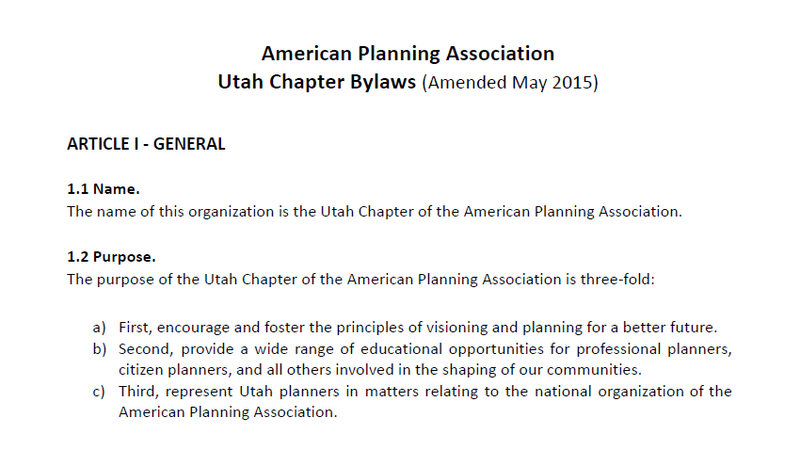
Current Bylaws:

Slide 9
Current Structure:
Professional Development Committee Chair (PDO) | Bruce Parker
Program Committee Chair | Chris Hupp
Legislative Committee Chair | Wilf Sommerkorn
Historian Committee Chair | Michael Maloy
Citizen Planner Committee Chair | Scott Hill
Student Rep | Tanner Visnick
Awards Committee
Education Committee;
Newsletter Editorial Board | Ted Knowlton
Small Cities
Professional Affiliations | Susie Petheram
Webmaster
Legal Committee;
Technology Committee
Sustainability Committee
Emerging Planners Group | Mackenzie Johnson
Central Utah Representative
Northwest Utah Representative
Northeast Utah Representative
Southeast Utah Representative
Southwest Utah Representative
ELECTED POSITIONS
President | Jason Boal
Vice President | Meagan Booth
Secretaty | David Rodgers
Tresurer | Mike Gottfredson
Past President | Tippe Morlan
Wasatch Back | Jamie Baron
North | Brian Carver
Central East | Matt Cazier
Southeast Utah Representative | Todd Thorne
Southwest Utah Representative | Cody Christensen
Central West/ SLC | Tayler Jensen
Central South
Utah County | Patrick O’Brien

Slide 10
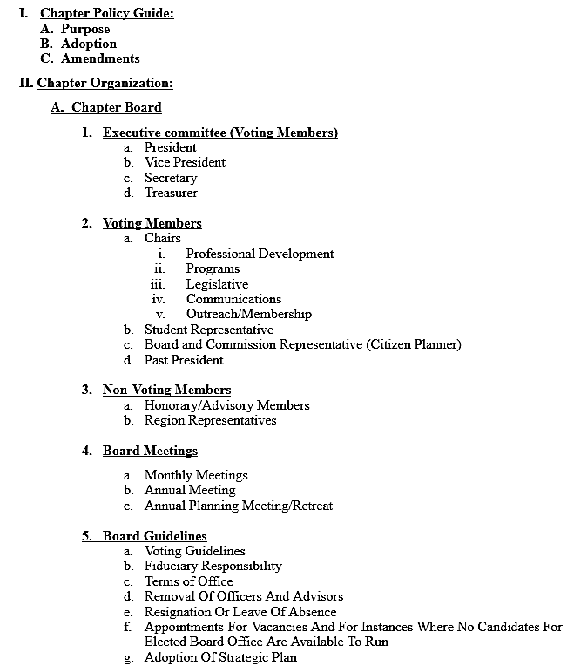
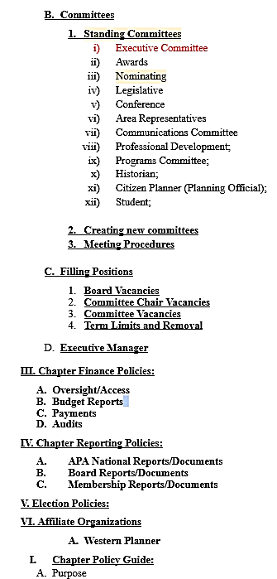
APA Utah Handbook:

Slide 11
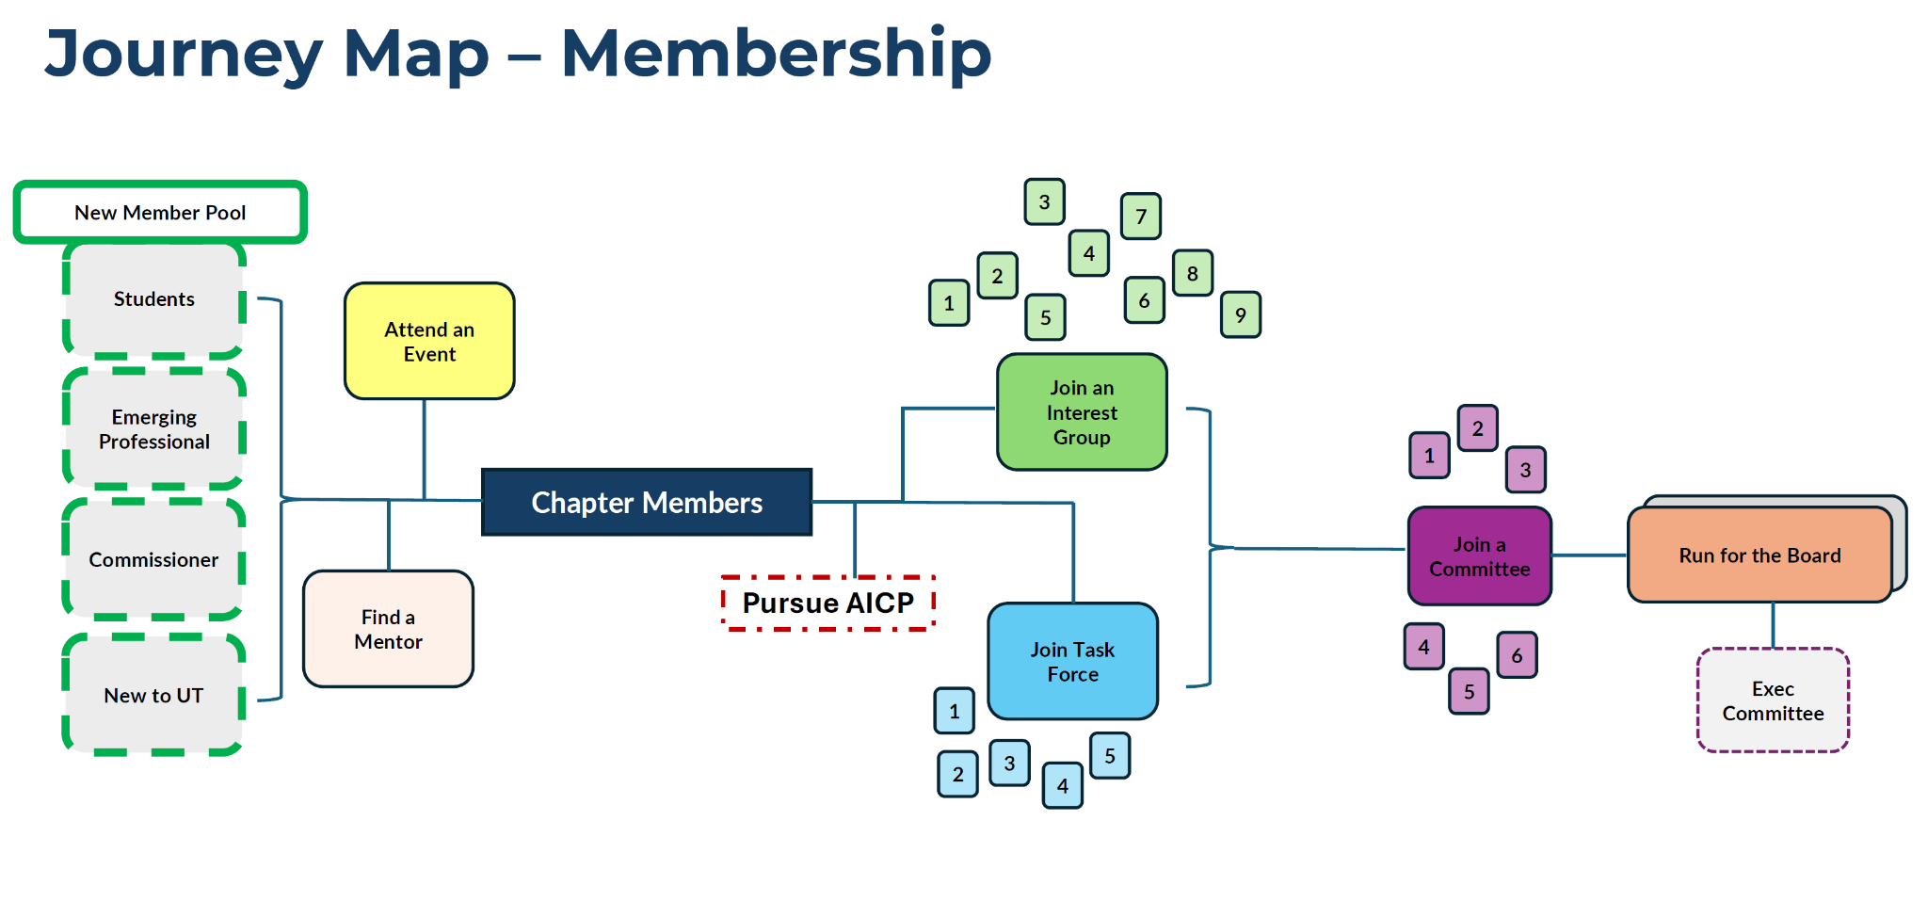
APA Utah Membership Growth Path:

Slide 12
APA Utah Issues We Are Considering:
Organizational Structure
Committee Structure
Board Structure
How Leadership is Selected
How is work divided?
How to make involvement from the membership easy and effective?
Regrouping for effectiveness (add/subtract/sub-areas)?
Committee vs Groups/Divisions vs Workgroup?
How to define board Member roles/responsibilities?
Parliamentary vs. Presidential System?

Slide 13
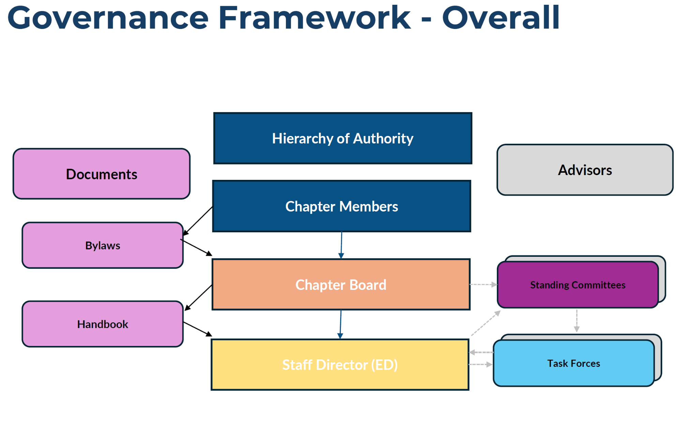
Governance Framework:

Slide 14
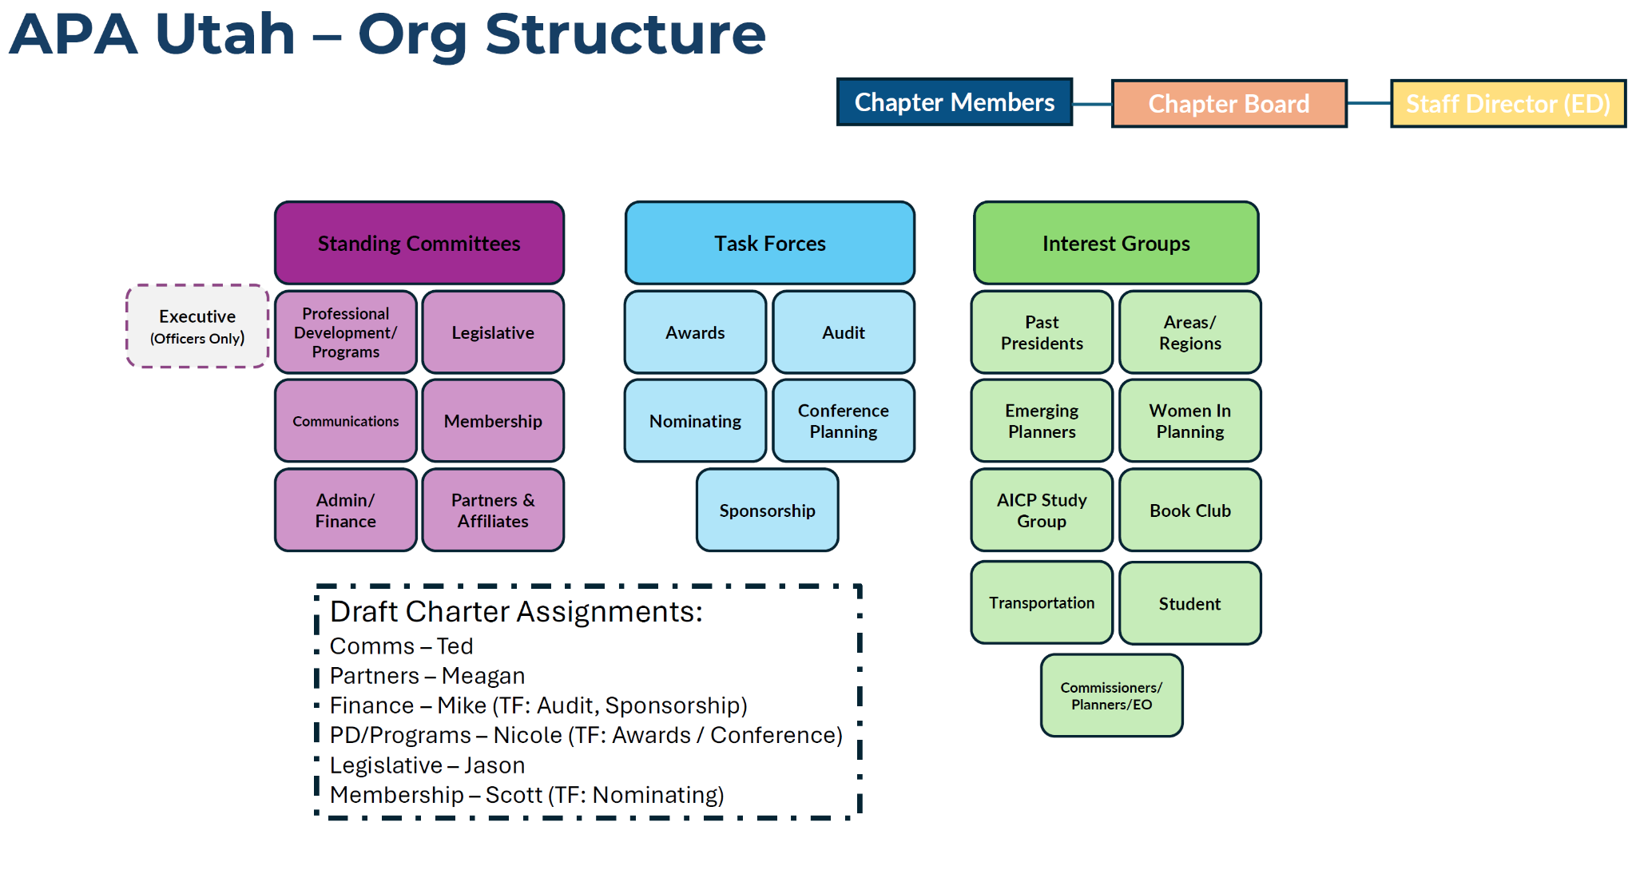
Organizational Structure:

Slide 15
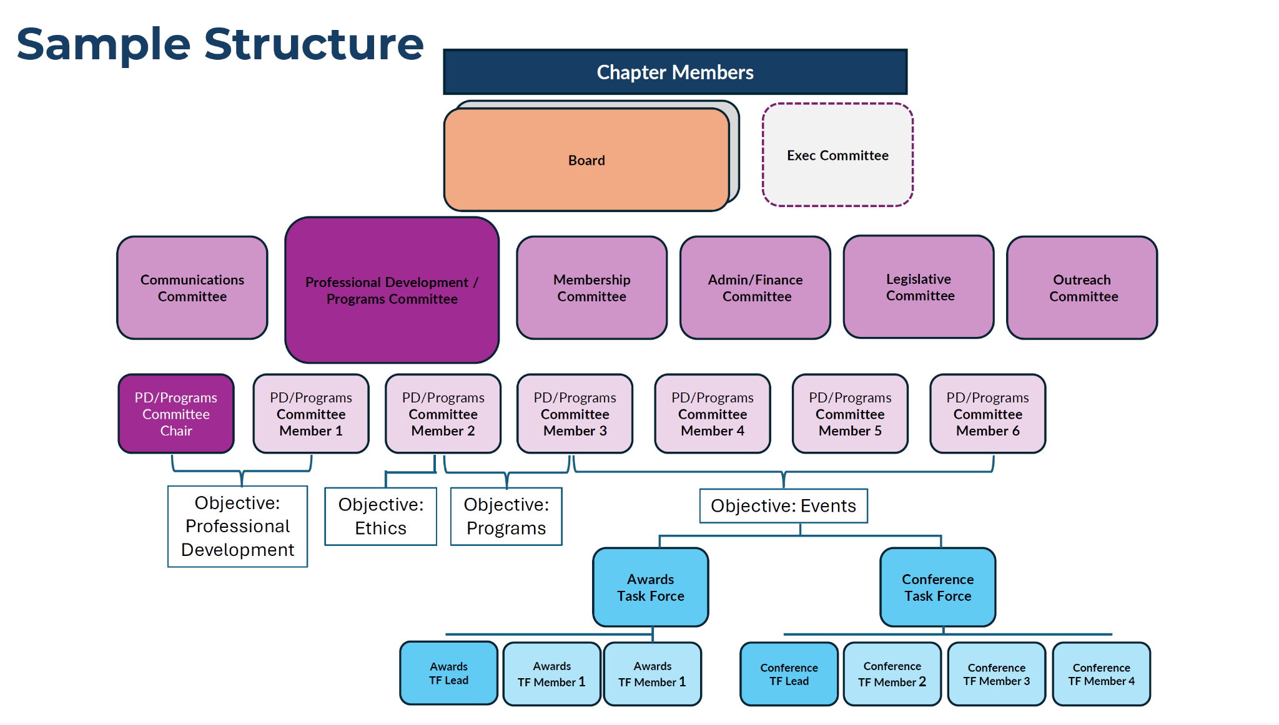
Committee Structure:

Slide 16


How Leadership is Selected:
Presidential System (current)
Membership elects President, Vice President, Secretary, Treasurer
Chair and other leadership positions are appointed
Two (2) year term
President, with support from the Board leads organization
Parliamentary System
Membership elects five (5) to nine (9) Board
Board appoints roles among themselves
Two (2) to three (3) year term
Board leads organization

Slide 17



Do not edit
How to change the design
Join at slido.com #1986167
Presenting with animations, GIFs or speaker notes? Enable our Chrome extension
Notes:
📣 This is Slido interaction slide, please don't delete it. ✅ Click on 'Present with Slido' and the joining instructions will appear when you get to this slide.

Slide 18


Question 1: Preference on electing APA Utah’s Leadership?
Option A: Elect four specific officers — President, Vice President, Secretary, and Treasurer. Committee chairs and other positions are appointed.
Option B: Elect five (5) to nine (9) Board Members. The Board then assigns officer roles and appoints committee chairs.

Slide 19

Do not edit
How to change the design
Preference on electing APA Utah’s Leadership?
Presenting with animations, GIFs or speaker notes? Enable our Chrome extension
Notes:
📣 This is Slido interaction slide, please don't delete it. ✅ Click on 'Present with Slido' and the poll will launch automatically when you get to this slide.

Slide 20

Question 2:
What Social, Special Interest and Professional Groups would you like to participate in? (transportation planners, regional area, sustainability, professional level, employer, etc.)

Slide 21

Do not edit
How to change the design
What Social, Special Interest and Professional Groups would you like to participate in? (transportation planners, regional area, sustainability, professional level, employer, etc.)
Presenting with animations, GIFs or speaker notes? Enable our Chrome extension
Notes:
📣 This is Slido interaction slide, please don't delete it. ✅ Click on 'Present with Slido' and the poll will launch automatically when you get to this slide.

Slide 22

Question 3:
What should APA Utah remember or consider as we explore our governance?

Slide 23
Do not edit
How to change the design
What should APA Utah remember or consider as we explore our governance?
Presenting with animations, GIFs or speaker notes? Enable our Chrome extension
Notes:
📣 This is Slido interaction slide, please don't delete it. ✅ Click on 'Present with Slido' and the poll will launch automatically when you get to this slide.

Slide 24
Question 4:
How can APA Utah provide better value and benefit to you?

Slide 25

Do not edit
How to change the design
Audience Q&A
Presenting with animations, GIFs or speaker notes? Enable our Chrome extension
Notes:
📣 This is Slido interaction slide, please don't delete it. ✅ Click on 'Present with Slido' and the questions from your audience will appear when you get to this slide.

Slide 26
Question 5:
What are some ideas to consider that would create a better result as we go through this process together?

Slide 27
Do not edit
How to change the design
Audience Q&A
Presenting with animations, GIFs or speaker notes? Enable our Chrome extension
Notes:
📣 This is Slido interaction slide, please don't delete it. ✅ Click on 'Present with Slido' and the questions from your audience will appear when you get to this slide.

