Slide 1
Shoot for the Moon
Even if you miss, you’ll land on an
implementable dark sky ordinance…
APA Spring Conference 2025

Slide 2
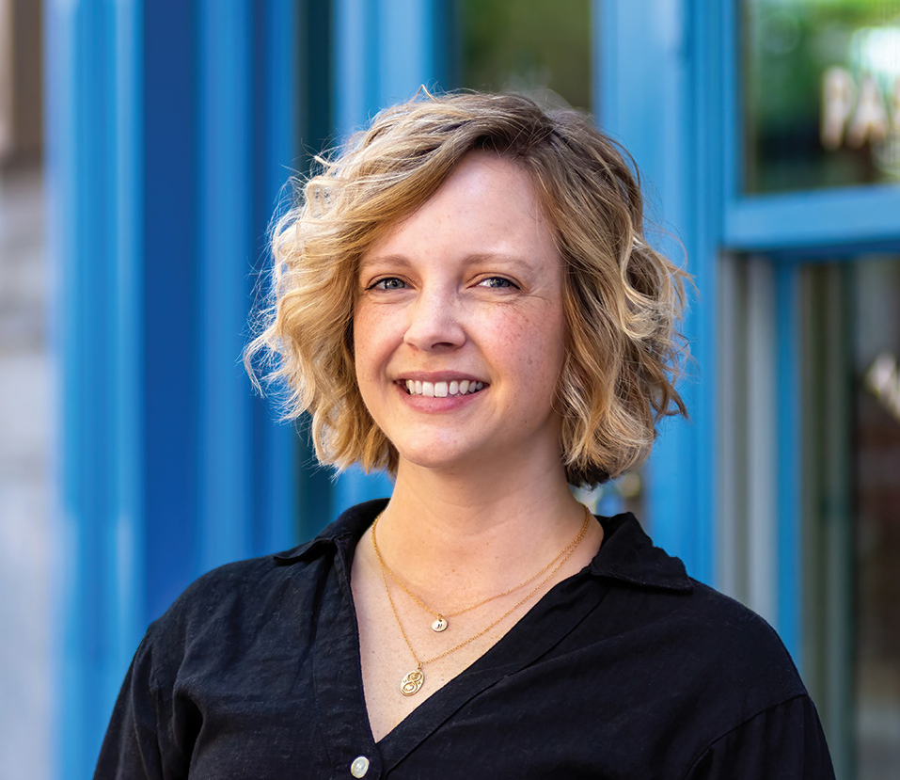
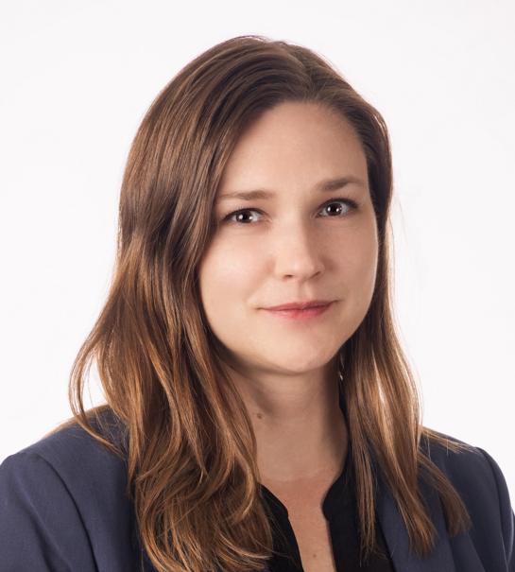
Liz Jackson – Moderator, Planner at GSBS Architects
Rebecca Ward, AICP –
Planning Director at Park City Municipal

Slide 3
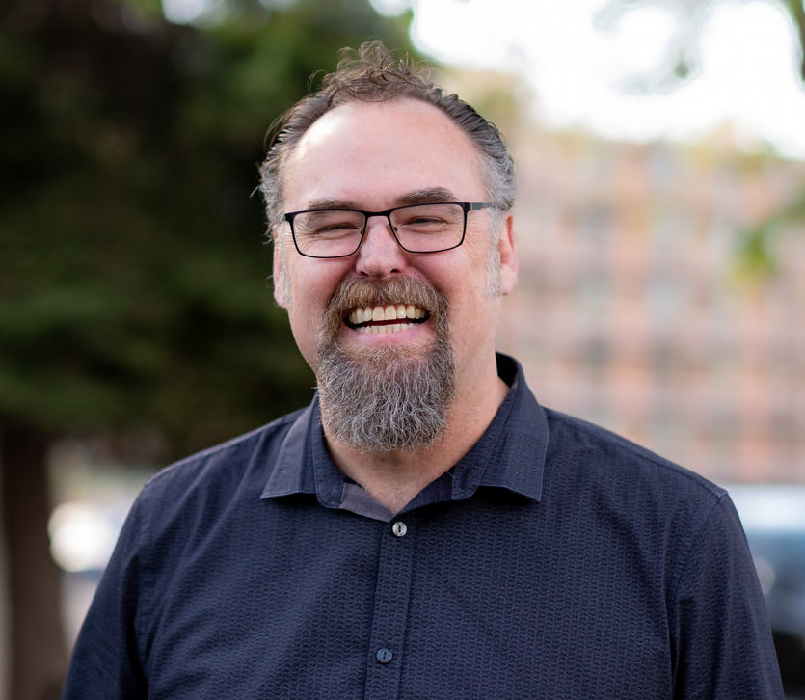
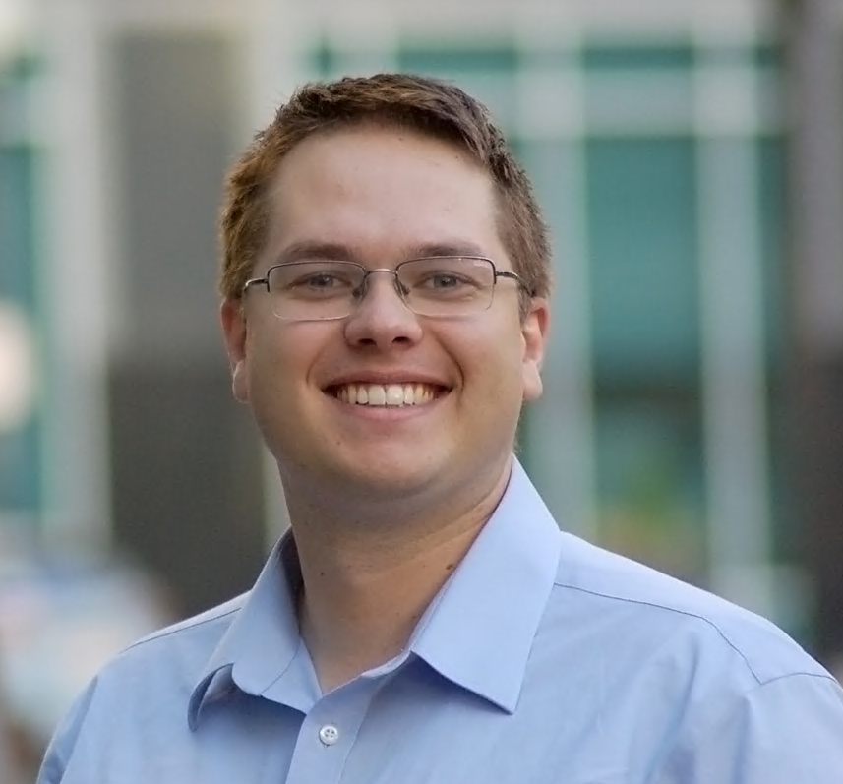
Dane Sanders, PE, LEED AP –
President and CEO at Clanton & Associates
Jeff Coons – Landscape Architecture Staff
at GSBS Architects

Slide 4
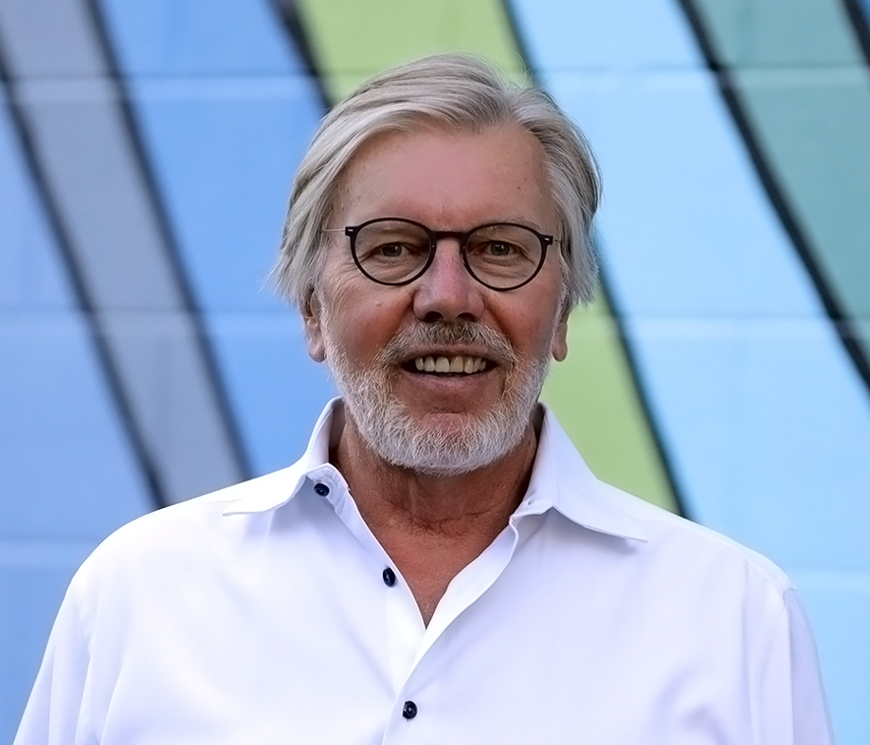
David Brems, FAIA –
Principal at GSBS Architects
Matthew Starley, MLA –
Long Range Planner II at Greater
Salt Lake Municipal Services District

Slide 5
Let’s Get This (Star) Party Started

Slide 6
Discussion Point #1 –
Your profession
and the night sky

Slide 7
Discussion Point #2 –
Experience implementing a dark sky ordinance(s)

Slide 8
Discussion Point #3 –
Successes and challenges of adoption – community support, concerns, delays

Slide 9
Discussion Point #4 –
Lessons learned after implementation

Slide 10
Discussion Point #5 –
Final “words to the wise”

Slide 11
Q & A

Slide 12
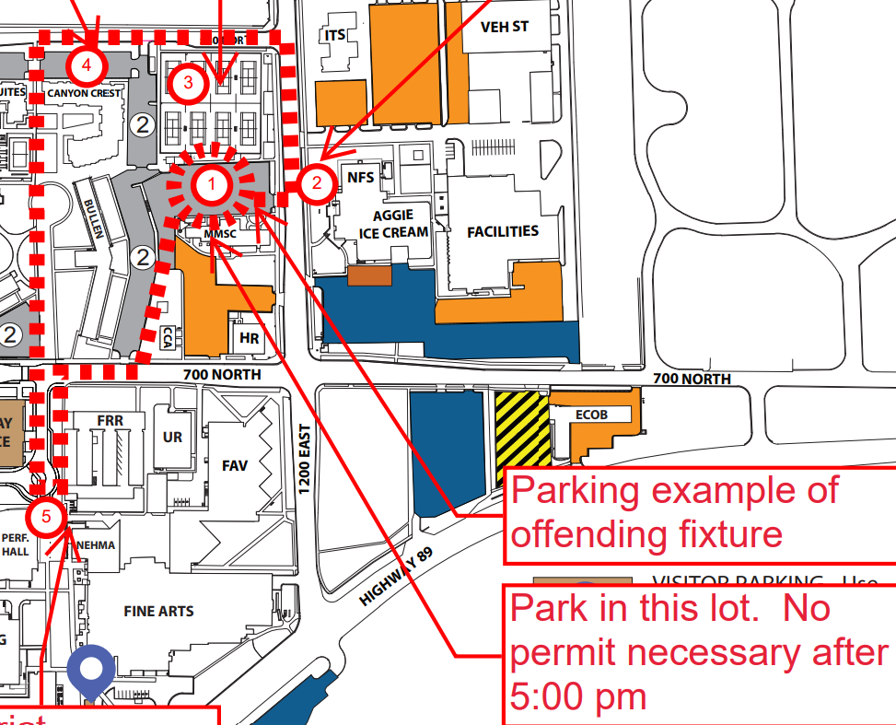
Please join us tonight for the Utah State University night sky light fixtures walking tour
8:00 PM starting at the USU Tennis Courts (approx. 745 N 1200 E)

Slide 13
Thank You!
Your community’s destiny
is written in the stars

