Slide 1
2025 LAND USE/ HOUSING LEGISLATIVE SUMMARY

Slide 2
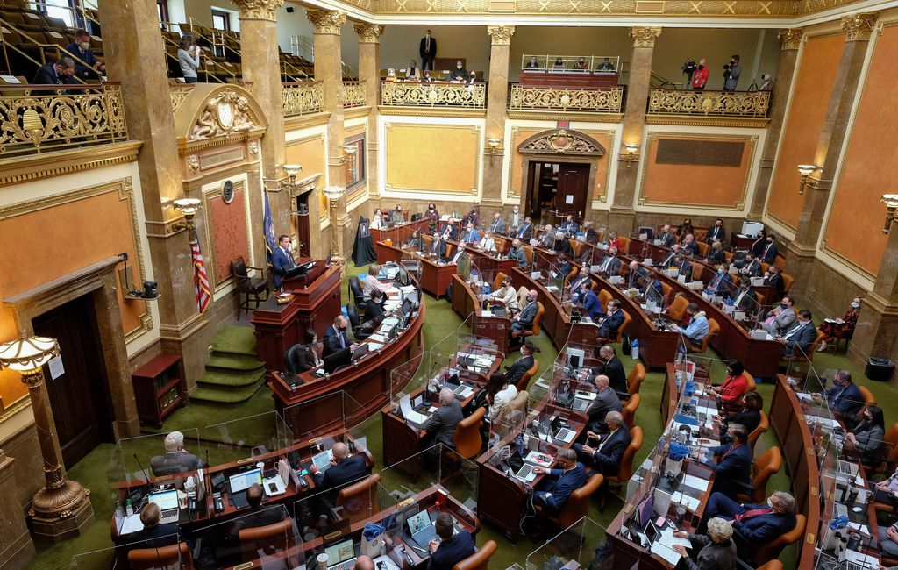
So Much New Added!
Other State Code Sections:
15A – State Fire and Construction
71A – Veterans and Military Affairs
79-6 – Utah Energy Act
35A-8 – Housing & Comm. Devel.
63N – Economic Opportunity Act
53B – Higher Education
19-5 – Water Quality Act
10-8 – Powers of Municipalities
17C – Community Development
11-41 – Retail Incentive Payments
53-29 – Security Improvements
Housing/Land Use
40 bills introduced, 25 passed
765 lines of code added to LUDMA (780 in county LUDMA)

Slide 3
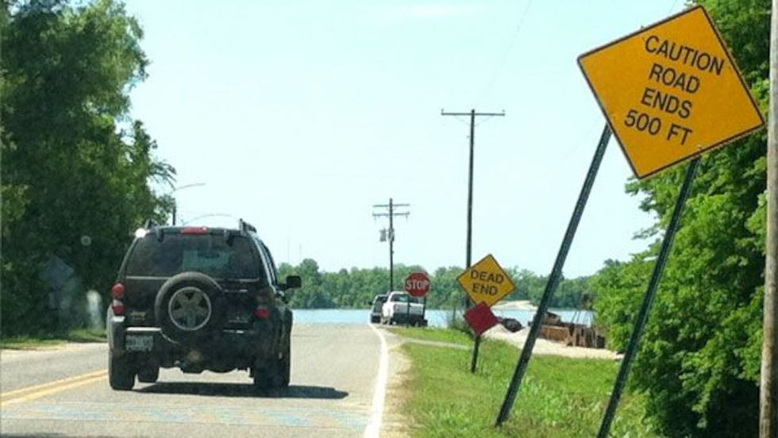
General Plans
Transportation and Traffic Circulation Element (SB195)
All communities in Metropolitan Planning Organizations (MPOs)
“identify priority connections to remedy physical impediments … that would improve circulation…”
Include cost estimates, potential funding sources, impediments to constructing
To be completed by July 1, 2027
MPO to provide annual reports to Transportation Interim Committee

Slide 4
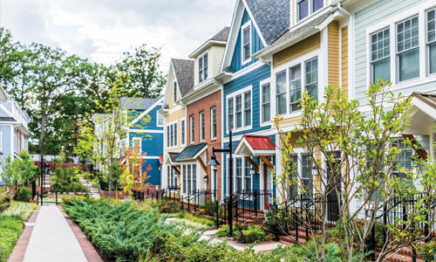
General Plans
Moderate Income Housing Element (HB37)
Creates Affordable Home Ownership Density Bonus option in LUDMA Section 5
Implementing an HTRZ, HOPZ, FHIZ, UHIP, Density Bonus – 3 years compliance

Slide 5
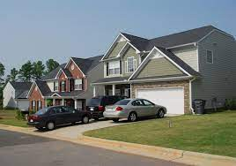
Local Ordinance Amendments
Provisions for identical housing plans (HB368)
Public hearings for variances, LU appeals prohibited (HB368)
Parking standards for 1- and 2- family units, townhomes in MIHP cities (SB181)
Street, fire improvements required for building permits, COs (HB368)
Inspections and bond releases for public improvements, landscaping (HB368)
Issuance of building permits, COs relating to landscaping (HB368)
TDR provisions, transfer outside of jurisdiction must have agreement (HB368)

Slide 6
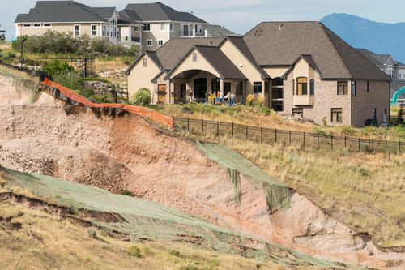
Local Ordinance Amendments
Storm water runoff controls, permits, inspections (SB220)
Property line adjustments – extensive changes (SB104)
Counties – high tunnels exempt (HB435)
Counties – minor subs now 50 acres, 500 ft. (HB255)
Gravel pit regulation – limited (HB355)
Process for determination of similar, unlisted business uses – flawed! (SB179)

Slide 7
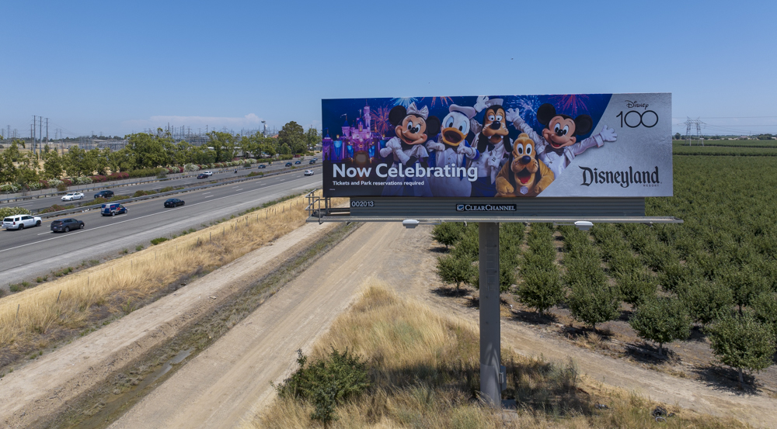
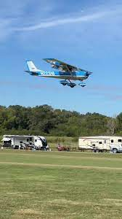
LU Administration
Mailing of notices for general code changes (HB368)
Notify properties within 2,500 ft of private airport runway (HB44)
Billboard relocations due to highway construction (HB198)
Short-term rentals enforcement, licensing (HB256)
No withholding building permits, COs for landscaping plans, installation (HB368)
Timelines for deeming applications complete, plan resubmittals, plan reviews (HB368)
Rules for release of bonds for infrastructure, landscaping (HB368)

Slide 8
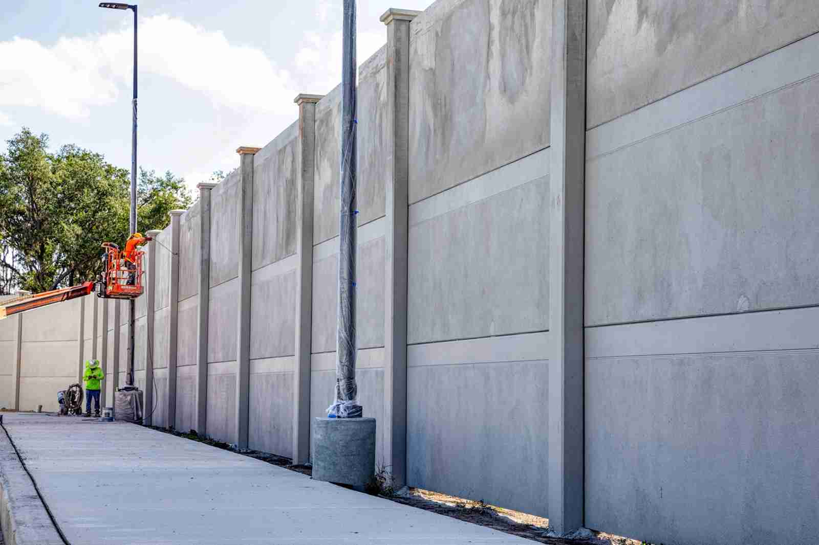
LU Administration
Changes to FHIZ program (SB23)
Changes to HTRZ program (SB26)
Station Area Plan reporting changes (SB195)
Changes to use of housing set-aside funds, CRA funds (SB250)
Cannot charge water districts with certified inspector permit fees (HB550)
Certified security improvements exempt from local LU regs (SB340)
Annexation process changed for Salt Lake County (HB368)

Slide 9
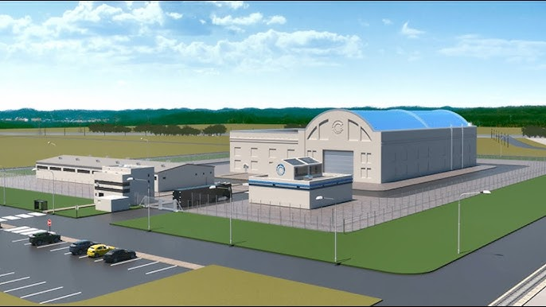
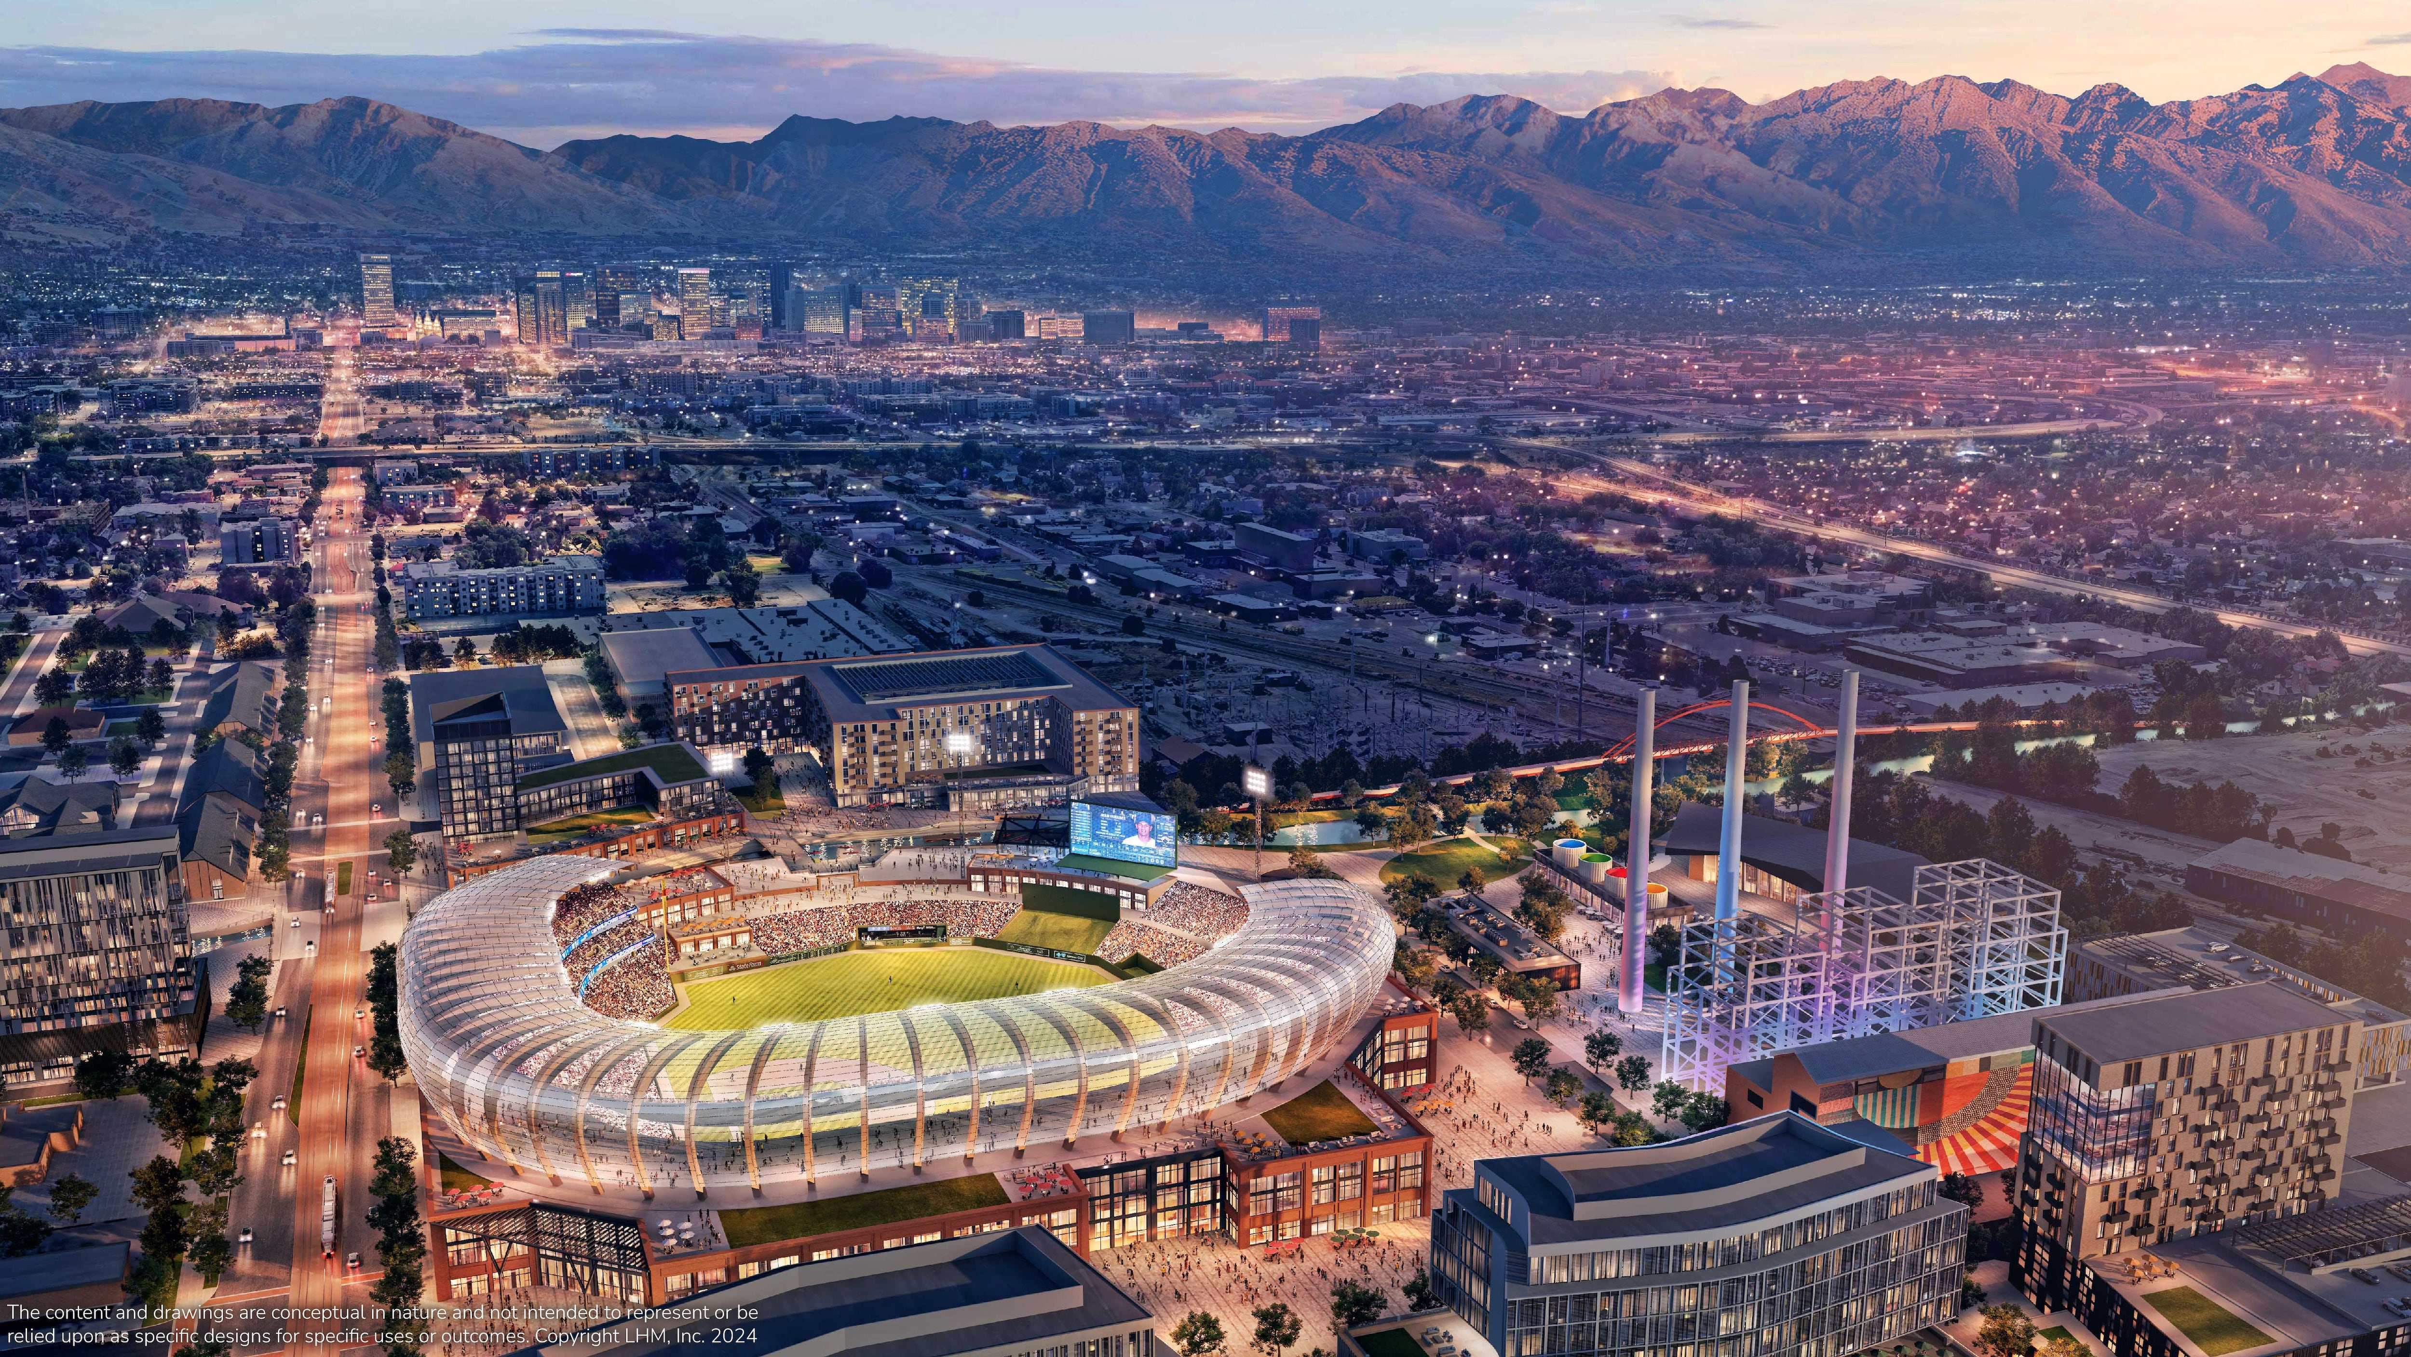
Other Planning Legislation
Electrical Energy Development Zones (HB249)
Development/Redevelopment of University property (SB129)
Convention Center renovation (SB26)
UDOT oversight of local transportation planning (SB195)
Sports stadium oversight and funding (SB333, SB336)

Slide 10
Coming Next Year?
Beehive Development Authority?
More zoning reform? (HB88, HB90, SB262)
Correct process for similar, unlisted businesses
Annexation?
Gravel pits?
State Housing Plan

