Slide 1
ADVANCING MITIGATION AND RESILIENCE IN UTAH
IT STARTS WITH A PLAN!
Notes:
Welcome!

Slide 2
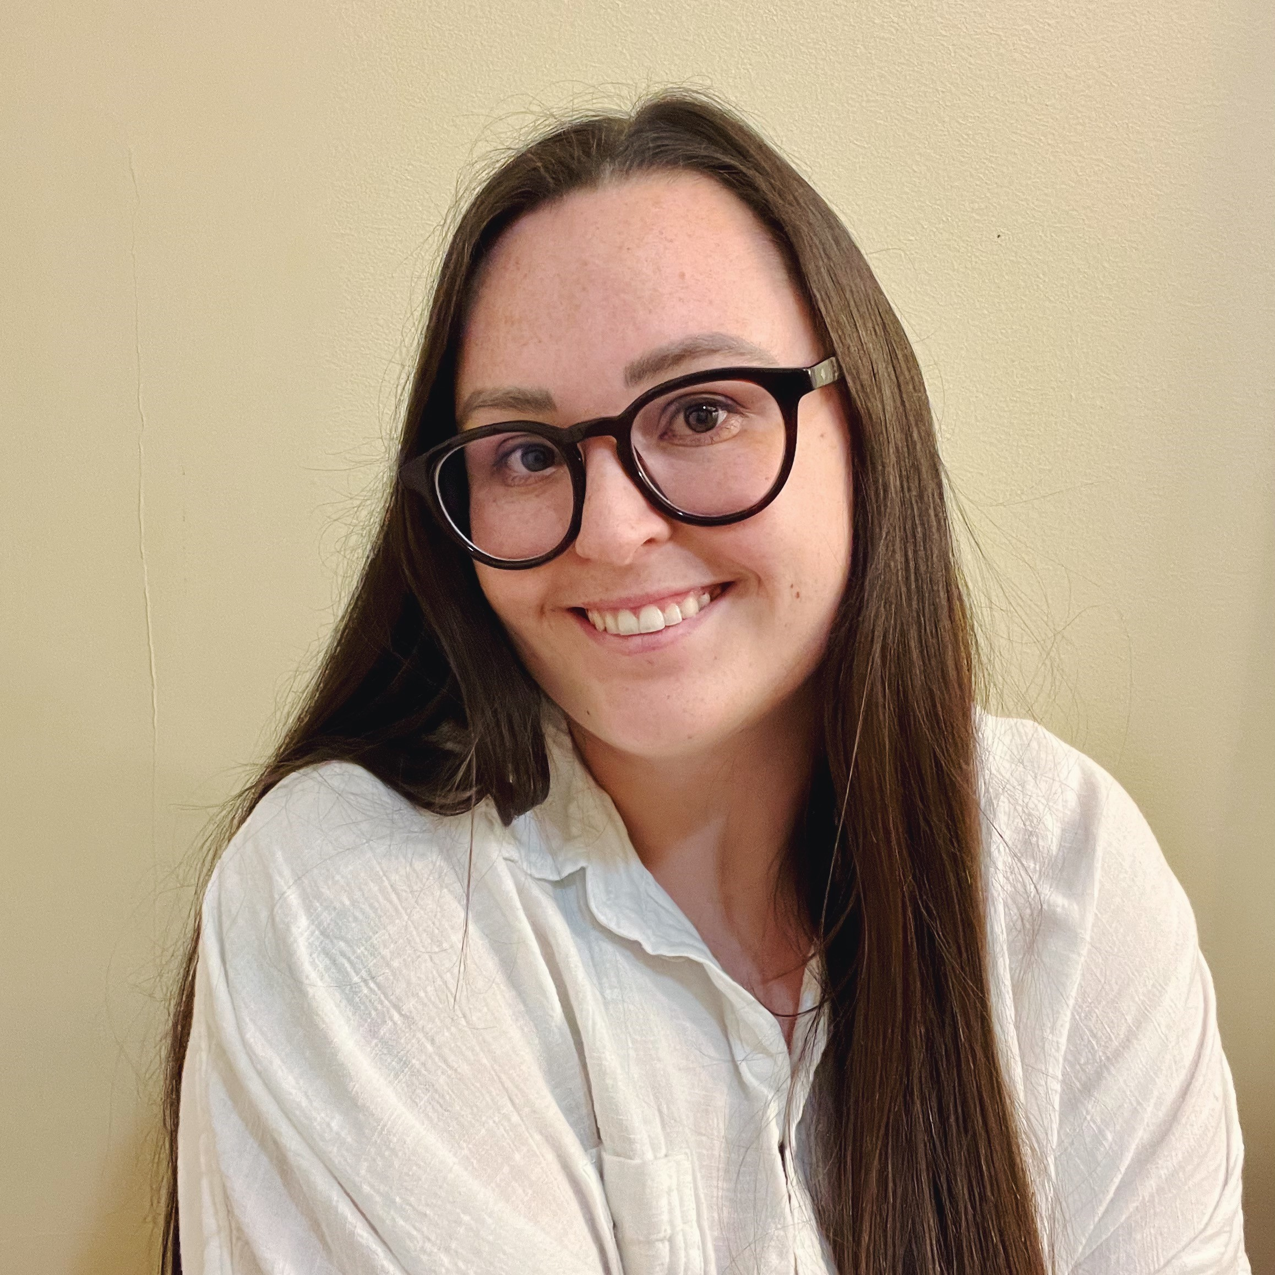

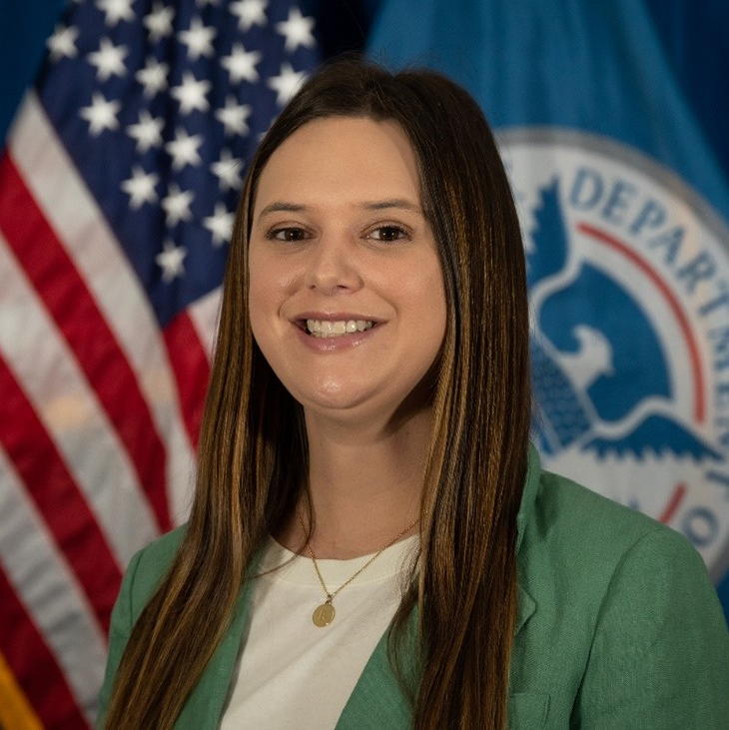
Maranda Miller
Post-Disaster Mitigation Coordinator
The Utah Division of Emergency Management
Logan Sand
Community Planning Section Chief
FEMA Region 8
Brooke LaPlaca
Program Analyst
FEMA Region 8
Notes:
Self introductions

Slide 3
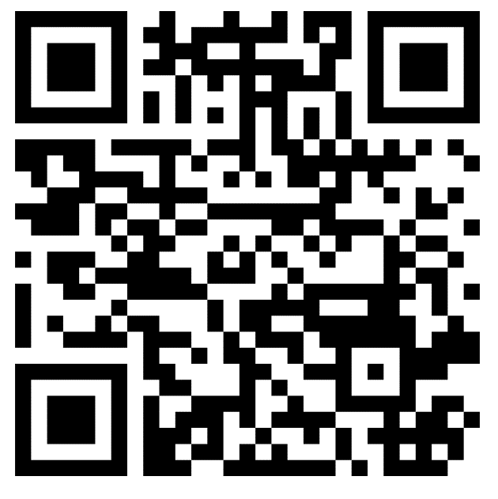
HAZARD MITIGATION PLANNING
AUDIENCE POLL
Poll Questions!
What word or phrase comes to mind when you think of Hazard Mitigation Planning?
Have you ever participated in a Hazard Mitigation Plan before?
Join at menti.com
use code: 2915 4462

Slide 4
SESSION OBJECTIVES
KEY TAKEAWAYS
Overview of hazard mitigation planning
Utah’s State Hazard Mitigation Plan
Roles of planners and call to action
Mitigation investment opportunities

Slide 5
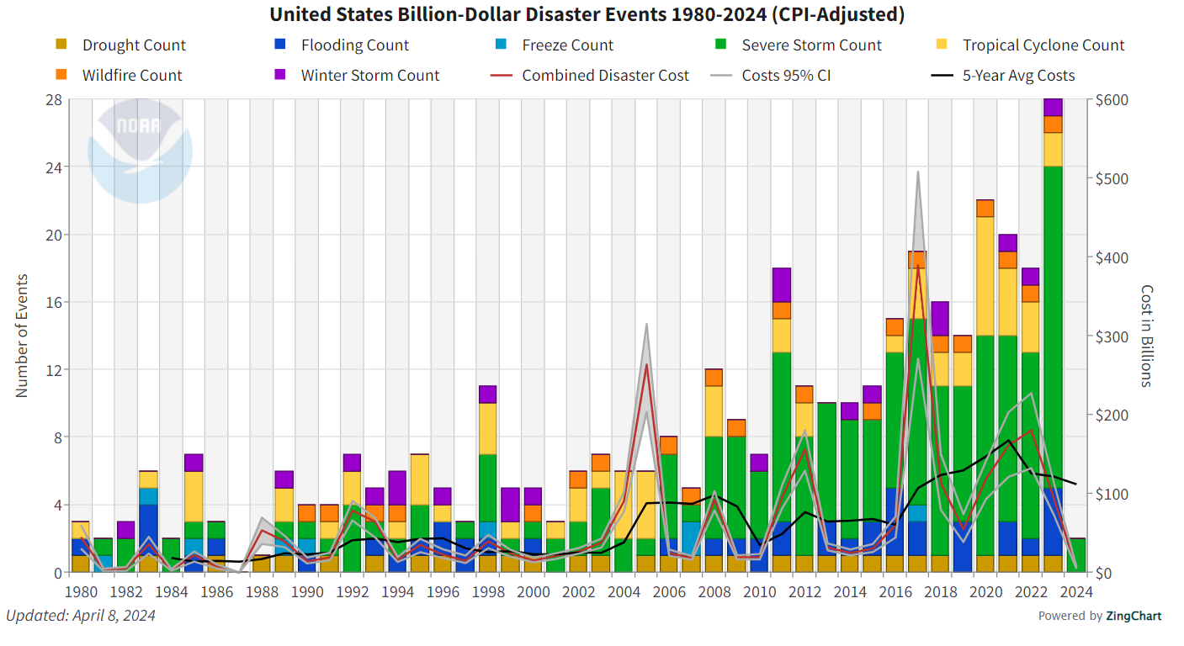
BREAKING THE DISASTER CYCLE
Source: National Centers for Environmental Information (NCEI) (noaa.gov)

Slide 6
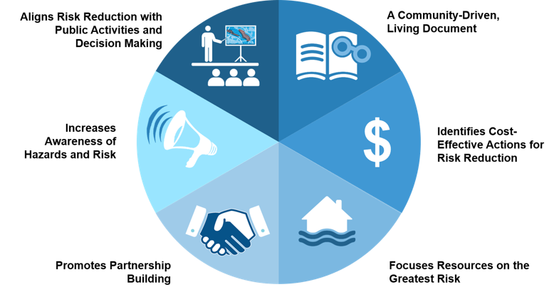
HAZARD MITIGATION PLANNING
THE BASICS
Any sustained action taken to reduce or eliminate the long-term risk to human life and property from hazards.
Notes:
First, let’s go over some basics. ​
Hazard mitigation is defined in the Local Mitigation Planning Policy Guide as any sustained action taken to reduce or eliminate the long-term risk to human life and property from hazards.​
Focus is on natural hazards
Serves as a roadmap for states to reduce risk and vulnerabilities to hazards​ and builds resilience by mitigating potential impacts to community lifelines.
Guides risk-informed decision-making​.
Updated every 5 years to reflect changes in development, progress on mitigation actions, and shifts in both state and local priorities.
Requirement to unlock specific funding opportunities.

Slide 7
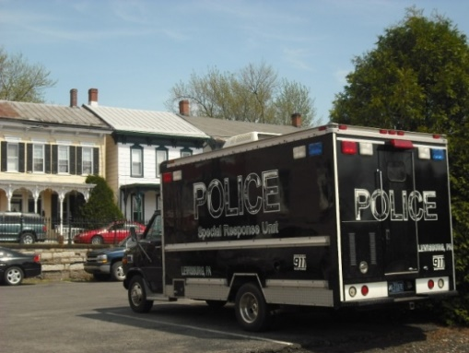

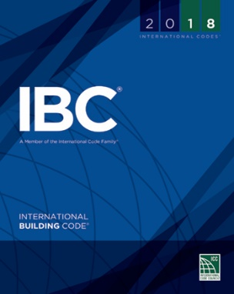
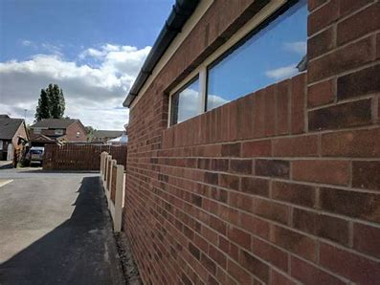
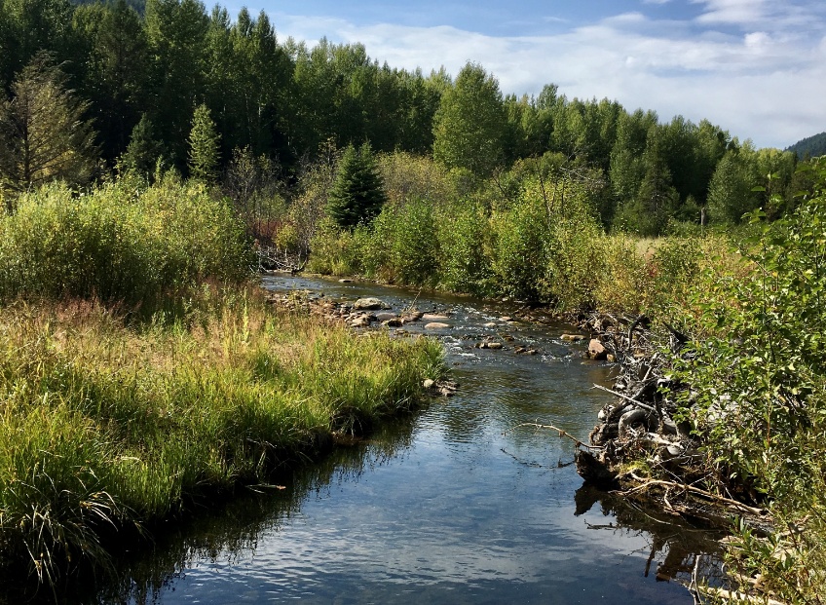
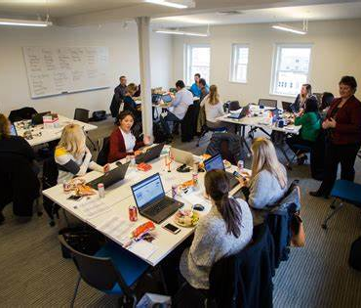
MITIGATION ACTION CATEGORIES
EXAMPLES
Preparedness and Response: Purchasing a Police Command Vehicle
Local Plans and Regulations
Government authorities, policies, or codes that influence the way land and buildings are developed and maintained
Structure and Infrastructure Projects
Modifying existing infrastructure to remove it from a hazard area or construction of new structures to reduce impacts of hazards
Natural Systems Protection
Education and Awareness Programs
Actions that minimize damage and losses and preserve or restore the functions of natural systems
Sustained programs to educate the public and decision makers about hazard risks and community mitigation programs
Mitigation: Adopt a building code or WUI code, or develop a landscaping ordinance for water conservation
Mitigation: Retrofit URM buildings
Mitigation: Stream restoration for flood storage and groundwater recharge.
Mitigation: Host a community workshop on the Fix the Bricks Program.

Slide 8

COMMUNITY LIFELINES
FUNDAMENTAL SERVICES
Lifelines are another way to think about critical assets.​
These are the most fundamental services in the community.​
If a lifeline is disrupted, decisive intervention is required to stabilize it.

Slide 9
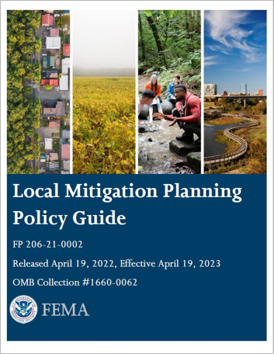
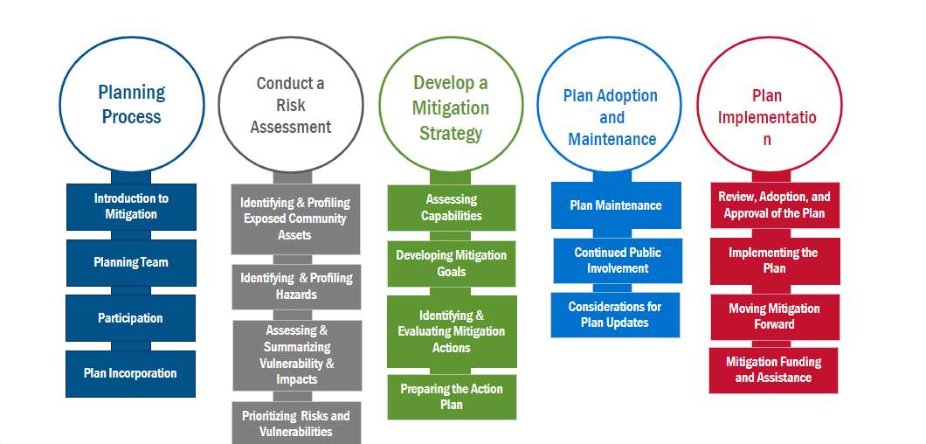
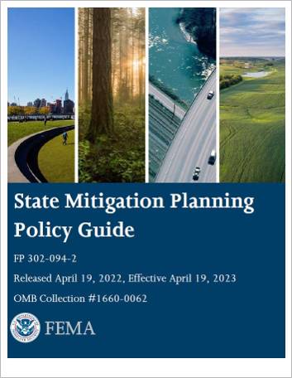
HAZARD MITIGATION PLAN STAGES
COMPONENTS

Slide 10
HAZARD MITIGATION PLANNING
WHO LEADS THE CHARGE?
STATE
Efforts led by state
Standard Vs. Enhanced ​
  Extra 5% in HMGP funds after a disaster​.
  HMA performance requirements​.
  Integration with other state and regional planning initiatives.
  Demonstration of capacity and resources to build state-wide resilience.
LOCAL
Efforts led by local jurisdictions
  County, municipality, city, town, school district, conservation district, etc.

Slide 11
WHOLE COMMUNITY APPROACH
SECTORS OF RESILIENCE
Hazard Mitigation Plan
Emergency Management​
Health and Social Services
Land Use and Development​
Economic Development​
Housing​
Infrastructure​
Natural and Cultural Resources

Slide 12
THE PARTNERS AND STAKEHOLDERS
INTERDISCIPLINARY PARTICIPATION
STATE
State Climatologist
State agencies and experts on population demographics
  Permanent and transient populations
  Specific gaps in social vulnerabilities
  Underserved communities
State geologists, floodplain managers, state NFIP Coordinator
  Hazard-specific data
LOCAL
Agencies involved with hazard mitigation activities
Agencies with authority to regulate development
Neighboring communities
Representatives of businesses, academia, and other private organizations
Representatives of nonprofit organizations, including community-based organizations, that work directly with and/or provide support to underserved communities

Slide 13
ENHANCED PLAN COMPONENTS
COMPREHENSIVE MITIGATION DEMONSTRATION
Enhanced Prerequisites
  Grants Management Performance Requirements
Integrated Planning
  Demonstrated history of integration with a wide range of agencies and stakeholders with mitigation capabilities and/or shared objectives to reduce risks from future natural hazards and increase resilience in the state, including underserved communities.
Demonstrating a Commitment to a Comprehensive State Mitigation Program
  Provide evidence that they are successfully implementing programs, actions and/or projects that reduce exposure to hazards.
Effective Use of Existing Mitigation Programs
  Demonstrated use of a wide array of opportunities to achieve its mitigation goals, including state and federal programs beyond FEMA funding.
Documentation of State’s Implementation Capability
  Established criteria and processes for making decisions with respect to allocating resources toward mitigation actions, projects and initiatives.

Slide 14
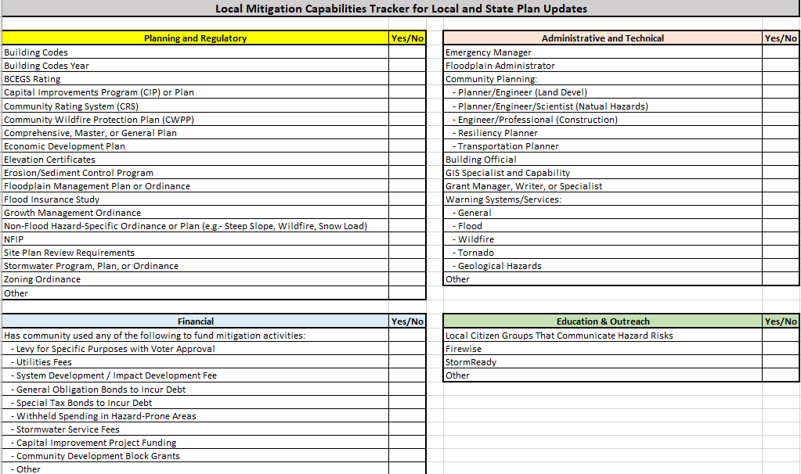
CAPABILITY ASSESSMENT
WHAT GETS ROLLED UP

Slide 15
FUNDING
Federal Funding Opportunities Unlocked by HMPs

Slide 16
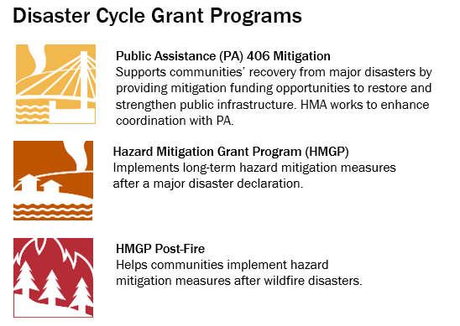
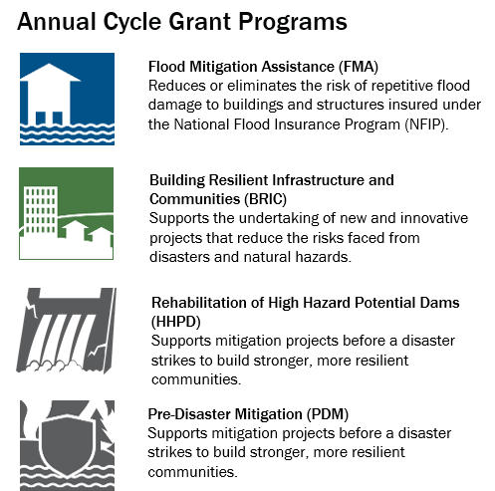
FEMA HAZARD MITIGATION ASSISTANCE (HMA)
PROGRAM OVERVIEW
*New: Safeguarding Tomorrow Revolving Loan Fund Program*
Notes:
PDM is now Congressionally Directed Spending

Slide 17
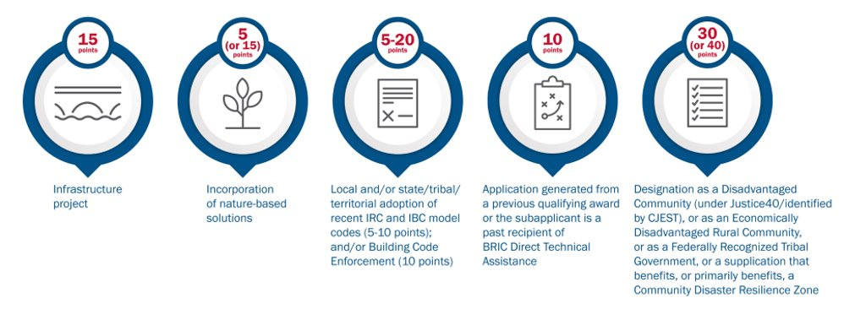
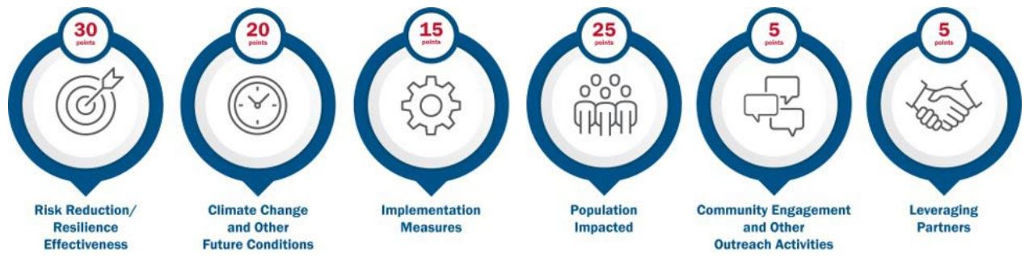
BRIC FY23 CRITERIA AND POINT VALUES
Technical Criteria: Project receives the specified points allotted or zero points for each criterion.
Qualitative Criteria: Project receives points based on to what degree they meet the criterion.
Notes:
These criteria are subject to change with each NOFO.

Slide 18
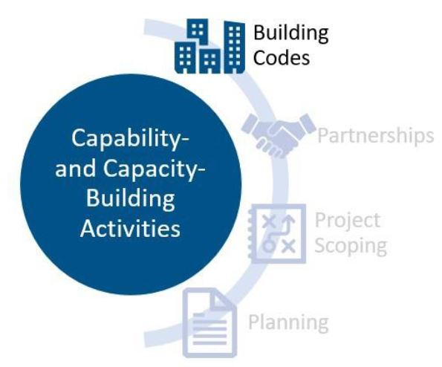
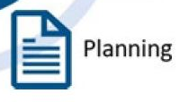
CAPABILITY AND CAPACITY BUILDING
PLANNING AND BUILDING CODE ACTIVITIES
PLANNING
Comprehensive or Master Plan
Water or Integrated Water Resources Master Plan
Climate Plan
Land Use Policies, Ordinances and Other Regulations
  Land use codes, grazing policies, subdivision and site design standards
BUILDING CODES
Adoption, Administration, and Enforcement Activities
  Improve or modify current or existing building code requirements to reflect the latest code edition, exceed the latest code edition, or develop or modify building code–coordinated requirements.

Slide 19
HAZARD MITIGATION PLANNING AND FUNDING
REQUIREMENT OVERLAP
Tribal Hazard Mitigation Plan
Capabilities Assessment
Community and Stakeholder Engagement + Continued Involvement
Climate Change and Future Conditions Considerations
Leveraging Partnerships
Mitigation Actions
Local Hazard Mitigation Plan
Grant Application Criteria
State Hazard Mitigation Plan

Slide 20
THE UTAH STATE HAZARD MITIGATION PLAN
Enhanced Status

Slide 21
2024 STATE HAZARD MITIGATION PLAN
PLANNING PROCESS
Questionnaires/Surveys
  Conferences
  Newsletters
  Social media
  Various websites
Focus Groups
Open Houses
  Virtual option
Online Draft Plan
  Open public comment period
Notes:
Questionnaires
1 emergency managers and local government. 45 complete and 28 partial responses for a total of 73 responses.
2 public – gauge public information on hazard concerns and perceptions. There were 407 complete and 183 partial responses for a total of 590 responses. Available in Spanish and paper copy.
APA website and DEM website
Focus Groups - The focus group meetings began with introductions and a presentation on the progress of the hazard mitigation plan. After the presentation, the two focus groups were asked a series of questions to help guide the discussion and better understand how the SHMP update can help the communities that their agency either represents or works closely with.
Focus Group #1 - Equitable Communities
Focus Group #2 - Association of Governments, Emergency Managers and Planners
Open Houses
368 people “visited” the virtual open house. No comments were provided.
Draft Plan
The review period provided a month-long window and several different avenues for the public to review the plan and provide any comments. This involved the use of an online platform to host the draft plan from October 16 – November 20. During this time period 298 people viewed the draft plan online, and 2 comments were left for the project team to review and implement.
Pros/Cons
Poor attendance, held too late in the year
Would suggest summer engagement if it can be planned that way
Equitable focus group:
THE UTAH DIVISION OF MULTICULTURAL AFFAIRS
Utah Division of Indian Affairs
Utah Pacific Islander Health Coalition
Pacific Islander Knowledge to Action Resources (PIK2AR)
Comunidades Unidas
Alliance Community Services
Midtown Health
OCA Utah
Project Success Coalition
Black Physicians of Utah
Utah Muslim Civic League
Interfaith Roundtable & LDS Church Gov. & Community Relations
Moab Multicultural Center
Utah State Latinx Center
Encircle
Utah Pride Center
Health Choice Utah
Utah Department of Health & Human Services
Utah Department of Health & Human Services
Refugee & Immigrant Center - Asian Association of Utah
International Rescue Committee
Utah Refugee Services Office
Holy Cross Ministries
New Americans & Immigration - Go Utah
Center for Economic Opportunity & Belonging
Salt Lake City Corporation
NeighborWorks Salt Lake
Governor's Committee on Employment of People with Disabilities & Business Relations
Art Access
Urban Indian Center
Utah NavajoStrong
Salt Lake Valley Coalition to End Homelessness
Ute Indian Tribe
Disability law center
DSPD Utah

Slide 22
2024 STATE HAZARD MITIGATION PLAN
RISK ASSESSMENT AUDIENCE POLL
Poll Question!
Which natural hazard do you think poses the biggest risk for Utah?
Join at menti.com
use code: 2915 4462
Avalanche
Dam Incident
Drought
Geologic Hazards (Problem Soil (radon) and Rock, Landslide, Volcanic)
Earthquake
Flooding
Severe Weather
Space Weather
Wildfire

Slide 23
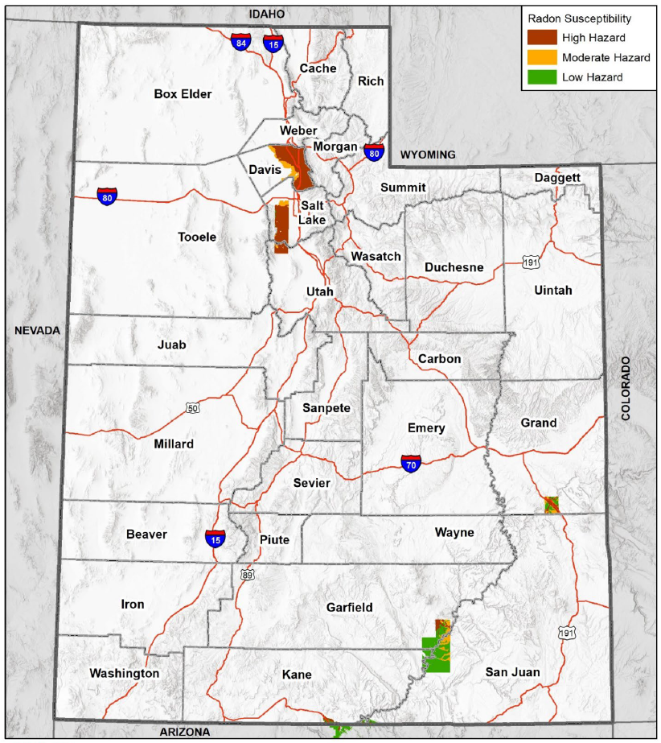
2024 STATE HAZARD MITIGATION PLAN
RISK ASSESSMENT
Avalanche
Dam Incident
Drought*
Geologic Hazards (Problem Soil (radon!) and Rock, Landslide, Volcanic)
Earthquake*
Flooding*
Severe Weather
Space Weather
Wildfire*
Notes:
Between 1973 and 2015, there were approximately 5,630 fatalities in Utah attributable to lung cancer caused by radon gas (based on World Health Organization general estimate that 14% of lung cancer cases are attributable to radon gas). Lung cancer fatalities caused by radon gas are Utah's most deadly geologic hazard.
Radon has been classified as a known human carcinogen and has been recognized as a significant health problem by groups, such as the Centers for Disease Control, the American Lung Association, the American Medical Association, and the American Public Health Association. The U.S. Environmental Protection Agency (EPA) estimates that radon is responsible for about 21,000 lung cancer deaths every year in the U.S.
About 2,900 of the deaths (14.5%) occur among people who have never smoked. Cao and others (2017) revised the EPA estimate, and estimated 15,600 to 19,300 radon-induced lung cancer deaths occur annually in the U.S. Only smoking causes more lung cancer deaths, and smoking combined with radon is a particularly serious health risk. Chances of getting lung cancer are higher from the combination of smoking and radon than from either source alone. Not everyone who is exposed to radon develops the disease, but the chances increase with increasing levels of radon and exposure time. It may take many years for lung cancer to develop.

Slide 24
2024 STATE HAZARD MITIGATION PLAN
INTEGRATED PLANNING
Statewide Planning Network
Utah Disaster Recovery Framework
Catastrophic Housing Plan
Statewide Opportunity Council
Wasatch Front Unreinforced Masonry Strategy
Utah Drought Response Plan
Utah Forest Action Plan
Watershed Plans
Utah Water Resources Plan
Local Hazard Mitigation Plans
Notes:
Local hazard mitigation plans inform risk and development across the state
Integration on other plans

Slide 25
2024 STATE HAZARD MITIGATION PLAN
MITIGATION STRATEGY
Protection of life safety before, during, and after the event of a disaster.
Protection of critical facilities, lifelines, structures, and infrastructure including high-hazard potential dams and state assets.
Eliminate and/or reduce property damage, especially to repetitive loss (RL) and severe repetitive loss (SRL) properties and properties, including those in historic districts.
Advocate, support, and promote the use of state laws and local and tribal regulations and ordinances aimed to mitigate hazards.
Assist and support state, local, and tribal planning efforts before, during, and after the effects of hazard events.
Promote education and awareness programs, campaigns, and efforts designed to encourage citizens, private and public entities, and local, state, and tribal agencies to mitigate against hazards.
Enhance and protect hazard communication, notification, and warning systems
Preserve, protect, and/or restore natural systems, natural resources, cultural resources, and other environmental conditions against hazard events.
Combine hazard loss reduction efforts with other environmental, social, and economic needs of the state through integrated planning and a comprehensive, statewide approach.
Notes:
The 2024 mitigation action plan contains 127 total actions, including 40 new mitigation actions developed during the 2023 update and the 87 actions being carried forward from the 2019 plan

Slide 26
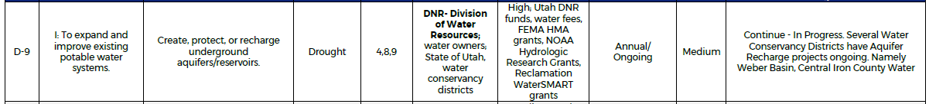
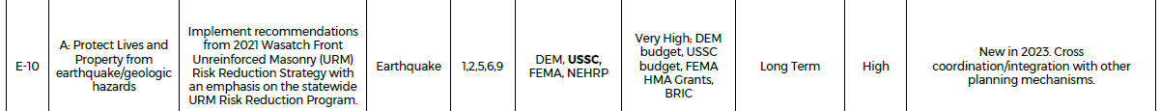
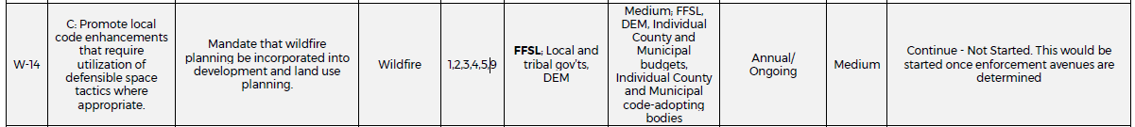
2024 STATE HAZARD MITIGATION PLAN
MITIGATION ACTIONS
Notes:
ALL 12
D-9
E-10
F-6
GH - 8

Slide 27
HMA FUNDING OPPORTUNITIES
Pre-Disaster Grants (on-going)
Building Resilient Communities and Infrastructure (BRIC)
Flood Mitigation Assistance
Pre Disaster Mitigation (PDM)
Post-Disaster Grants (funding from federally declared disasters or wildfires)
Hazard Mitigation Grant Program (HMGP)
Post-Fire HMGP

Slide 28
LOCAL MITIGATION PROJECTS

Slide 29
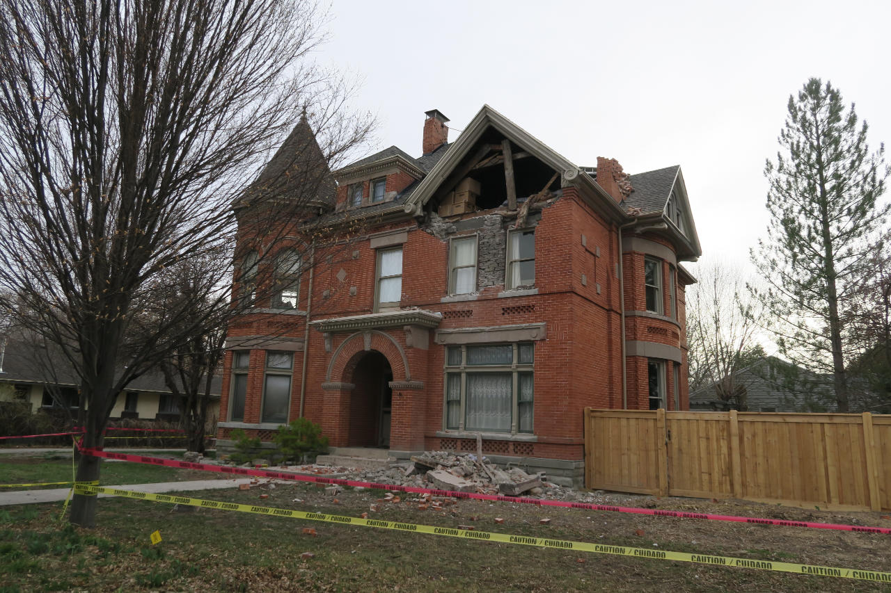
SALT LAKE CITY FIX THE BRICKS
PDM
The program will pay up to 70% of the seismic retrofit of the home.
The project is an intensive education campaign and incentive program to effectively motivate and empower homeowners to add seismic reinforcements to their unreinforced masonry houses as part of routine maintenance.
About 32,000 homes in Salt Lake City are URMs. These single-family homes in SLC require some kind of seismic improvement as a life-saving measure.
As of early 2024, 120 houses have been retrofitted, 80 are in process and over 4,000 are on a waitlist.
Photo: Google Images
Notes:
Fix the Bricks program can pay for up to 70% of the seismic retrofit of your home.
FEMA PDM funding has been key to reducing potential losses, deaths and injury from earthquakes in Utah. PDM awards from 2017 to 2019 totaling roughly $9.5 million helped fund 75% of a project to enhance the Fix the Bricks campaign. The project is an intensive education campaign and incentive program to effectively motivate and empower homeowners to add seismic reinforcements to their unreinforced masonry houses as part of routine maintenance. The Utah URM earthquake threat is ranked in the top five nationally and is the number one threat facing FEMA Region VIII. In Salt Lake City there are approximately 50,00042 single family homes. About 32,000 or 68% of those homes are URMs. Sixty-eight percent of all single family homes in SLC require some kind of seismic improvement as a life-saving measure. Over time the project is helping address the daunting challenge of mitigating the potential collapse of tens of thousands of single-family homes at risk of collapse in the event of a large magnitude earthquake, and reduce the potential for injury and loss of life in smaller events as well. This project has been immensely effective since 2018, not only by raising awareness and providing education and outreach to residents about earthquake safety and URM risk, but by helping retrofit homes for the past six years. As of early 2024, 120 houses have been retrofitted, 80 are in process and over 4,000 are on a waiting list, which is a testament to the interest and need for the program. With the help of this grant, and potentially future BRIC funding, more and more Utah residents are mitigating their risk against failing structure against an earthquake.

Slide 30
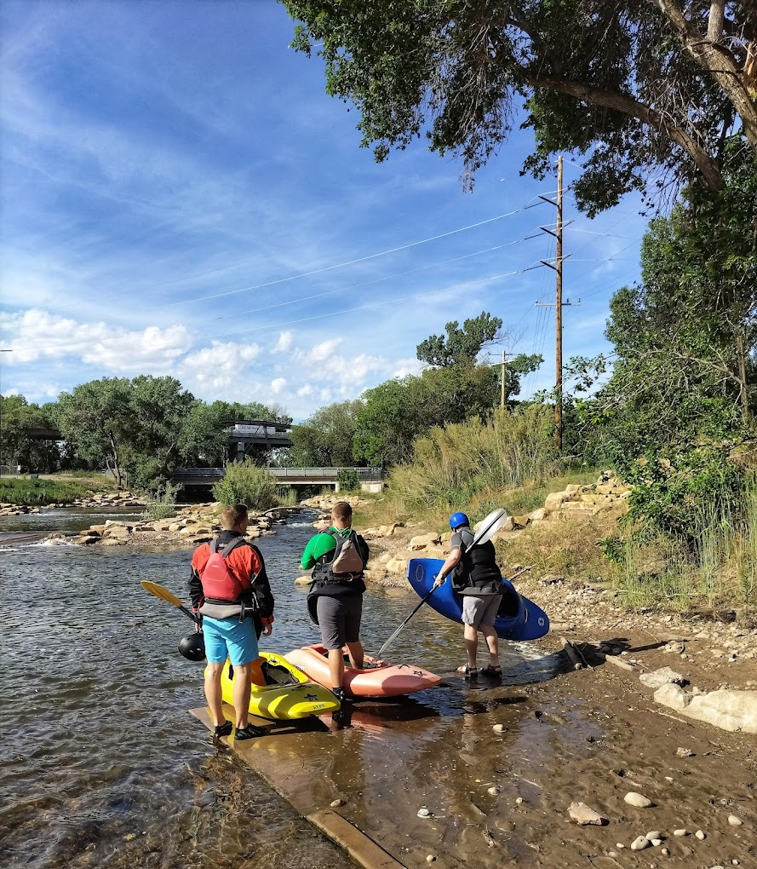
OGDEN CITY RIVER RESTORATION
HMGP
Photo: Google Images
An existing below-grade sewer line runs parallel to the bridge with a risk of failure. Other benefits from this project include debris removal, improvements to water quality, restoring aquatic and riparian habitats, and recreation benefits.
Kayak park and safer recreational area.
Success has motivated the city council to pursue more mitigation and improvement projects.
Notes:
HMGP 4311
Federal share of $487,615.00
Other partners that include state recreational grants (UT outdoor recreation, DNR, Trout Unlimited, private donors and more).

Slide 31
PROVO WATER SUPPLY
BRIC
Infrastructure improvement project
Project Cost
  Federal Share $50,000,000.00
  Local Share $30,000,000.00
Provo is a city of 115,718 people, where water is primarily drawn from 160 springs and 15 wells, and is supplemented with groundwater supply through the Central Utah Water Conservancy District.
Aquifer Storage Recovery (ASR) has been identified as a key tool in securing a long-term sustainable water supply for the City of Provo.
Notes:
Drought mitigation and water supply preservation
ASR system
New distribution line installation
Booster Station upgrades
Two discharge points off the distribution line
Provo River Water Treatment Plant (WTP)
- FEMA’s BRIC program recently awarded Utah $47 million to fund slightly more than 60% of a project to enhance the long-term sustainability of Provo’s water supply and improve drought resilience. The infrastructure improvement project will draw an increased volume of water from the Provo River, In addition, piping will be added to convey the treated water from the perimeter of the distribution system to the proposed infiltration site, which is an ephemeral stream. From there, the water will infiltrate into the ground and recharge the aquifer. The water will be recovered when needed using existing wells. This project effectively provides long-term sustainability of Provo’s water supply while also having a ripple effect that benefits the region by utilizing aquifer storage of water resources, as opposed to traditional reservoir storage that is subject to evaporative loss. While the Project is only a piece of the statewide and Western U.S. water puzzle, it is a key element of the community and regional resilience strategy. The project will result in stability in pricing and delivery of water, which will benefit the high percentage of elderly and university students in the city and region and support families and business livelihoods – leading to a true equity paradigm for the community. The project will allow the Provo Aquifer to remain a part of Provo City’s water infrastructure, but also provide water in times of drought when other sources are stressed.

Slide 32
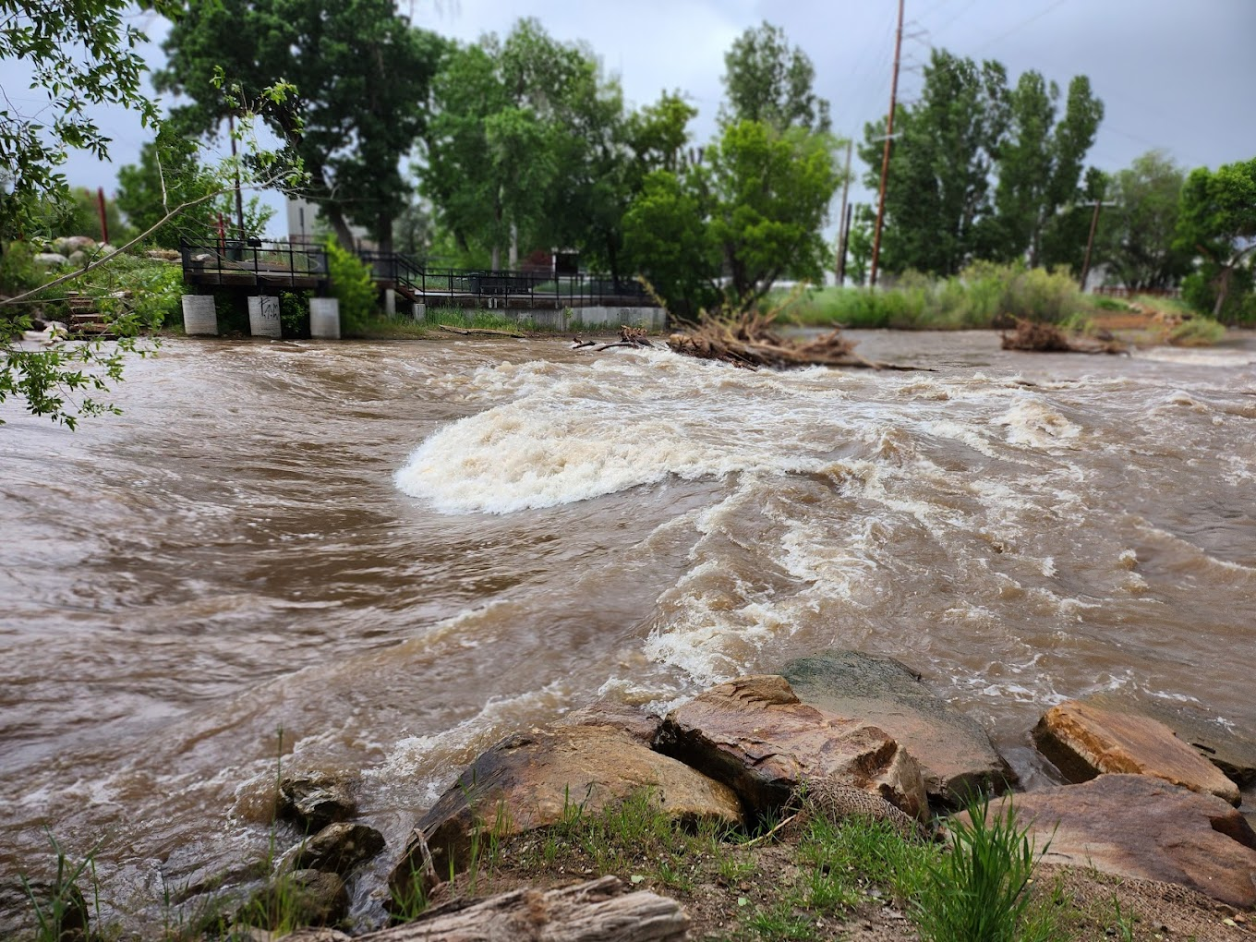
WHAT ABOUT LOCAL PLANNERS?
Photo: Google Images
Capital Improvement Plans
Infrastructure Plans
Climate Plans
Housing Plans
Historic Preservation Plans
Master/General Plans
Notes:
Outside of hazard mitigation plans, what other plans can mitigation and projects be included in?
Natural Areas Land Management Plan
Recreation Facility Master Plan
Park Master Plans
Trail Master Plan

Slide 33
STATE RESOURCES AND OPPORTUNITIES

Slide 34
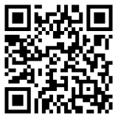
UTAH DIRECT TECHNICAL ASSISTANCE (DTA)
DTA Notice of Interest Link
Examples of DTA
Hazard mitigation plan development/update
Mitigation of a specific hazard(s) or in-depth risk assessment of a specific hazard(s)
Project identification, conceptualization, and scoping
Budget development and potential funding sources identification
Community outreach and partnership development
Benefit cost analysis
Grant writing and management workshops
Other [climate adaptation planning, equity analysis, building code work, etc.]
BRIC/HMGP sub-application development
DTA is for communities with a desire to increase their capacity and capability to conduct mitigation activities, increase resilience to natural hazards, need help identifying projects that will reduce risk, or need support developing or submitting a BRIC/HMGP application. This is a service for communities that do not have the resources to do the work for themselves.

Slide 35

G-318 LOCAL HAZARD MITIGATION PLANNING TRAINING
Please visit train.org/utah
Create an account
Search “G318” and register
Aug 26-28 8AM to 4PM
Taylorsville State Office Building TSOB
The registration deadline will be Aug 12, 2024 at 11:59 PM MDT

Slide 36
THANKS!
Any questions?
Maranda Miller: marandamiller@utah.gov
Mason Kemp: masonkemp@utah.gov
Logan Sand: logan.sand@fema.dhs.gov
Brooke LaPlaca: brooke.laplaca@fema.dhs.gov
Notes:
Add logan and brooke contact info

