Slide 1
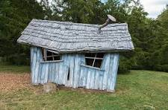
Which is more rare: Bigfoot or the Affordable Home?
Steve Waldrip
Senior Advisor to the Governor for
Housing Strategy and Innovation

Slide 3
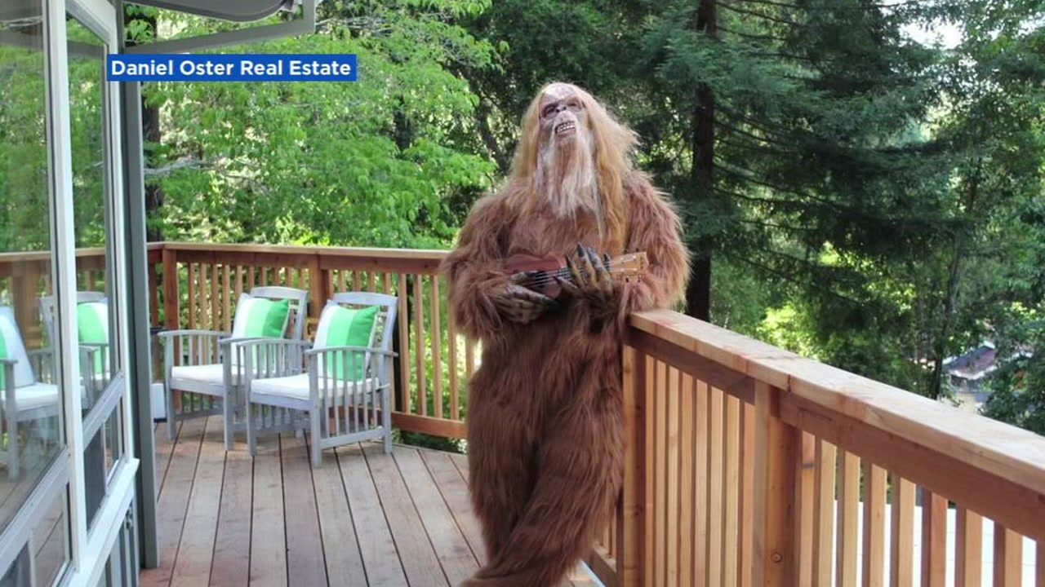

Slide 4
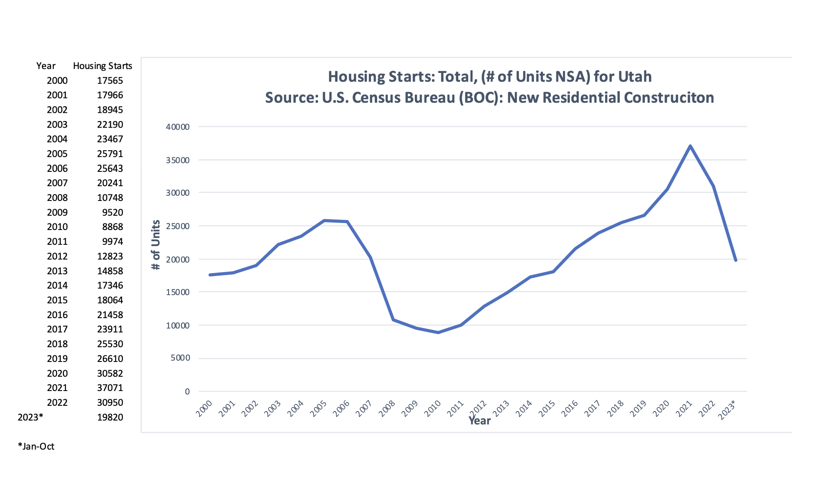

Slide 5
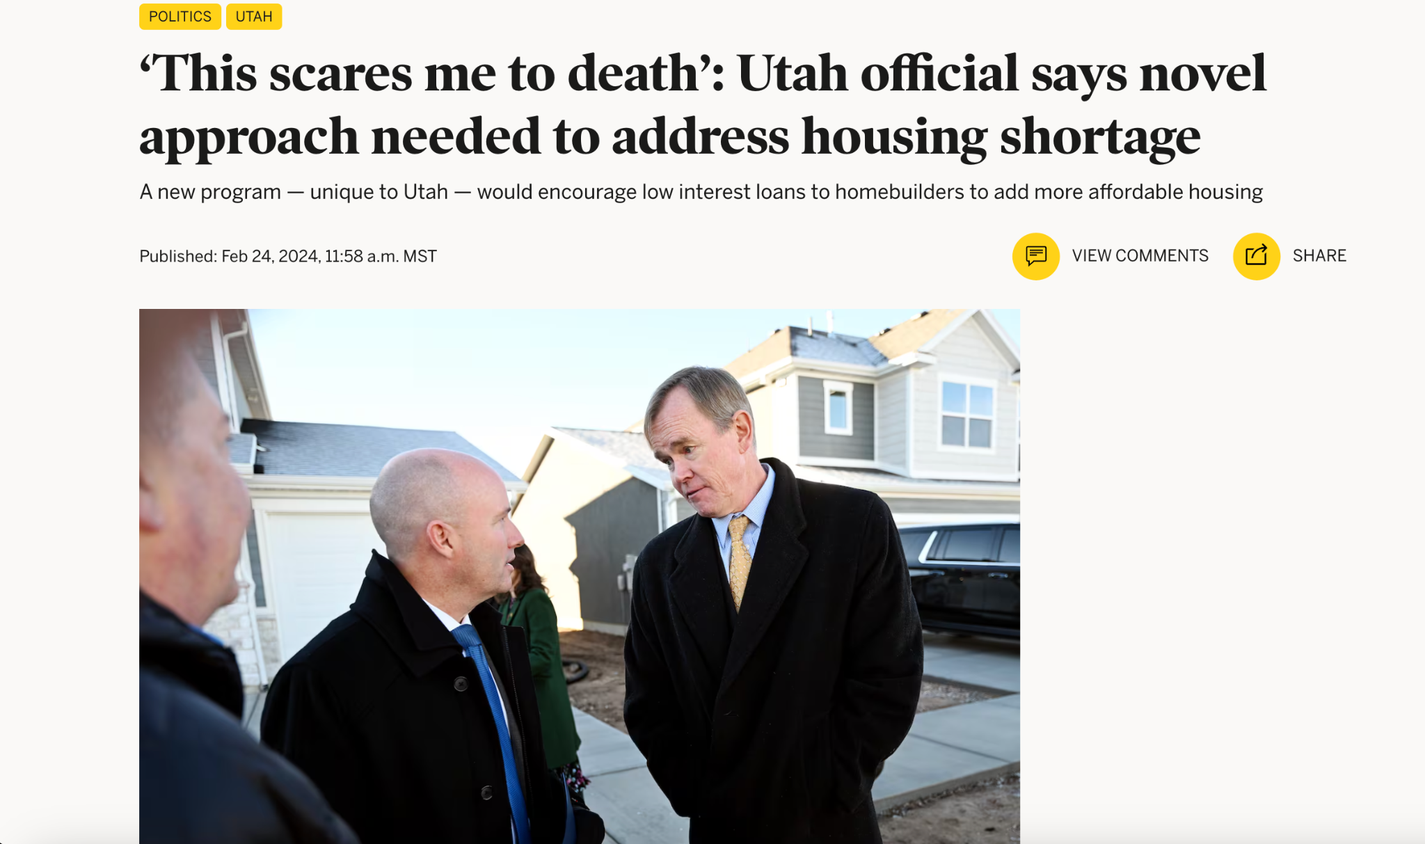

Slide 6
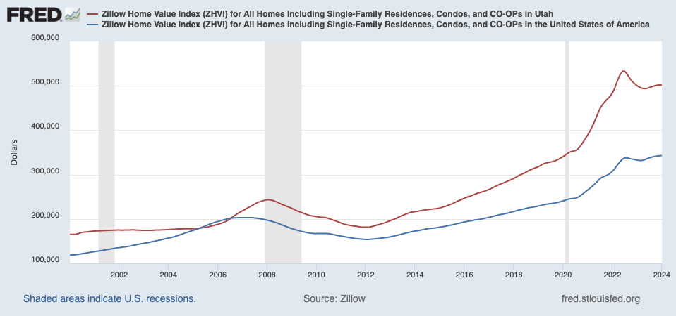
Utah Home Prices Much Higher Than US
Utah
$501,652
U.S.
$342,941

Slide 7
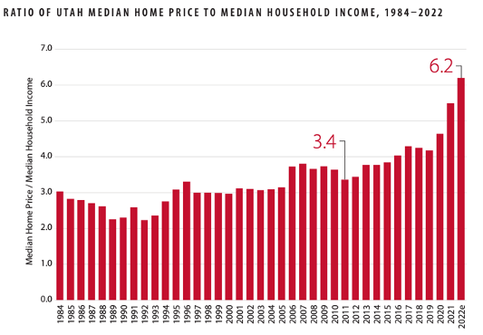
Home Prices Outpacing Income in Utah
Source: Kem C Gardner Policy Institute
Notes:
Shocking Data

Slide 8
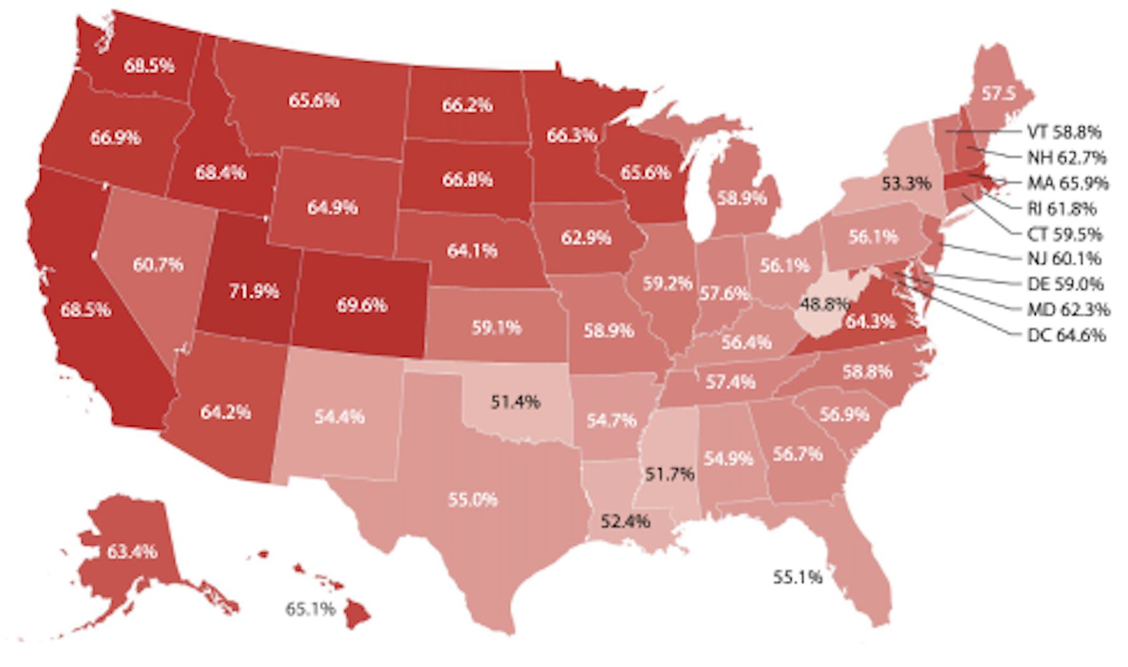
Utah Homeowners Are Locked In Low Rate Mortgages
Share of Existing Mortgages With an Interest Rate at 4% or Lower
Sources: Kem C Gardner Policy Institute; Federal Housing Finance Agency
Notes:
Data

Slide 9
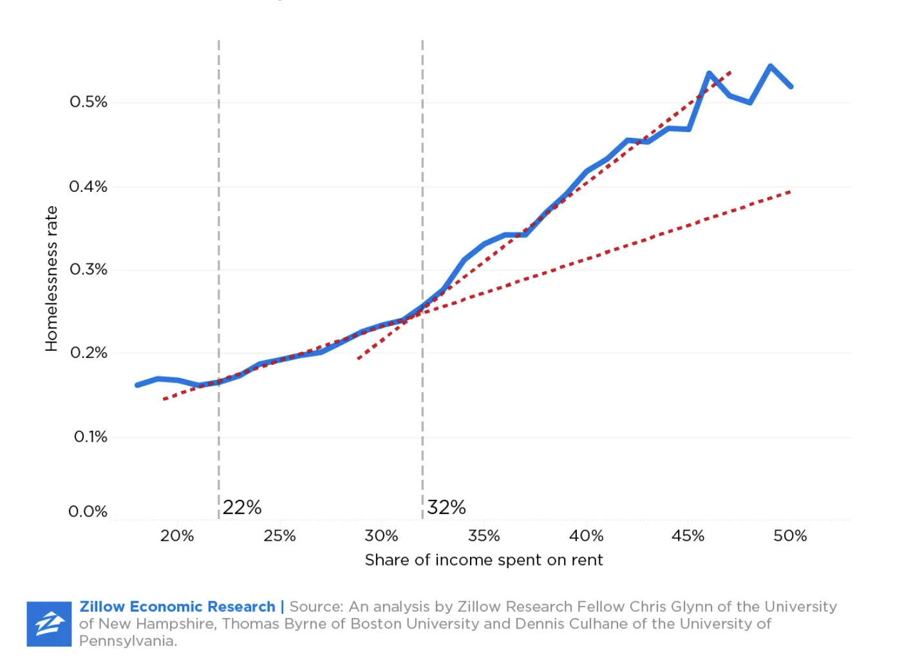
Rate of Homelessness vs Share of Income Spent on Rent
Notes:
Homelessness

Slide 10
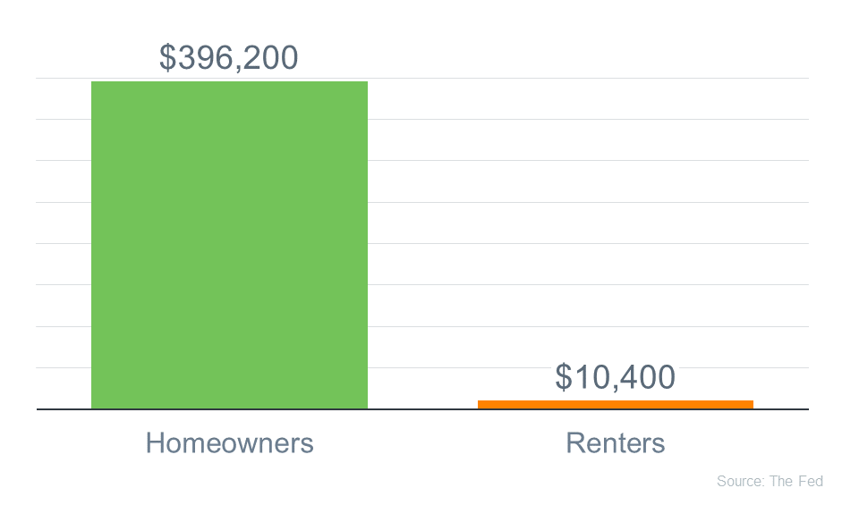
Homeownership: Key to Wealth Building

Slide 11
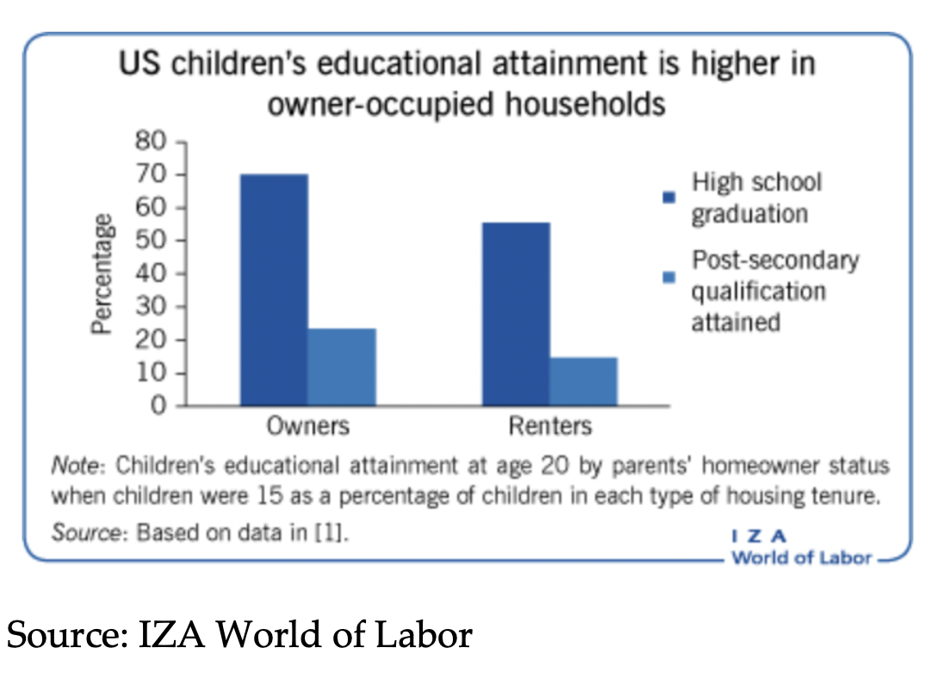

Slide 13
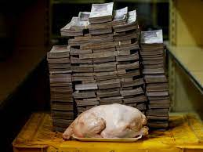

Slide 14
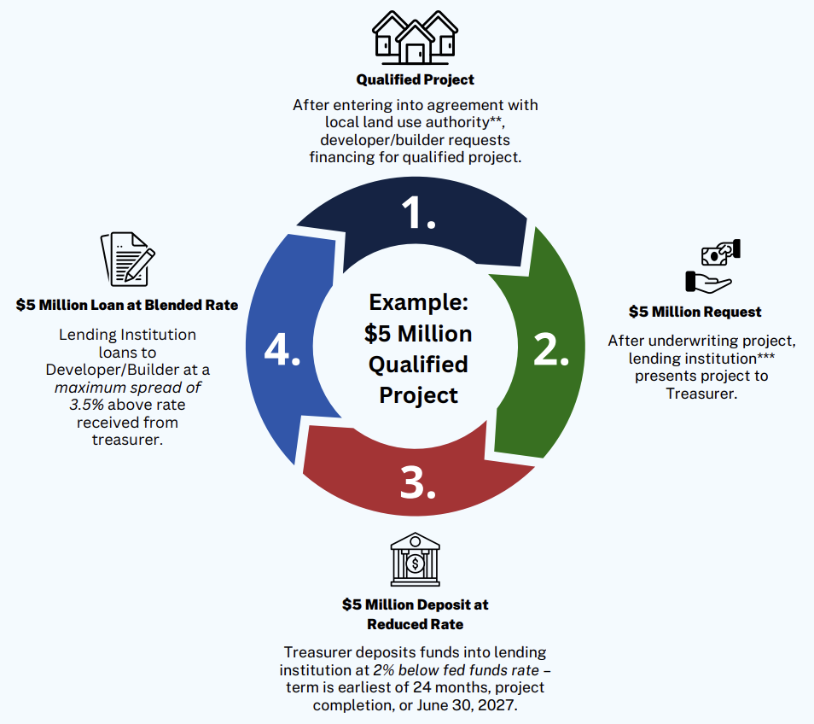

Slide 15
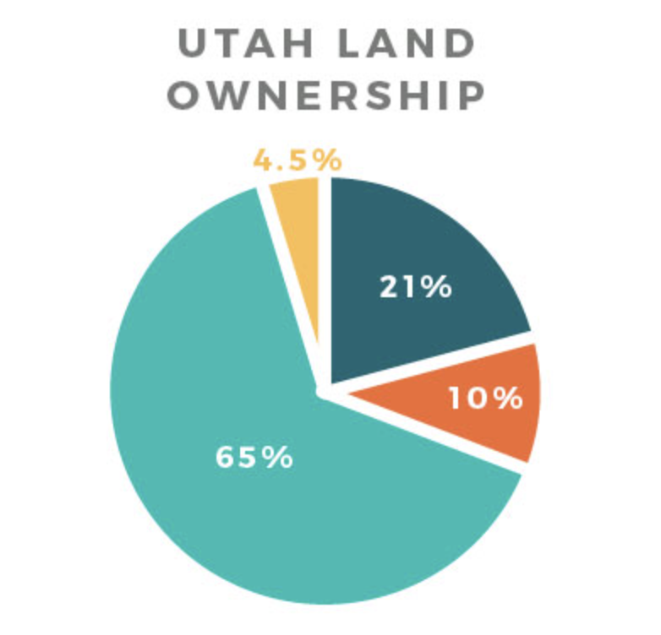
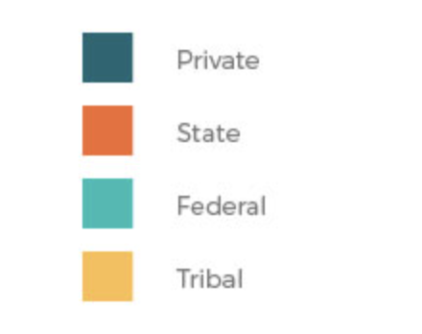
Public Lands

Slide 16
Legacy Cities

Slide 17
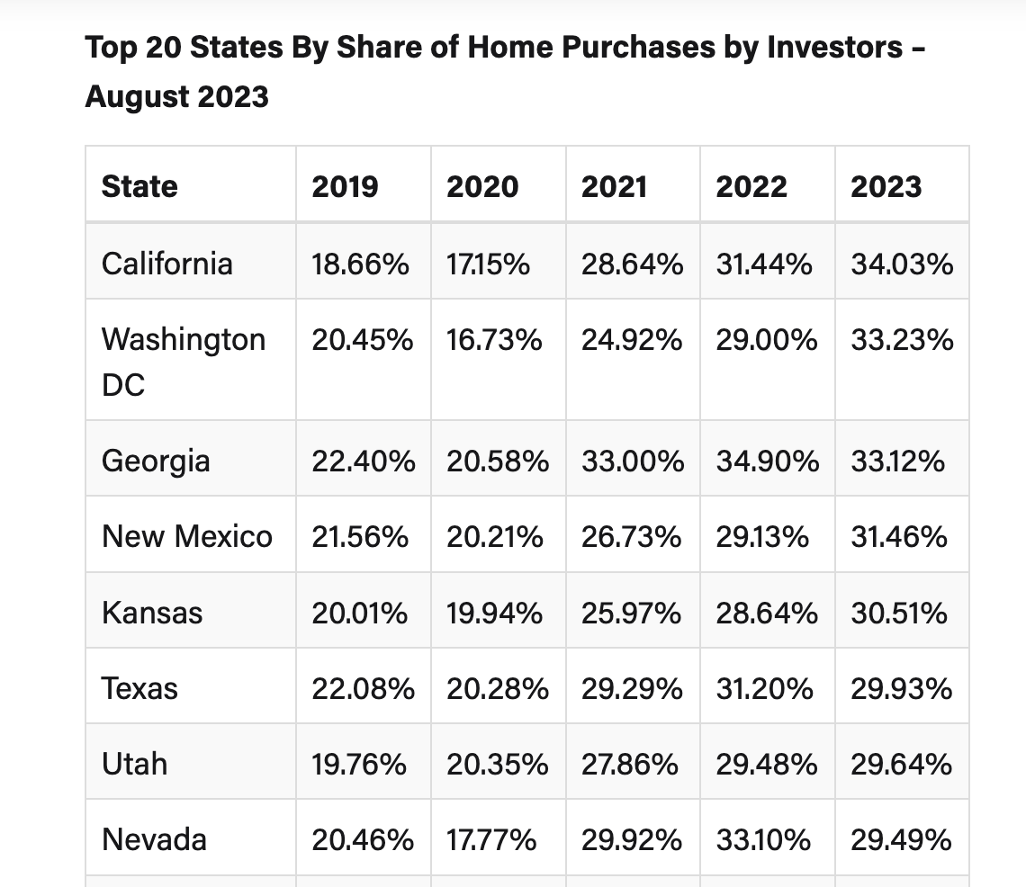
Corporate Ownership and Overnight Rentals

Slide 18
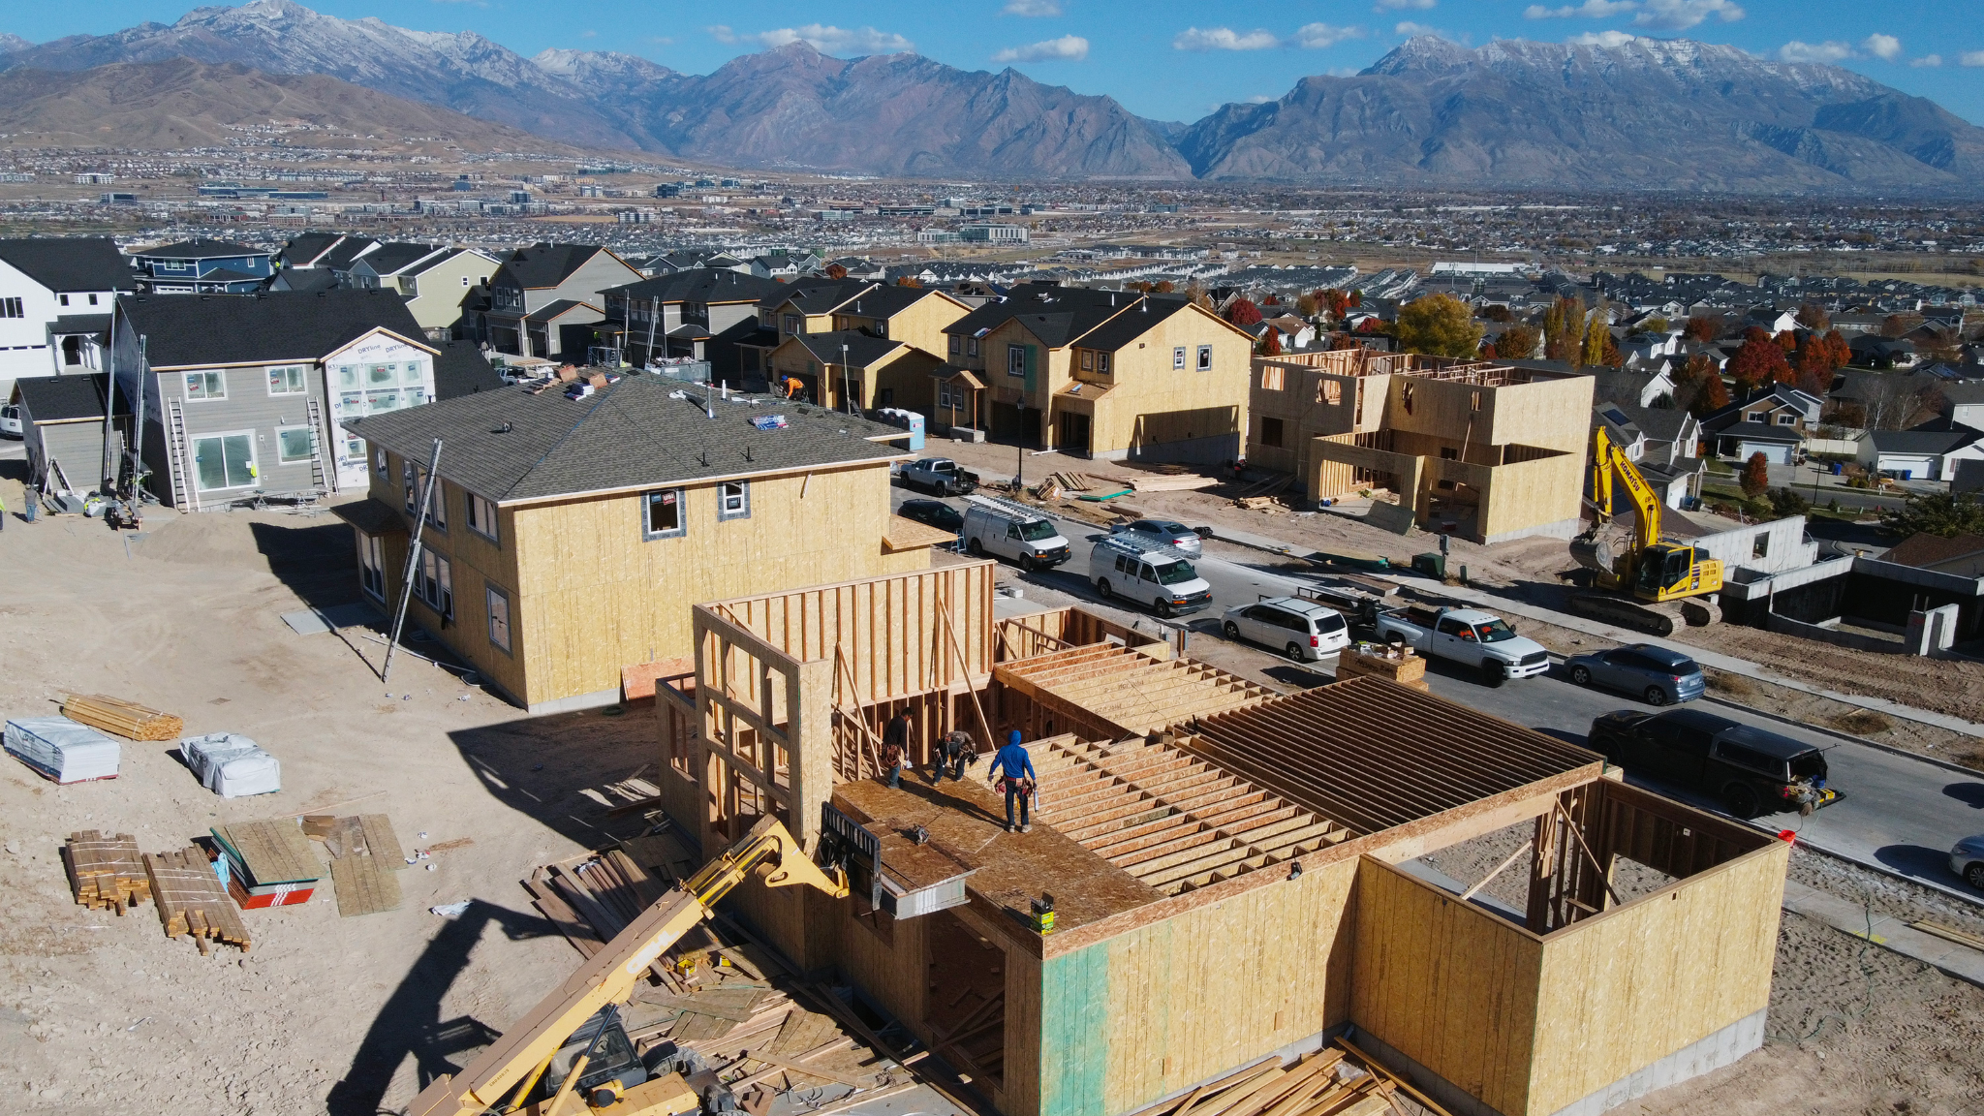
Process Issues

Slide 19
Communication

