Slide 1
2024 Utah Legislative Session Housing/Land Use Is This Really Gonna Work? APA Utah Spring Conference Wilf Sommerkorn, Scott Hess, Jason Boal

Slide 2
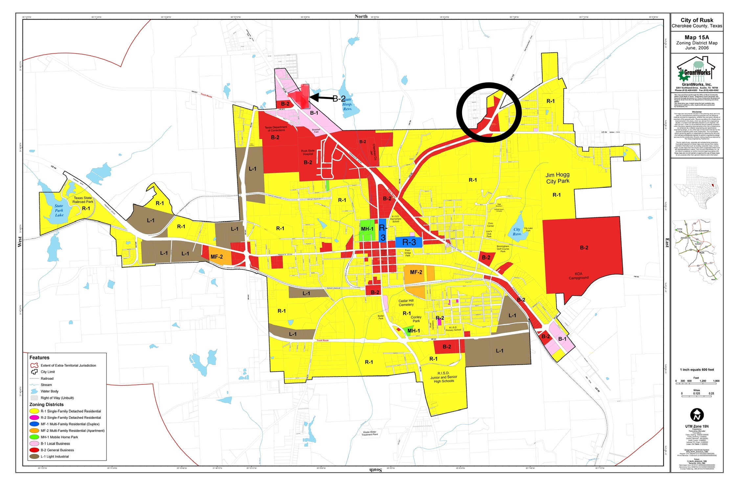
Housing Zoning Affordability Reform

Slide 3
Housing Supply Accelerator

Slide 4
Top-Down Mandates

Slide 5
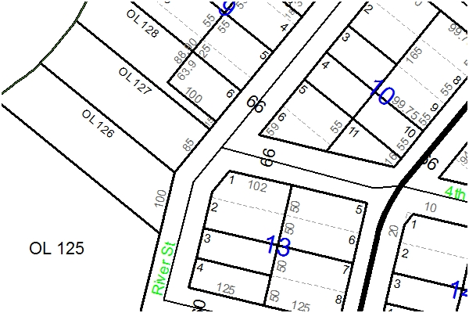
HB306 – Residential Housing Amendments
Failed – this time!
Would have defined starter home, made permitted use in all residential zones
Would have allowed lots as small as 5400 sf in all residential zones

Slide 6
Collaboration

Slide 7
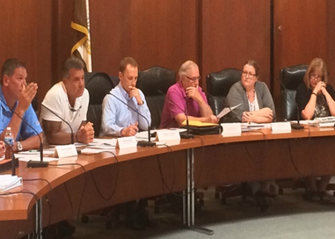
Land Use Administration Changes

Slide 8
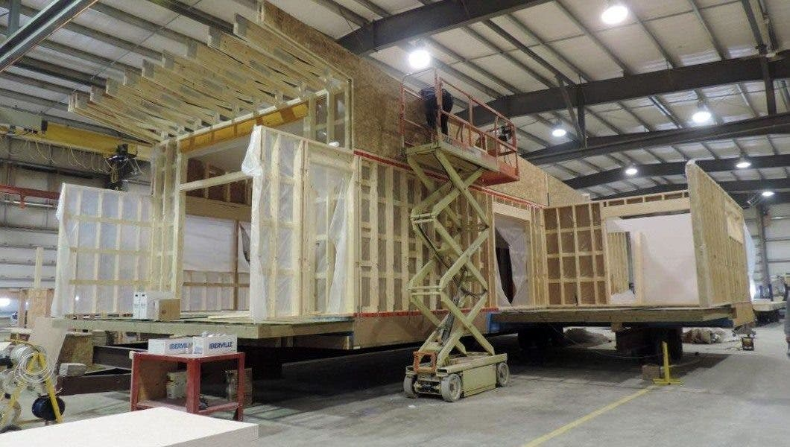
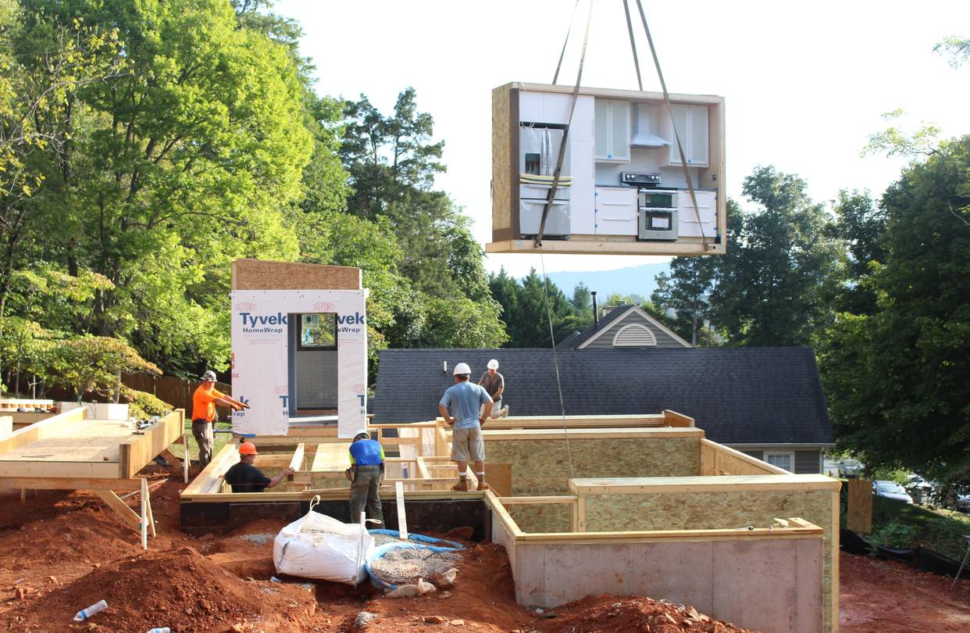
SB168 – Affordable Building Amendments
Defines the regulatory process for modular (pre-fabricated) building construction​
Goal: Affordable home ownership through lower building costs and faster construction​
Built off-site​
- Local building official performs plan review of onsite elements only​
- Constructed and inspected offsite by manufacturer​
- City inspects onsite elements (foundation, assembly of modular, etc.)​

Slide 9
HB465 – Housing Affordability Revisions
Moderate Income Housing Plan Revisions​
No substantial changes to menu items or reporting timelines ​
Reports will now include zoning maps (or links to them) and number of entitled units​
Objective: better understanding of 190k planned for and unbuilt housing inventory pipeline ​
Take the data collection seriously​

Slide 10
HB476 – Land Use Regulations Modifications
Subdivision process clean up
Land Use Application Processing/Phasing​
Landscaping Requirements​
Development Agreements
Landing/rear setbacks
Sidewalk phasing assurance bonds
Design exceptions for overpressure zones​
Annexation Language​

Slide 11
HB476 – Land Use Regulations Modifications
Subdivision process clean up
Subdivision Improvement Plan submissions​
Preliminary vs. Final Engineering Plans​
Timing of reviews​

Slide 12
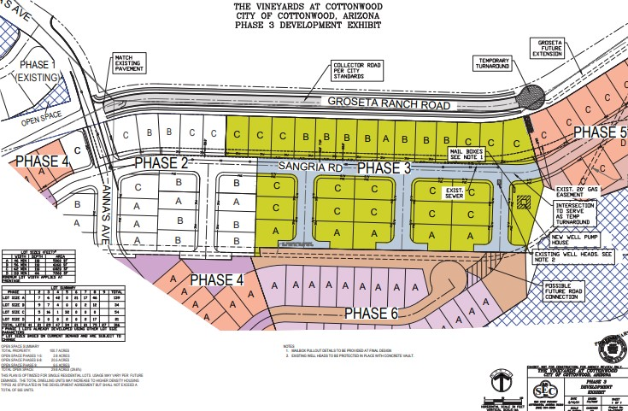
HB476 – Land Use Regulations Modifications
Land Use Application Processing/Phasing
Clarifies that unless otherwise required in a development agreement, a municipality must accept and process a land use application without regard to any other separate and distinct land use application.​

Slide 13
HB476 – Land Use Regulations Modifications
Landscaping Requirements
Clarifies that a certificate of occupancy may not be withheld because the homebuilder has not put landscaping in​
Allows a municipality to require a seller of a new residence to inform the first buyer of the new residence of the city’s ordinance requiring waterwise landscaping​

Slide 14
HB476 – Land Use Regulations Modifications
Development Agreements
Removes language about disclosure of “clearly established state law”​
Clarifies that development agreements may not be required by a municipality if the developer is not requesting anything outside of what is already permitted​
Limits municipalities from recording certain documents that impose development requirements on land ​

Slide 15
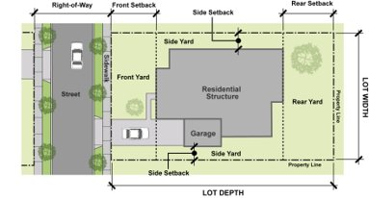
HB476 – Land Use Regulations Modifications
Landing/rear setbacks
Permits landings and walkout porches to be located within the rear setback if:​
No larger than 32 square feet in size​
Used for ingress and egress from the rear​
Is uncovered, connected to the rear of the dwelling​
​Does not apply to historic districts​

Slide 16
HB476 – Land Use Regulations Modifications
Sidewalk phasing assurance bonds
Prohibits requiring sidewalks to be completed prior to a building permit​
Prohibits cities from redeeming sidewalk assurance bonds prior to 18 months after issued​
Allows cities to require completion prior to the Certificate of Occupancy being issued​
Sidewalk phasing can skip, but must be installed for each residence before it may be occupied​
**Only applies to single family homes and townhomes​

Slide 17
HB476 – Land Use Regulations Modifications
Design exceptions for overpressure zones
Allows municipalities to determine design standards IF the development is within a blast zone that would cause an explosion which could pose a risk of damage to a window, garage door, or carport of the facility​

Slide 18
HB476 – Land Use Regulations Modifications
Annexation

Slide 19
HB289 – Property Rights Ombudsman
Goal: Compliance with Office of the Property Rights Ombudsman advisory opinions​
Process: ​
OPRO issues advisory opinion against you, AND ​
District Court sides with advisory opinion​
Then:​
Court may award the substantially prevailing party reasonable attorneys fees and court costs​
AND​
If the Court finds that the city knowingly and intentionally violated the law it may award:​
$250 per day (remnant of past law)​
Consequential damages​

Slide 20
SB185 – Residential Building Inspections
Cities required to have Third-Party Inspection List:​​
**Can include other city/town building inspectors​
Builder notifies city/town on fourth day of what building inspector it will use​
Third party inspector is paid by city/town after receiving approval and report by inspector

Slide 21
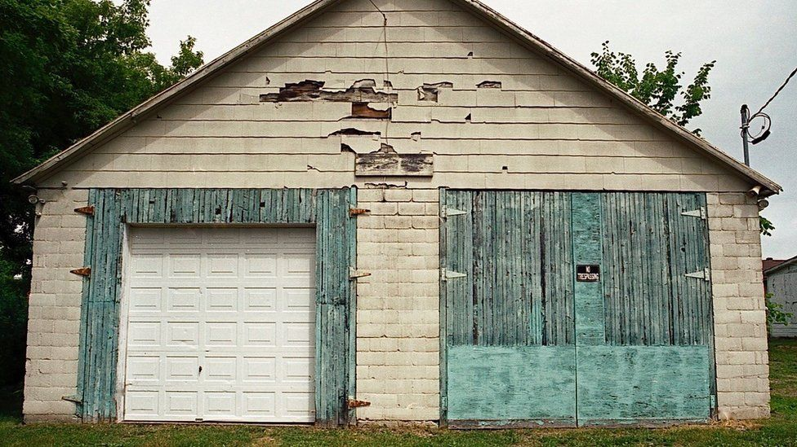
HB518 – State Construction Code Modifications
Must cite specific provisions not complied with, and describe how a project is non-compliant, when denying a project
Cannot withhold or deny permit for a project where there is a noncompliant structure on the land that will not be affected or included in a project – provisions apply

Slide 22
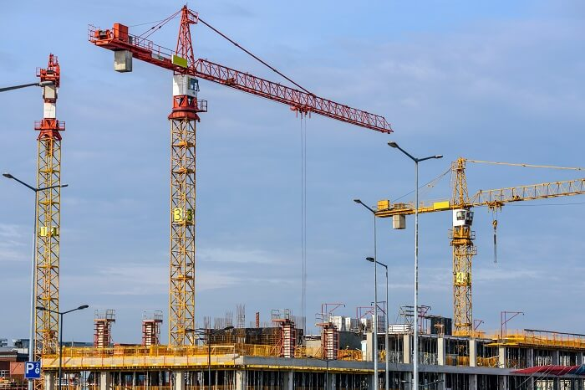
HB188 – Modifications Relating to the Use of Land
prohibits adding to/changing requirements on an issued building permit, except for building code compliance
adds a section to LUDMA on tower cranes

Slide 23
SB13 – Education Entity Amendments
creates educational entities identified as homebased microschools, and micro-educational entities
applies the same rules to these new entities as for charter schools (permitted in all zones, overriding land use and inspection regulations apply)

Slide 24
HB256 – Military Compatible Land Use Amendments
stipulates that for any land use application within 5,000 ft of military property, the local entity must first consider the adopted compatible use plan for that military facility
requires submittal of all such applications to the State Department of Veteran and Military Affairs for comment
These provisions are not required if the application is already vested.

Slide 25
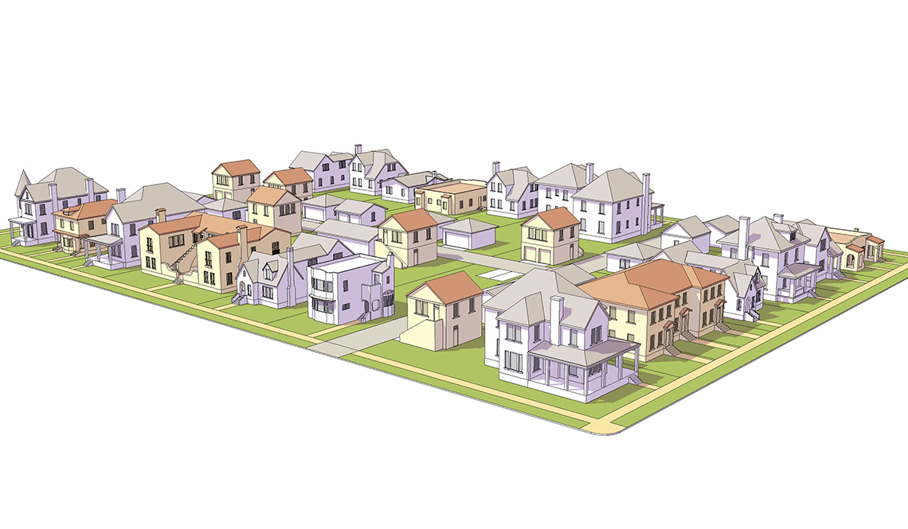
Housing Affordability/Zoning Reform

Slide 26
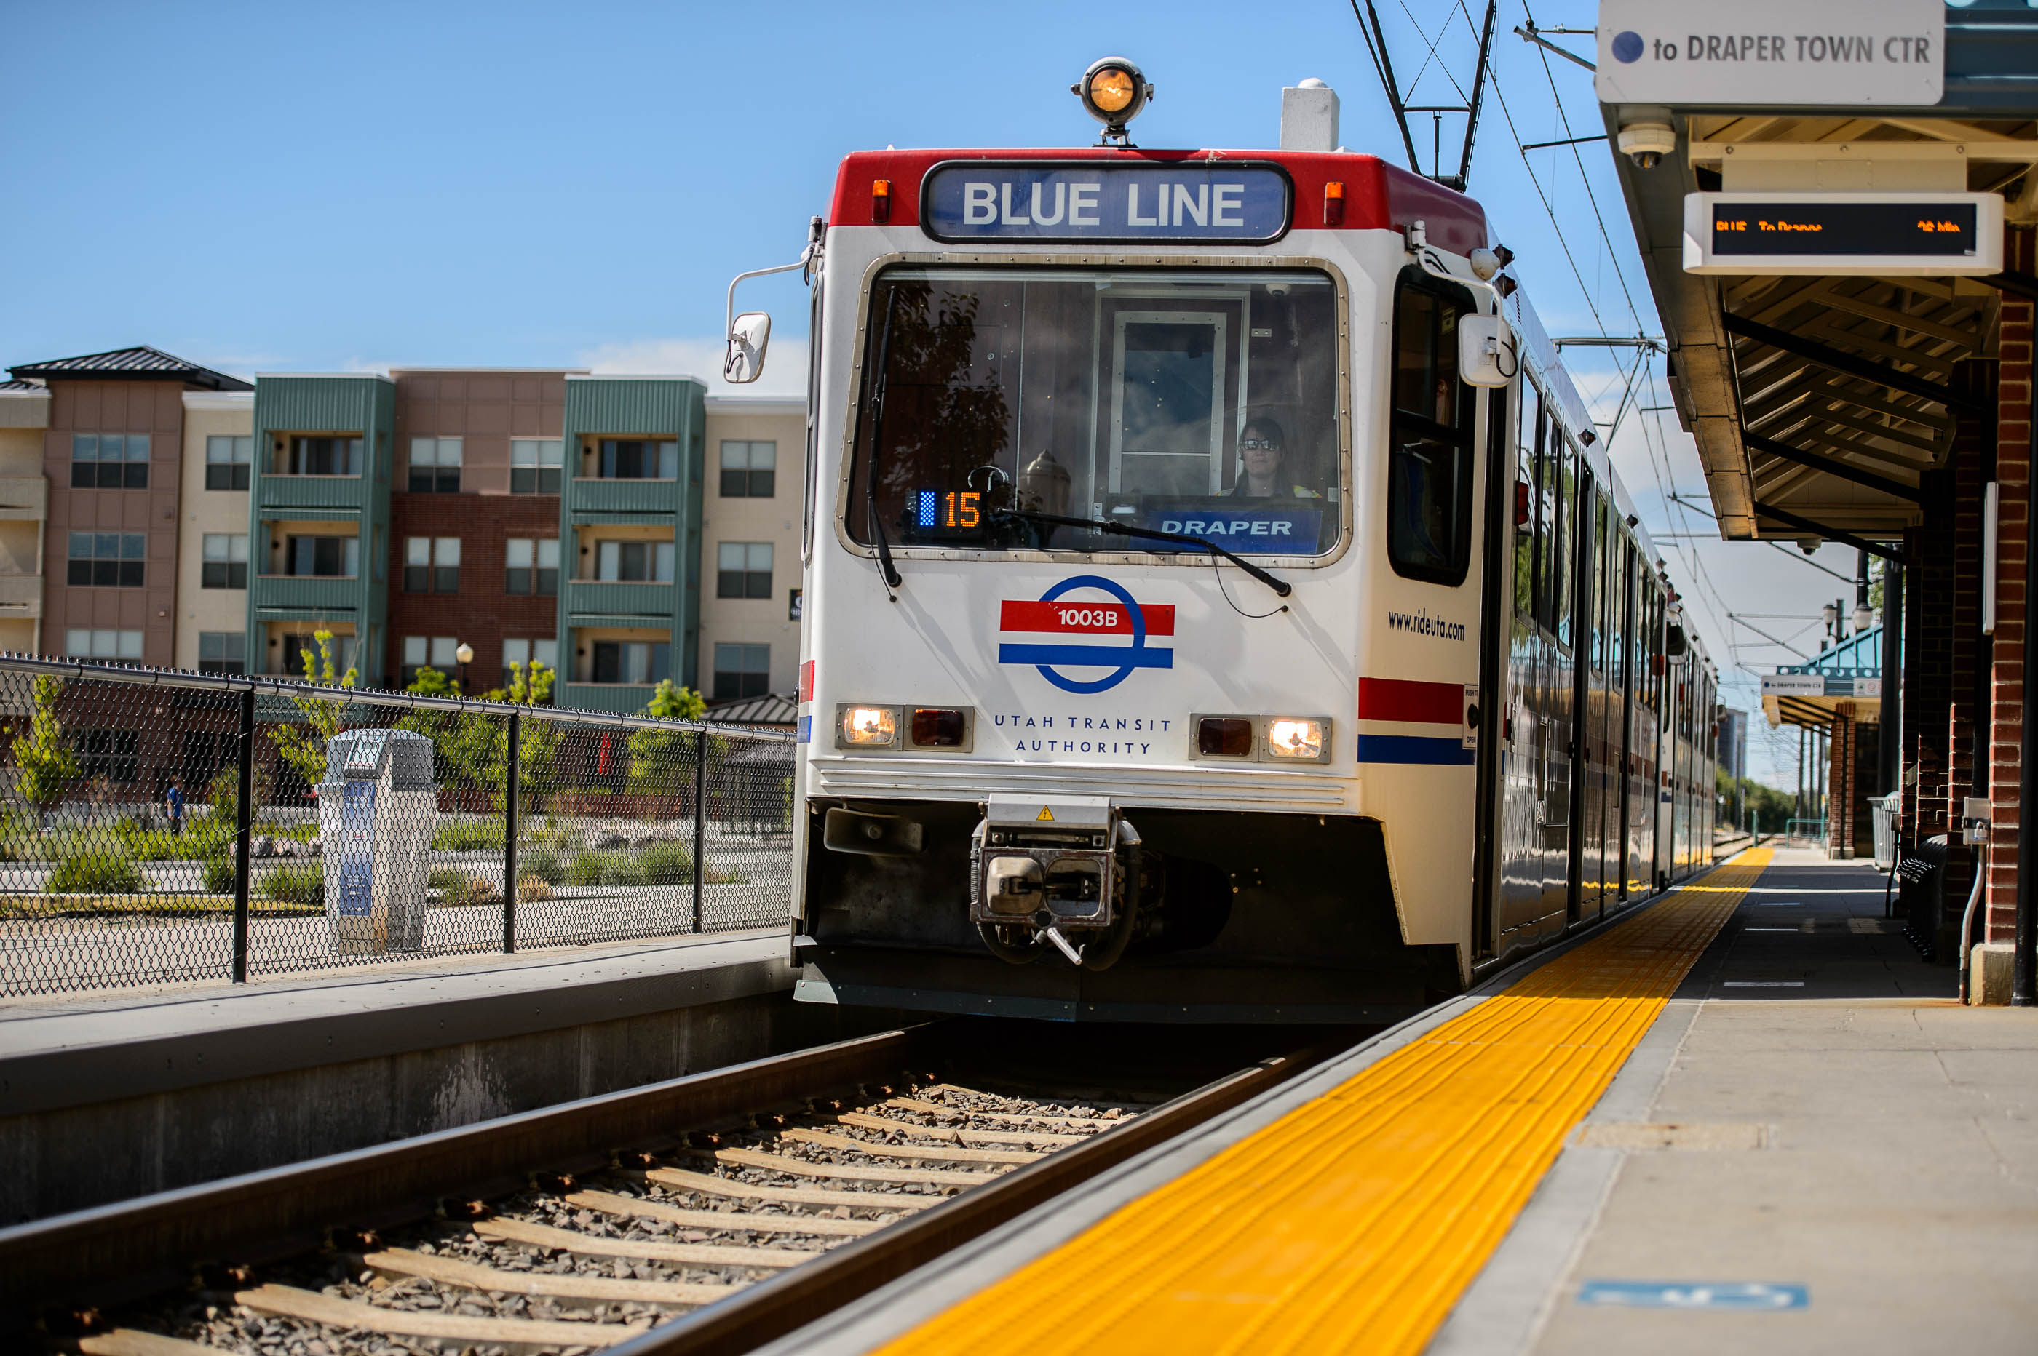
HB206 – HTRZ Amendments
Consideration for owner-occupied housing​
Increases % of required affordable units​
Addresses phasing of housing units​
Increases HTRZ committee members​
Enhances the "but for" test​

Slide 27
SB268 – First Home Investment Zone Act (FHIZ)

Slide 28
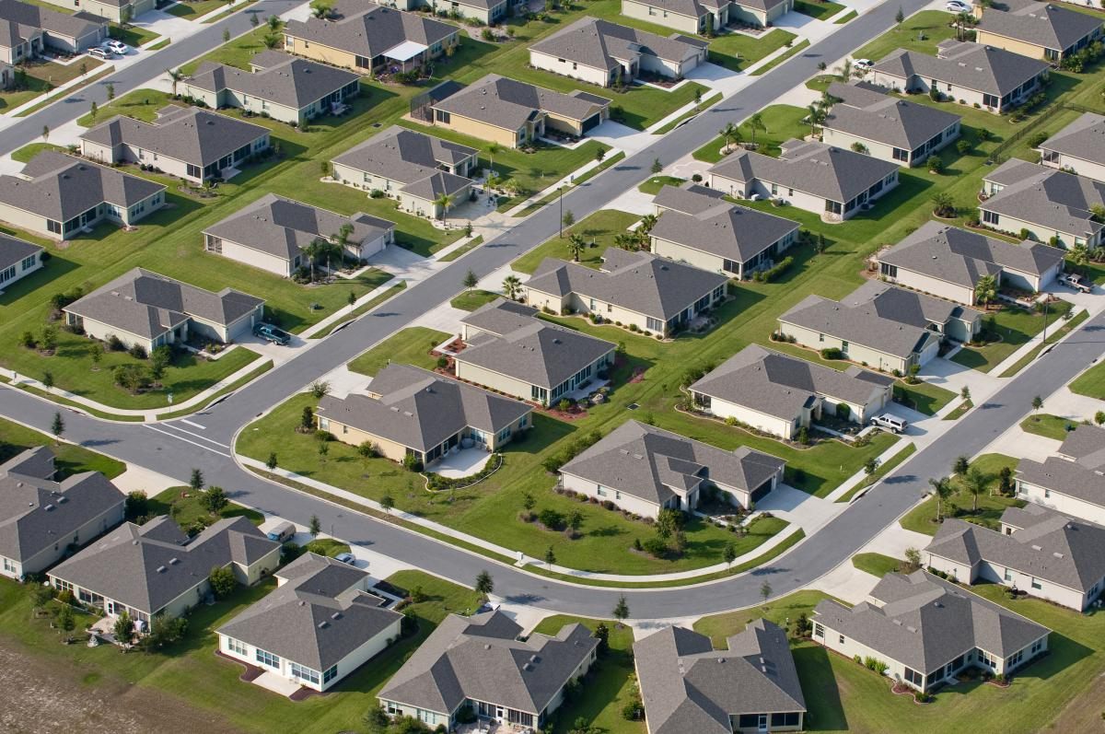
SB168 – Affordable Building Amendments
Home Ownership Promotion Zone (HOPZ)
Zone is less than 10 contiguous acres​
Cities must zone for at least 6 units per acre​
60% of the housing units must be at 80% of the county median sales price​
All housing units must be owner-occupied for at least 5 years​
Tax increment:​
Other taxing entities are required to participate​
60% of increment for system or project infrastructure for up to 15 years
Makes technical changes to the First Time Homebuyer Assistance Program and real estate reinvestment covenants​​

Slide 29
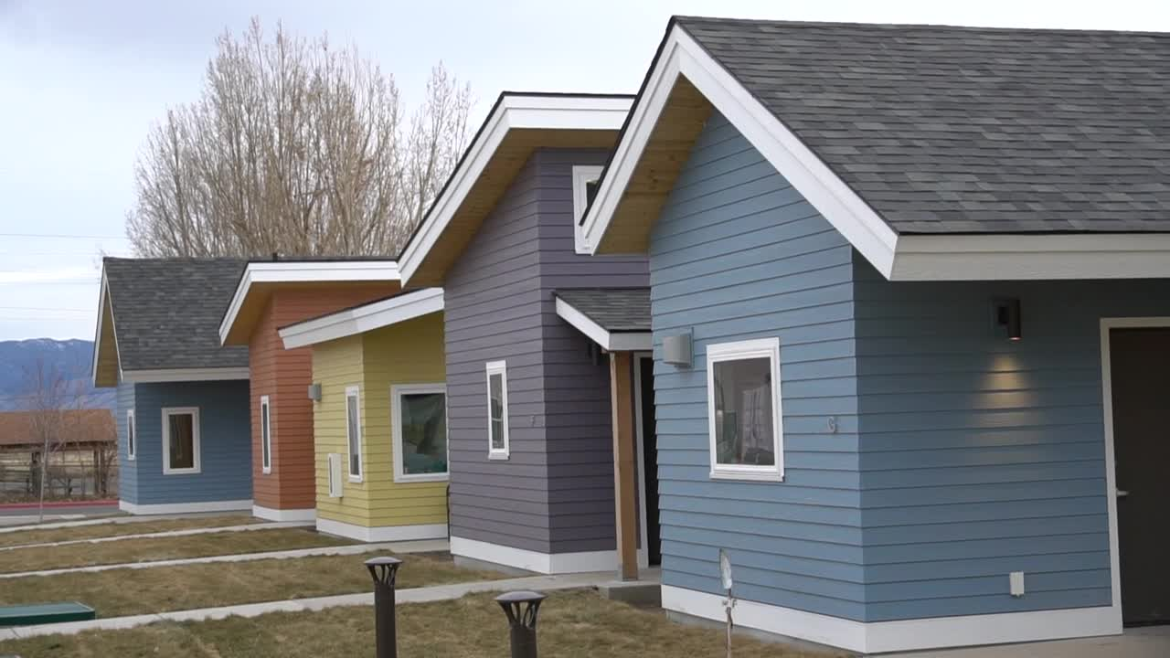
HB572 – State Treasurer Investment Act
Authorizes State Treasurer to invest up to $300 million of state funds (TIF) as deposits to lenders for “qualiﬁed projects”
“Qualiﬁed project” = housing proposal with:​
60% sold at “ﬁrst home” levels ($450k)​
owner-occupancy requirements for 5 years​
Max of 75% of overall QP ﬁnancing​

Slide 30
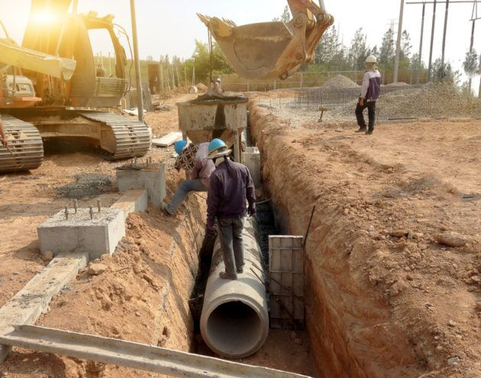
HB13 – Infrastructure Financing Districts
Creates a type of special district to finance public infrastructure​
IFDs are created by petition with consent of 100% of the surface property owners. ​
Governed by an appointed board.​
IFDs may issue bonds to pay for infrastructure on the public bond market to access lower interest rates. ​
Must have land use approval​
Infrastructure must be built to city standards​
Assessments must be paid prior to C of O issuance​
Property tax may not be used to repay the bonds​

Slide 31
HB465 – Housing Affordability Revisions
CRA/RDA Set-aside Changes​
​Housing set aside flexibility - set aside funds may be spent in nearby communities (w/ interlocal agreement) and on owner occupied affordable (<120% AMI) product​
Set aside funds must be spent, encumbered, or otherwise planned for within six years of the set aside funds being deposited​
Year 1 set-aside funds must be planned for/encumbered/spent by year 6, year 2 funds by year 7, etc.​
Other technical changes to tax credit program, DWS housing grant pass through administration

Slide 32
Other Bills of Interest
HB430 – Local Government Transportation Services Amendments
HB502 – Critical Infrastructure and Mining
SB28 – Scenic Byway Program Amendments
SB258 – Municipal Incorporation Amendments
SB264 – Inland Port Authority Amendments
HB330 – Unincorporated Areas Amendments
HB220 – Water Related Amendments

Slide 33
Salt Lake City Sport – Redevelopment Bills
HB562 – Utah Fairpark Area Investment and Restoration District
SB272 - Capital City Revitalization Zone

Slide 34
Failed Bills – this time!
HB 180 Short Term Rental Amendments. Would have required standardized ordinances on short term rental, requirements for tax commission permit, other changes.
HB 195 Land Use Planning. Would have required wildlife studies for development
HB175 Impact Fees Amendments. Would have allowed impact fees for fire trucks
HB 235 Eminent Domain. Would have allowed eminent domain for Bonneville Shoreline Trail
HB 243 Riparian Amendments. Would have required cities/counties to include riparian element in general plans
HB 258 Airport Land Use Amendments. Would have added to the requirement for developing near airports
SB 230 Property Transaction Amendments. Would have made Utah a disclosure state relative to the price paid for commercial real estate.
SB 252 Property Incorporation Amendments. Would have made it more difficult to incorporate cities based on costs evaluated in feasibility study.
HB 169 Rental Property Disclosure Requirements. Would have required landlords to disclose defects to renters.

Slide 35
Big Issues for Next Session
More zoning reform? What kind?
Transportation fees
Annexation and incorporation
Gravel pits
Storm water management
Conditional uses

