Slide 1
The rental revolution:
Adapting Land Use Planning for the Age of Short-Term Rentals

Slide 2
MEET THE panelists
TOM DANSIE​
KADEN FIGGINS
FRED RESCH​
Director of Community Development
Town of Springdale
Director, Planning & Economic Development
Garfield County
City Planner
Hurricane City

Slide 3
DISCUSSION OVERVIEW
2024 SESSION
House bill 180 & $600k appropriation for compliance software
NOT SO KNOTWELL
Our thoughts on how to navigate the Notwell language
BEST PRACTICES
Sample ordinances and applications

Slide 4
2024 legislative session
HB 180 (Rep. Bennion)
$600K APPROPRIATION
Requires municipalities and counties that allow STRs to adopt a STR ordinance
Prohibits operation of a STR unless the municipality or county issues a permit and the tax commission issues STC/STR numbers.
Provides requirements for STRs
NOT PASSED
Statewide STR compliance monitoring
Administered by State Tax Commission
NOT FUNDED

Slide 5
NAVIGATING KNOTWELL
Town of Springdale
Balancing tourist accommodation with community character.
GARFIELD COUNTY
Hot Compliance screenshots of listings & reviews
Site visits and knocking on doors
HURRICANE CITY
Use postings as a starting place
Rely on reviews and neighbor testimony

Slide 6
BEST PRACTICES

Slide 7
Town of SPRINGDALE

Slide 9
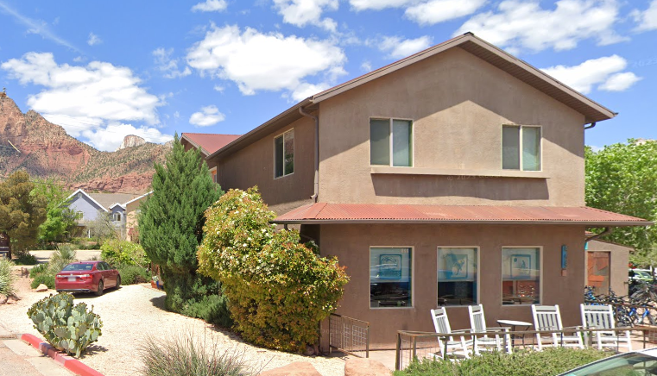

Slide 10
Town of SPRINGDALE
General plan vision and goals
“Develop policies that ensure new lodging facilities will promote Springdale’s unique village atmosphere and enhance the quality of life. In keeping with its village atmosphere and unique character, the Town will adopt policies that result in hotels, inns, bed and breakfasts and other lodging facilities that promote the Town’s ‘in the Park’ feel, its small village scale, and its unique atmosphere. This goal is for the Town to have attractive, memorable, and unique lodging that complements the visitor’s experience in Zion Canyon and Zion National Park.”

Slide 11
Town of SPRINGDALE
Transient lodging overlay zone
New transient lodging (including STRs) only allowed in the TLO
Requires legislative approval
Limited application window
Requirement to develop long-term residential uses in conjunction with new transient lodging units
Enforcement tools built in (restrictive covenant recorded against property, annual compliance review with business license renewal)

Slide 12
GARFIELD COUNTY
GEOGRAPHY
5175 square miles 5,200 population
90% federal land 4.7% state land 5.2% private land
DESTINATIONS
Bryce Canyon | Capitol Reef | Canyonlands | Grand Staircase | Glen Canyon
Kodachrome | Petrified Forest | Red Canyon | Highway 12 | Panguitch Lake
SHORT-TERM RENTALS
355 unique STR units 9 municipalities unincorporated
DEFINITIONS
Short-Term Rental Glamping General Commercial

Slide 13
DEFINITION
SHORT-TERM RENTAL (STR). A dwelling unit, or any portion thereof, being used for transient accommodation purposes, including but not limited to, single-family dwellings, multiple family dwellings, accessory dwelling units (ADU’s), or any other dwelling unit for a period typically less than thirty (30) consecutive days.
Additionally, any dwelling unit that is listed on any accommodation website including but not limited to Airbnb, Vrbo, HomeAway, Trip Advisor, etc.; is hereby considered a Short-Term Rental and shall be subject to the regulations set forth in this Ordinance, even if the STR is rented out for a period longer than thirty (30) days.

Slide 14
Accommodation classifications
SHORT-TERM RENTAL
GLAMPING
GENERAL COMMERCIAL

Slide 15
BUILDING INSPECTION
egress | smoke/co2 | railings | GFCI | fire extinguisher | bedrooms
address/name sign | parking | contact info | property map
CONDITIONAL USE
AG, FR, R, RE zones | 1 per parcel | location/access | parking |
compliance with STR ordinance
BUSINESS LICENSE
Inspection | conditional use | STR/STC numbers
PENALTY
class C misdemeanor | $100/day fine

Slide 16
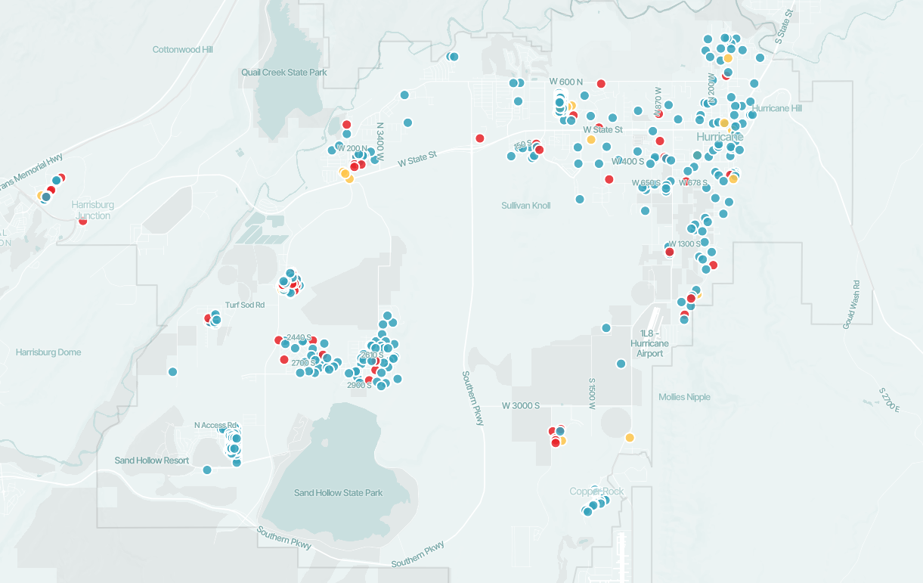
HURRICANE CITY
Regulate STRs in three ways
Residential hosting
Renting out a casita or guesthouse while the owner lives in the main house.
Recreation Resort
Renting out an entire home in a designated resort community.
Vacation Rental in a single-family zone
Renting out an entire home in an otherwise single family neighborhood. These are being phased out.

Slide 17
HURRICANE CITY
Enforcement
Tips and Best Practices
Switched enforcement of the short-term rental ordinance from a criminal action to a civil action.
Identify properties being used as a short-term rental via RentalScape.
Send up to three warning letters, give the owner 30 day warning period.
Issue a civil citation with a $750 a day fine.
If citation is not appealed then move to small claims court.
The goal is compliance not money-making, if you give owners the ability to get licensed let them get licensed.
Have clear standards for who can get a license, what those require, and what is a violation of the ordinance.
Make license revocation a staff level determination.
Require onsite or nearby management of some sort for all units.

Slide 18
Contact information
Tom dansie
Kaden figgins
Fred resch
Town of Springdale
tdansie@springdale.utah.gov
(435) 772-3434
Garfield County
kaden.figgins@garfield.utah.gov
(435) 676-1157
Hurricane City
fred@cityofhurricane.com
(435) 635-2811 ext. 110

Slide 19
QUESTIONS?

Slide 20
THANK YOU!

