Slide 1
2023 Legislative Update
Utah Land Use Institute
2023 Spring Conference
St. George, Utah
April 7, 2023

Slide 2
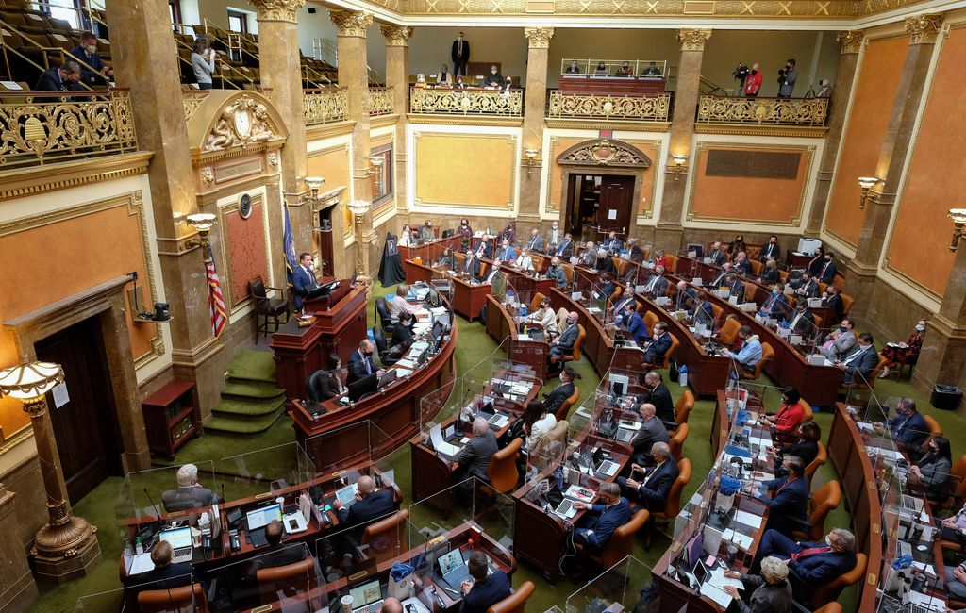
So Many Bills!!
Local Land Use Planning & Administration
35 bills introduced, 19 passed
388 lines of code added to LUDMA (400 in county LUDMA)

Slide 3
Zoning Reform
Most states had legislation
Usually state-imposed “reforms”
Utah has been more collaborative

Slide 4
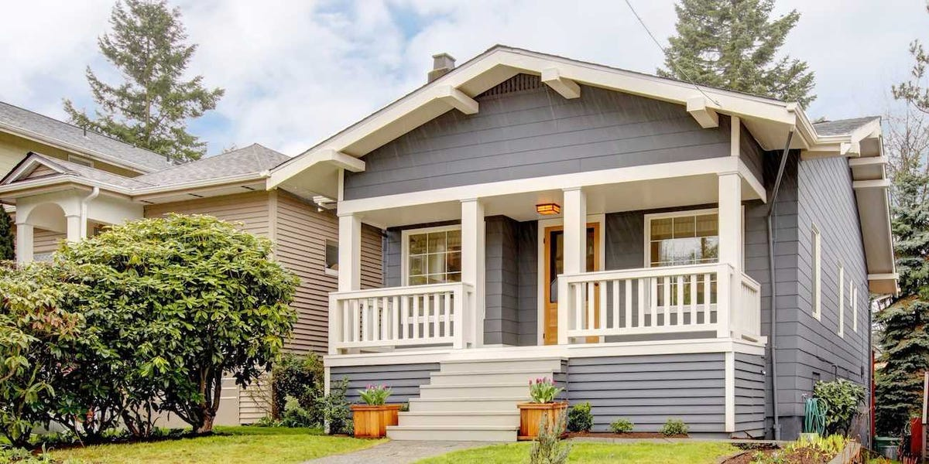
Moderate Income Housing Element
Compliance requirement date changed to Aug. 1 (HB364)
Modifies requirements for adopting number of strategies (HB364)
Specifies 5-year implementation timeline (HB364)
Makes a number of revisions to MIH reporting (HB364)
Modifies provisions for MIH compliance (HB364)
Establishes appeal process for determination of non-compliance (HB364)
Modifies incentives and penalties for MIH non-compliance (SB174)

Slide 5
General Plan Modifications
Some modifications to provisions for transit station-area plans (SB27)
Consultation required with Div. Water Rights in preparation of water use and preservation element (SB76)
Counties require additional consultation with water providers and agricultural interests (SB76)
Requires submittal of comprehensive general plan amendments to AOG within 45 days of adoption (SB27)

Slide 6
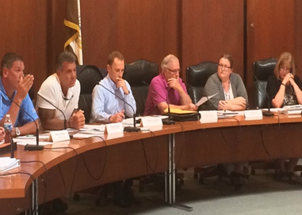
Subdivision Approval Process (SB174)
New LUDMA Section 604.1 – Process for subdivision review and approval
Designate “administrative land use authority”
Only applies to subs for 1- or 2-family dwellings, townhomes
Preliminary and final plats only
Applicant may request pre-application meeting
ALUA may complete preliminary plat review by staff, or in public meeting; may hold one public hearing
Final plat cannot be reviewed by Council or PC

Slide 7
Subdivision Review Process (SB174)
New LUDMA Section 604.2 – Review of subdivision land use applications and subdivision improvement plans
Initial review of preliminary plat to be completed within 15 days of receiving application
Review of final plat to be completed within 20 days of receiving application
Maximum of 4 review cycles permitted
Applicant must respond to required changes he/she disagrees with in writing
Lot line adjustment changes (HB406, SB174)
For most larger cities and counties, subdivision process must be in place by Feb. 1, 2024; all others by Dec. 31, 2024

Slide 8
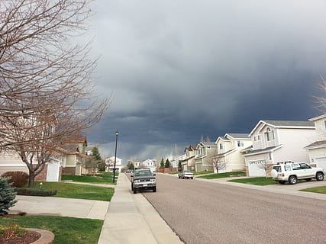
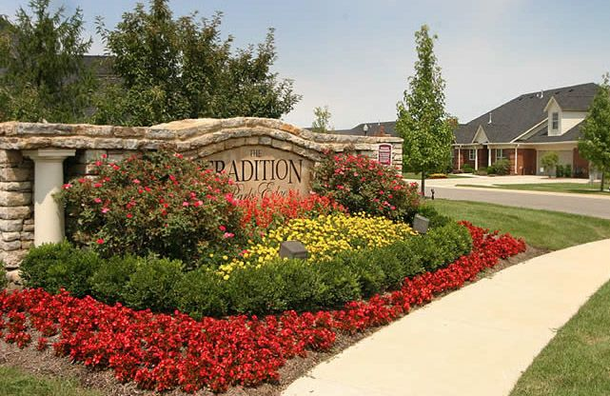
Development Standards
“Residential roadway” limited to 32 ft. pavement width, with exceptions (HB406)
Methodology for determining water rights exactions to be based on state standards and 5 years of actual useage data (SB158)
Allows smaller towns and counties to establish drinking water source protection zones (SB158)
Bonding for landscaping only for that on public property or to be dedicated, adjacent to trails, or to be maintained by HOA (HB406)

Slide 9
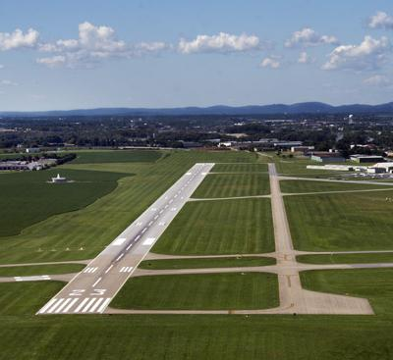
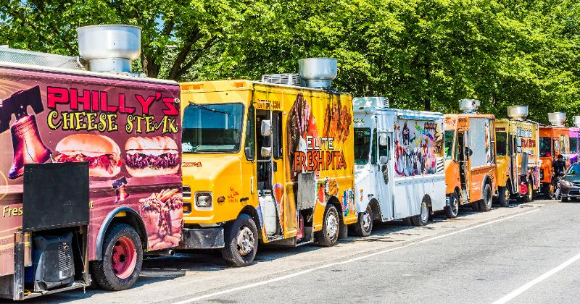
Specialized Land Use Provisions
Airport Overlay and Influence Zoning required within 5,000 ft. of airport runways (HB206)
Military Land Compatible Use “Plan” required within 5,000 ft of military facilities (HB265)
Regulation of mobile businesses standardized (including food trucks) (HB408)
HTRZ modifications (SB84)
Kimball Junction property entitlement

Slide 10
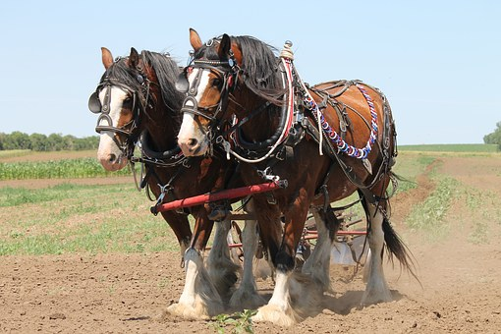
Other Land Use Provisions
IADU provisions for attached garages, parking (SB174)
Clarifies use of “moratoriums” (HB406)
Clarifies use of development agreements (HB406)
“Working animals” and “animal enterprises” (cities only) (SB113)
Define “urban farming” (HB169)
Referenda on land use regulations prohibited if: (SB199)
Adopted by unanimous vote
Transit station area regulations, by two-thirds vote
Prohibit regulation of “co-owned” homes differently (SB271)

Slide 11
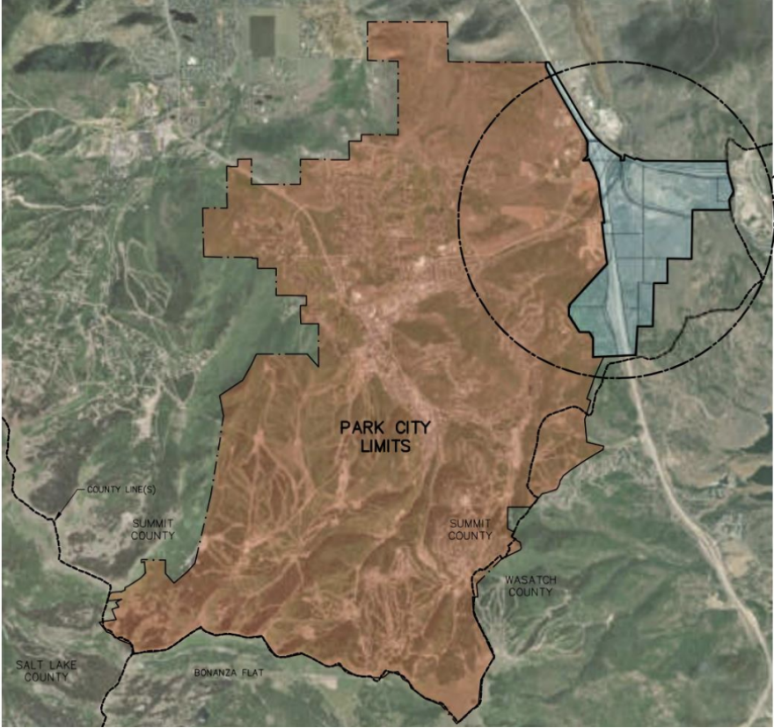
Annexation (HB406)
Modifies definition of “rural real property”
Allows partial annexations of islands or peninsulas
Allows governing body to reconsider vote
In considering a protest, Boundary Commission to give weight to preference of petitioner and protestors
Eliminates requirement for 100% consent from
property owners in Ag Protection Area (oops!)

Slide 12
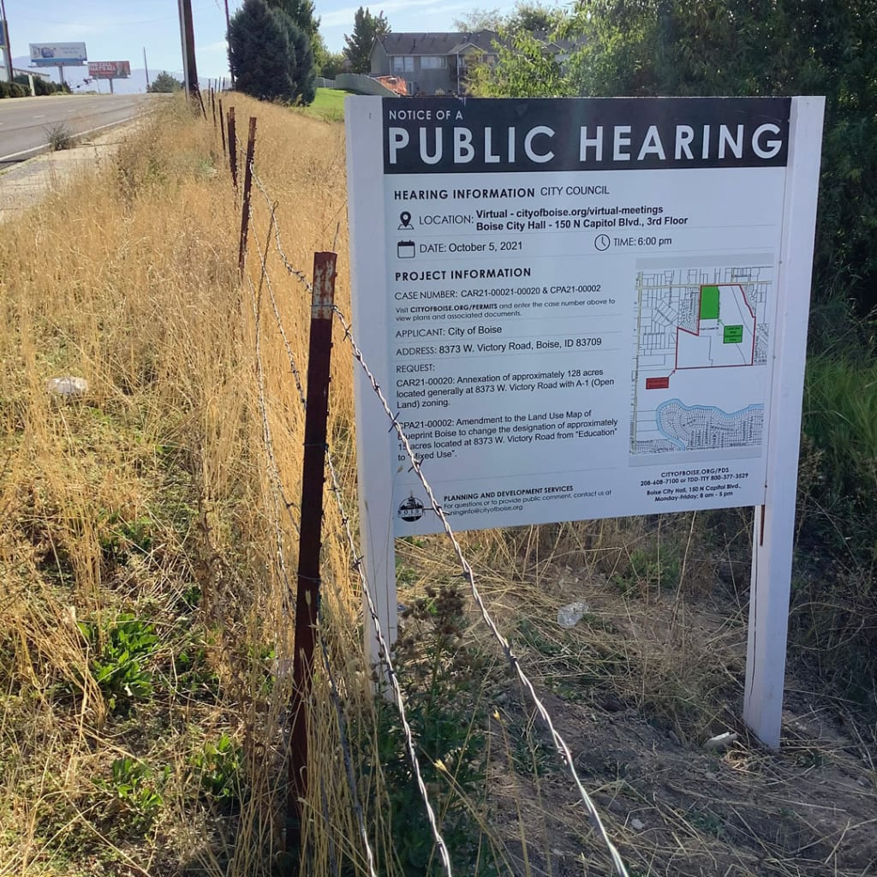
Public Noticing (SB43)

Slide 13
Public Noticing (SB43)

Slide 14
Coming Next Year?
Short Term Rentals (STRs)
Dedicated Infrastructure Districts (DIDs)
Annexation Code Revision
Gravel Pits
Transportation Use Fees?
More land use administrative processes?
Zoning reform?

